Slide 1

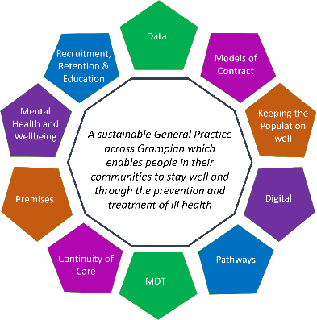
General Practice Vision Programme
Emma King, Primary Care Lead
Ali Chapman – Programme Manager, GP Vision

Slide 2
General Practice Vision Programme:
Background
General practice is a cradle to grave service- expert medical generalists
69 practices in Grampian down from 80 in 2013. 63 independent contractors and 6 2C/healthboard run (although about to change)
General practice sees 90% of all patient health contacts a
n effective
10% of the population seen every week
7.5% of the NHS budget

Slide 3
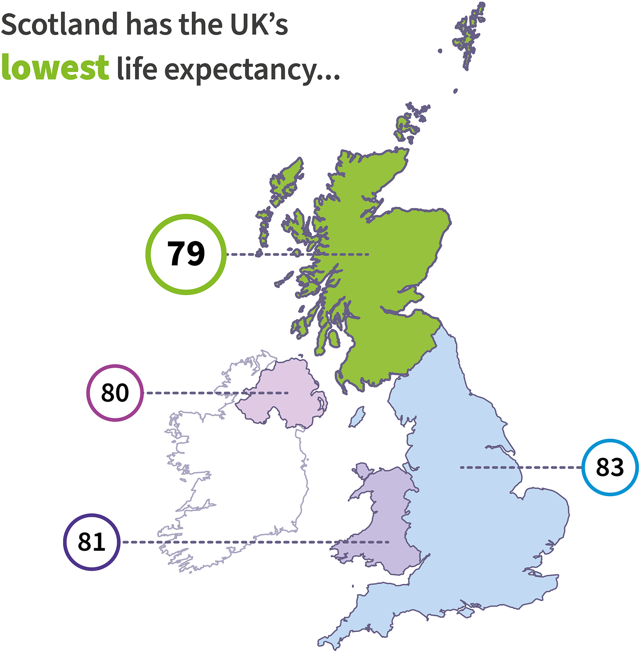
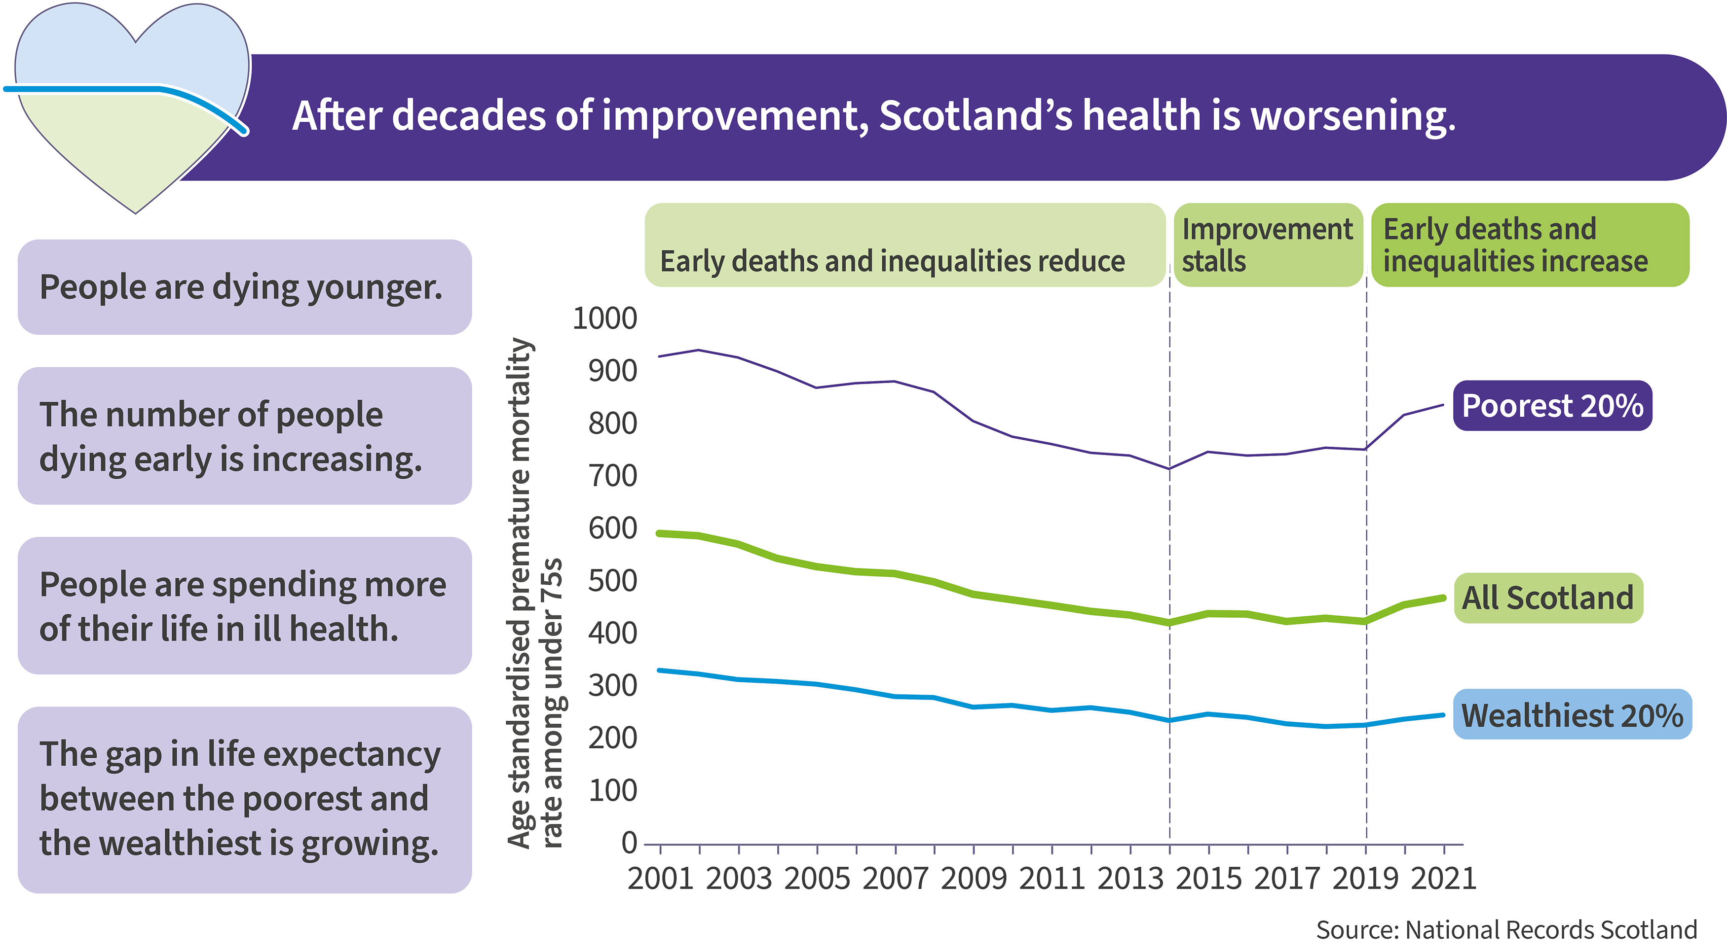
Scotland's Public Health Challenges
General Practice Vision Programme:
Why was the work required & what was done?
Notes:
More than a quarter of all deaths in Scotland are avoidable. More information about avoidable deaths is available from the National Records of Scotland (external website).
Scotland’s population is expected to fall by 2043 but the level of illness is expected to increase by 21%. Learn more about the impact of illness on the Scottish population over the next 20 years in the Scottish Burden of Disease (SBOD) study.
This trend will combine to create greater demand for health and social care.

Slide 4
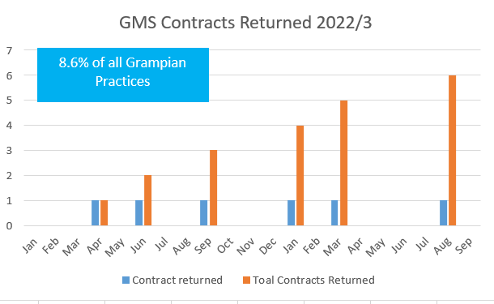
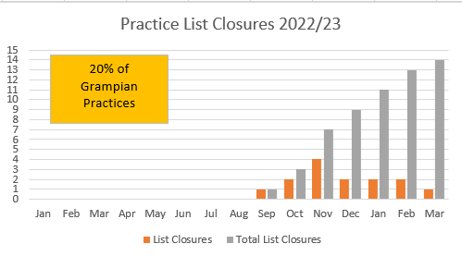
General Practice Vision Programme:
NHS Grampian Impact
2022/3 GMS contracts returned (6)
Practice list closures- 20% of all practices (9% Scottish average)
51 WTE GP vacancies cf 14 in 2013

Slide 5
General Practice Vision Programme:
Why was the work required & what was done?
Recruitment Challenges
National Recruitment challenge across the disciplines, head count up slightly but full time equivalent is down
Practices handing back their contract
Consultation rates increasing
Practices Handing back Contract
Increasing consultation rates
and long waits for out patient appointments and surgery
or
Unable to deliver the full 2018 GMS contract and the Memorandums of Understanding (MoUs).
unable to provide full width of services
leads to increased complexity
Practice list sizes growing
Aging population
vs
and
Practice List Size Increasing
Aging Population
Increased morbidity and complexity
Decrease in GP Headcount

Slide 6
So what are we doing about it?
General Practice Vision Programme:
Sustainability group looking at how can better support practices: Sub groups looking at
  Recruitment
  Wellbeing
  Patient communication
Better monitoring of practice levels. General Practice Alert System (GPAS)
Business continuity and major incident group- links to LRP and offer more robust situation monitoring and reporting back to wider system
  Ensure practices have BCP and support them in developing them
  Buddy practice identified
  Practices can apply to change their level of service provision- level 0-3- business as usual to emergencies only
Better links with partners in urgent care- FNC, SAS, ED and AMIA
Future Vision of General Practice
  Presented the challenges to Chief executive team in June- got their full support
  Petitioned Scottish Government and have been awarded additional funding
  Commissioned a series of 3 workshops with good engagement to agree on a future vision and key projects

Slide 7
What we have done so far:
General Practice Vision Programme:
Why was the work required & what was done?
Workshop 1: Closed space for General Practice to celebrate what is going well from their perspective and to explore the challenges being faced
Workshop 2: Workshop 2 was to bring together a lager group of stakeholders including Wider Primary care, secondary care, Scottish Ambulance Service, patients and third sector.
To allow all stakeholders to reach agreement on the baseline and consolidate the information from workshop 1 and move towards defining the vision of General Practice
Workshop 3: Begin to define a vision and Strategic Objectives in relation to themes identified at workshop 2;
Pathways, data, models of contract, premises, keeping the population well, IT & Technology, Multi-Disciplinary Team, mental health, education and continuity
Workshop 4: Vision Statement and SMART Objectives Development – this will be a smaller workshop with the Programme board. The focus groups with schools also fed into this.

Slide 8
General Practice Vision Programme:
Why was the work required & what was done?
Stakeholder Engagement
Patient Survey
Patient Stakeholder Group
School Focus Groups
Further Engagement
1300 Responses from across Grampian
The most important things are: Being seen by the right person first time , contact my practice with ease ; Being listened to ;
able to access same day/emergency appointments and book an appointment in advance
Improvements around, getting though on phone line and role of the reception staff.
Showed that there was a need for patient education
Existing networks were used to identify individuals to take part. Including: PPG’s, GREC, PIN Network and via the patient survey
Attended the facilitated events on 8th and 22nd November.
Due to demographics in survey and output of early workshops it was agreed to engage with senior secondary school pupils
Focus group sessions planned with Secondary Schools across Grampian
Aberdeen City LEGS - December 2023 – This will be replicated in Aberdeenshire and moray
MSP and MP Briefing in December 2023
Local Medical Council and GP Sub Committee
Clinical Board

Slide 9
General Practice Vision Programme:
Vision & Objectives - Output
Vision
‘A sustainable General Practice across Grampian which empowers people in their communities to stay well and enables the treatment of ill health’
Key themes
Data-Driven Decision Making
Diverse Models of Contract
Empowering the Population
Integrated IT Systems
Clear Pathways and Integrated Systems
Multi-Disciplinary Team
Continuity of Care and Preventative Medicine
Modern Premises
Mental Health & Wellbeing Integration
Comprehensive Education and Workforce Development

Slide 10
General Practice Vision Programme:
Next Steps
Next Steps
  IJB Approval – end of March 2024
  Establish Governance Structures
  Allocate resources
  Create and action an Implementation Plan
Notes:
Establish Governance Structures
Define roles, responsibilities, and decision-making processes to ensure effective coordination and accountability.
Ensure representation from all relevant stakeholders to promote shared ownership and commitment (including LMC / GP Sub and Patient representatives)
Agree a set of principles and ways of working as a system to maximise shared resource for the shared purpose
Identify opportunities for pooling resources
Ensure fairness and equity in resource distribution
Establish regular forums for communication, collaboration, and joint planning
Establish reporting structures and provide regular updates on progress
Agree principles for patient involvement group going forward
Agree escalation processes
Agreement on what priorities across system to pause to enable resource to be allocated to move work forward
Allocate Resources
Determine resource allocation across all Programme Board and project subgroups to ensure delivery
Clearly define roles and expectations to ensure accountability and effective coordination
Create and action an Implementation Plan
Identify specific actions required to achieve each strategic objective outlined in the vision
Establish realistic timelines for each action, including resource availability, dependencies between tasks, and external constraints
Assign actions to individuals or teams identified during resource allocation.
Make use of governance structures for monitoring progress and evaluating the effectiveness of the implementation plan.
Communicate the implementation plan clearly and transparently to all stakeholders

Slide 11
General Practice Vision Programme:
Why was the work required & what was done?
Grampian View - Context
NHSG Financial Position:
NHSG needs to save 77 million this financial year
Equates to £210k a day every day from the 1st April
The health board budget is under pressure due to supplementary staffing and inflation
A shared challenge. All NHS Boards, Health & Social Care Partnerships and all of our public sectors are similarly affected
Together we need to find the balance between financial pressure, clinical governance and patient safety, staff governance with a focus on prevention.

