Slide 1
Aberdeen City
Vaccination & Wellbeing Hub

Slide 2
Our Aim
Create a Priority Intervention Hub which delivers an
easily accessible location where a range of health, social care, voluntary
organisations & community partners work together all
responding to local need.

Slide 3
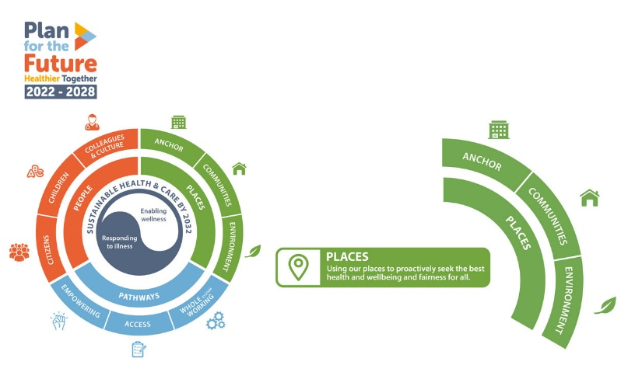
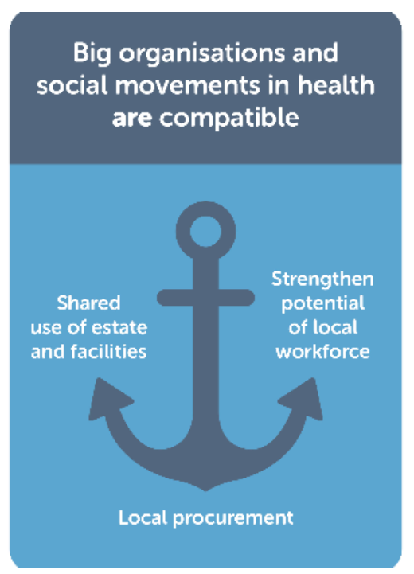
Links to current priorities
Anchor Organisation

Slide 4
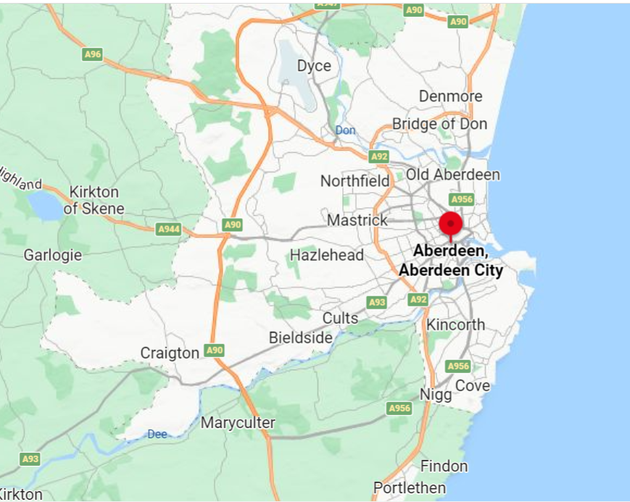
Healthy Hoose
Prevention
Stay Well/Stay Connected
Addressing inequality
Priority Intervention Hubs
Tillydrone Community Campus
Working Jointly with ACC focussing on:
Prevention
Stay Well/Stay Connected
Addressing inequality
Get Active Northfield
Working Jointly with Sport Aberdeen focussing on:
Prevention
Rehabilitation
Stay Well/Stay Connected
Addressing inequality
Aberdeen City Vaccination Centre
Focussing on:
Prevention
Stay Well/Stay Connected
Addressing inequality
Health Promotion
Countesswells
Future project
Greyhope Centre, Torry
Prevention
Stay Well/Stay Connected
Addressing Inequality

Slide 5
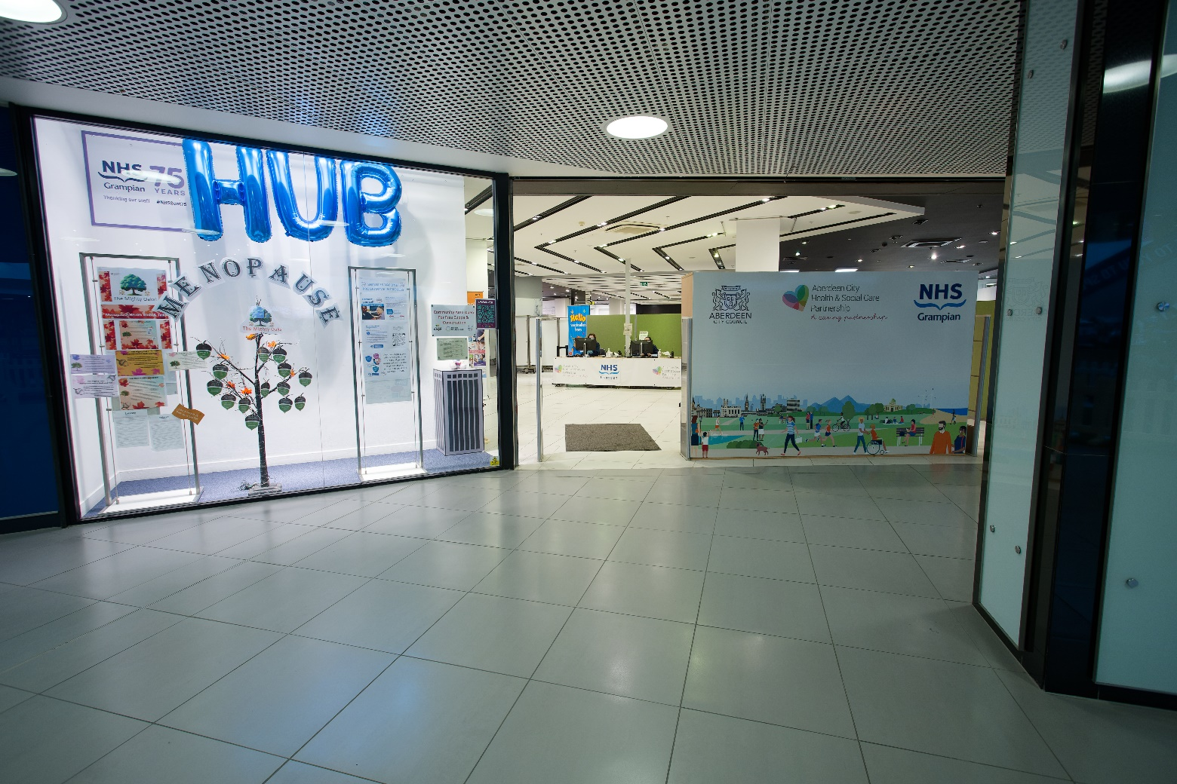
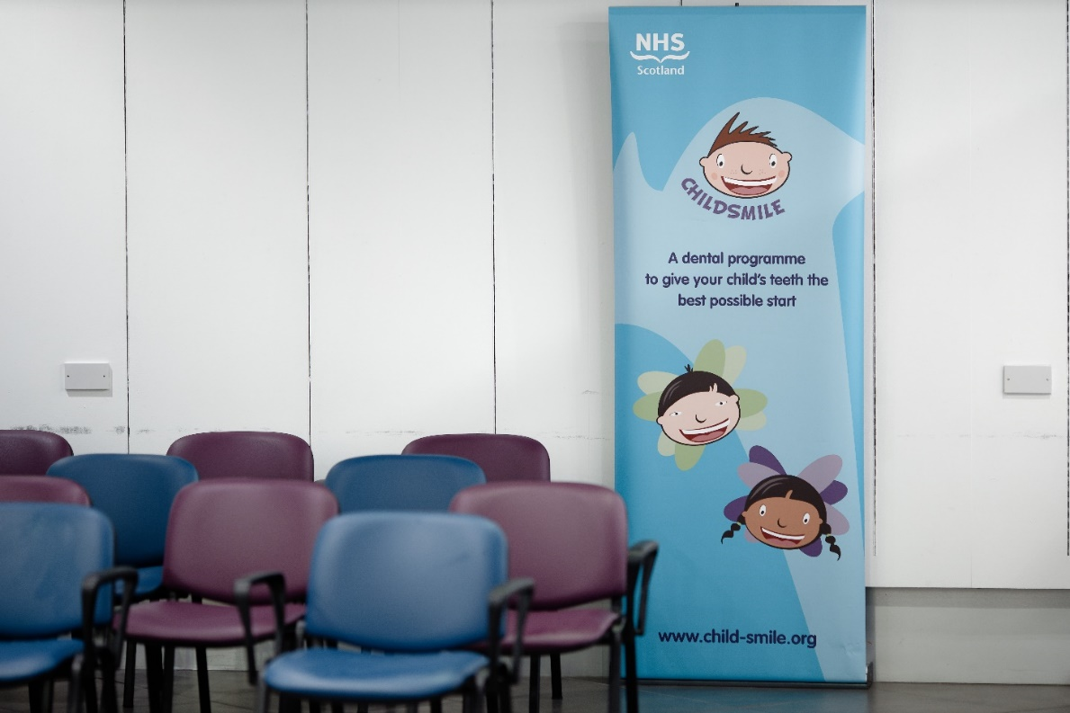
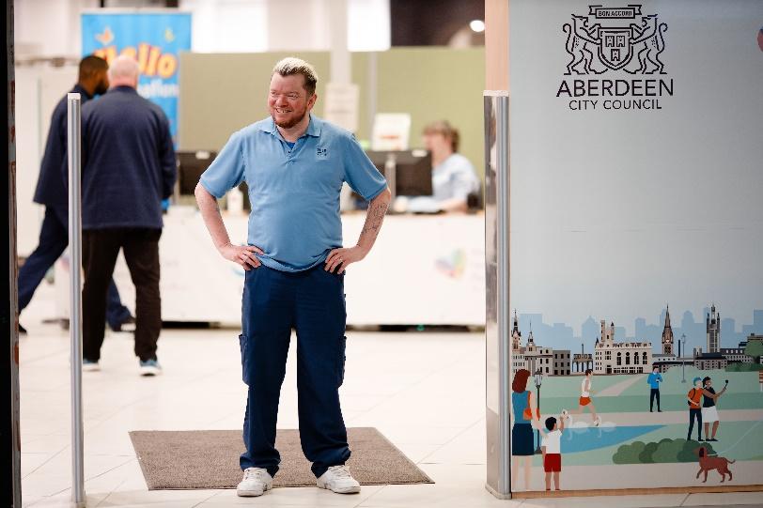
Welcome to the Hub
The Aberdeen City Vaccination & Wellbeing Hub is based right in the middle of the City Centre in a busy shopping centre – very accessible with one bus from every part of the city.
Aberdeen City Vaccination
& Wellbeing Hub

Slide 6
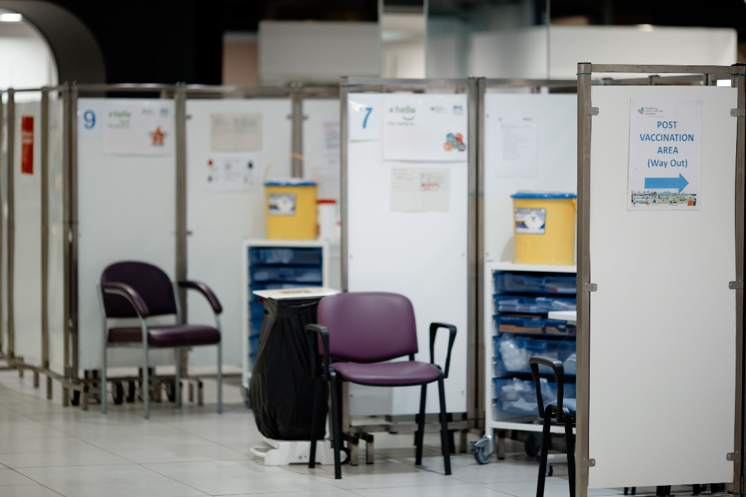
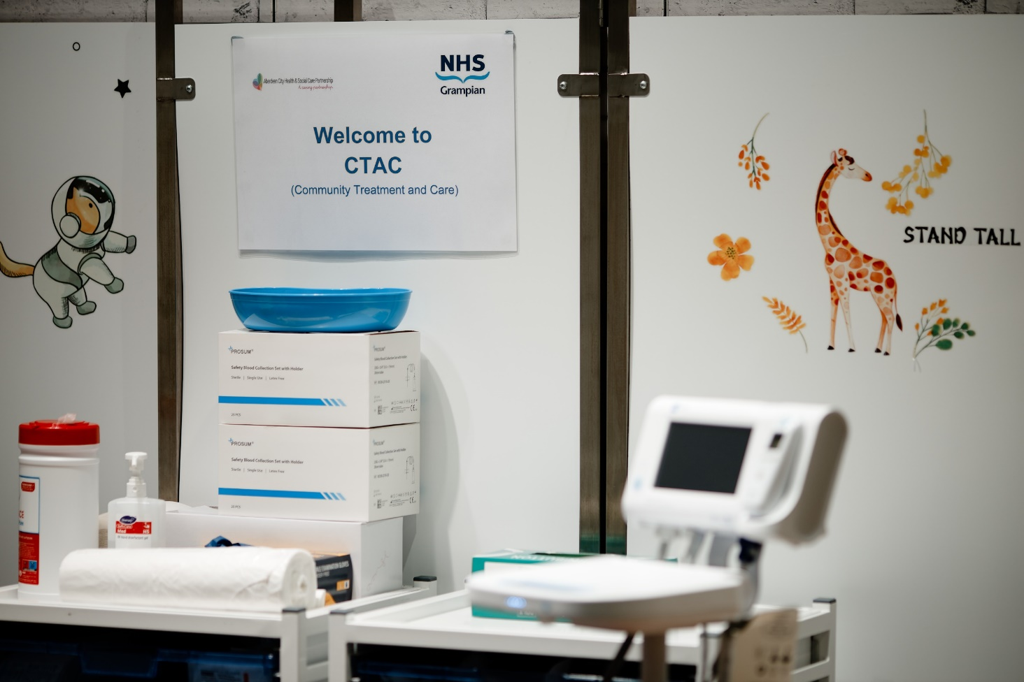
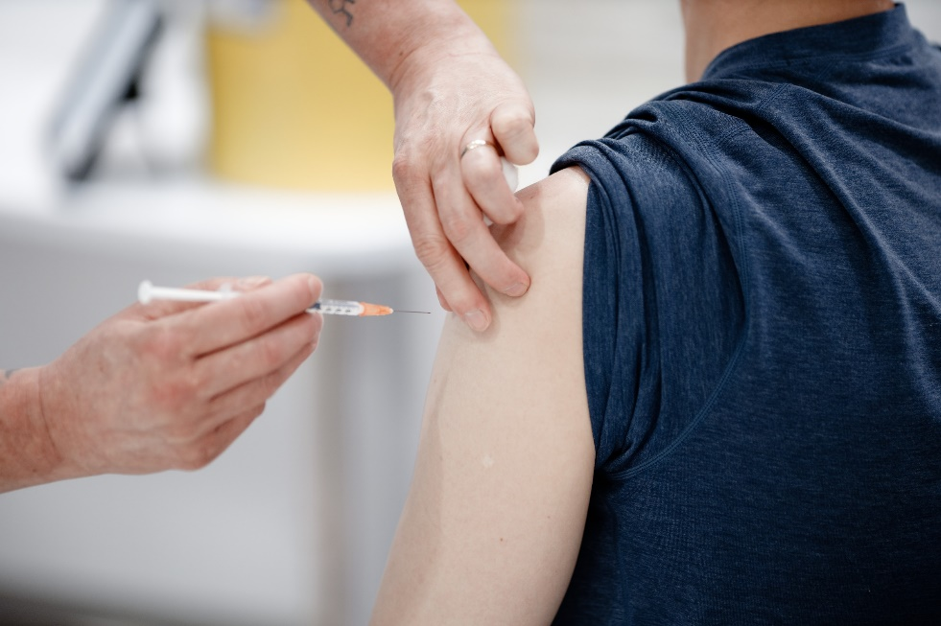
Clinical Space
Notes:
Main Channel has 12 pods, 2 Children pods and 3 additional bookable spaces.

Slide 7
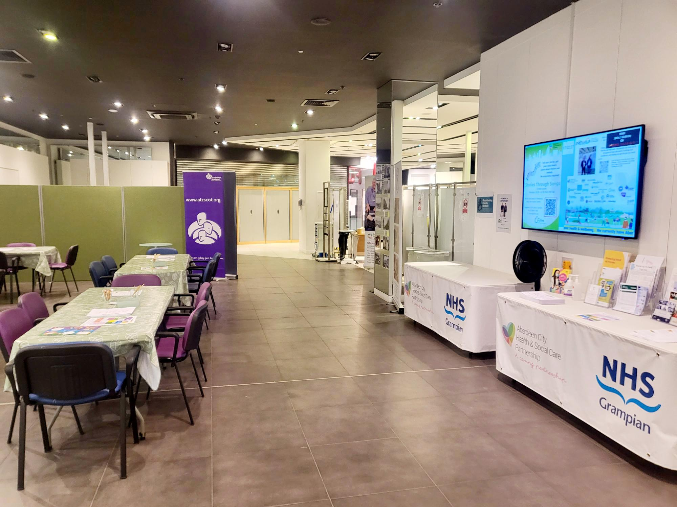
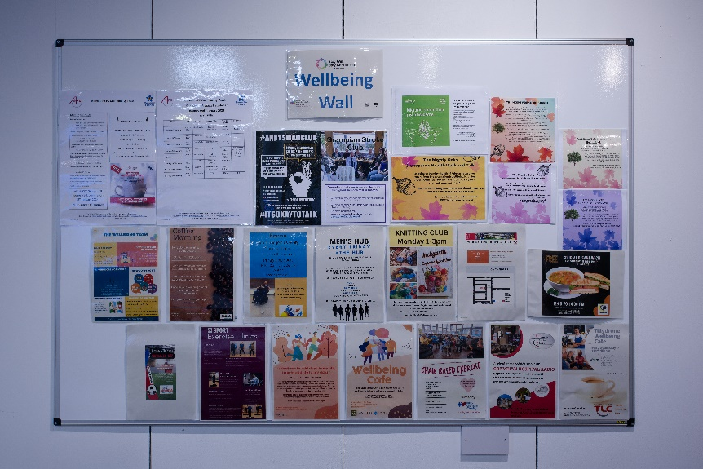
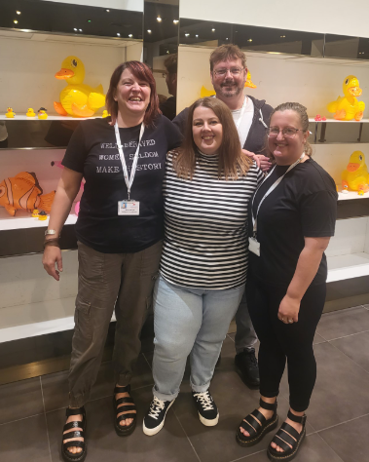
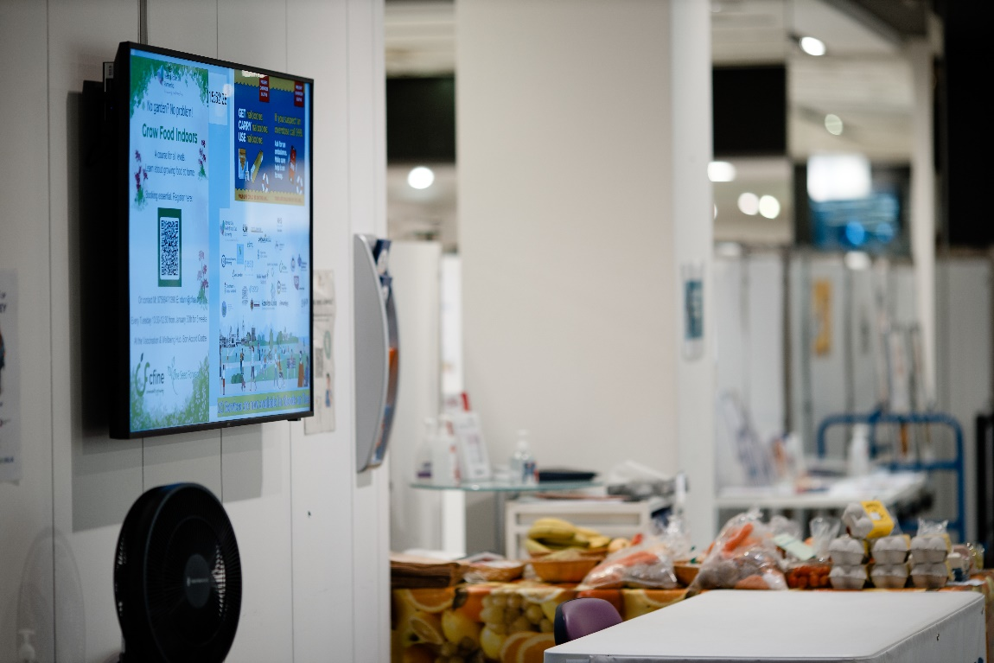
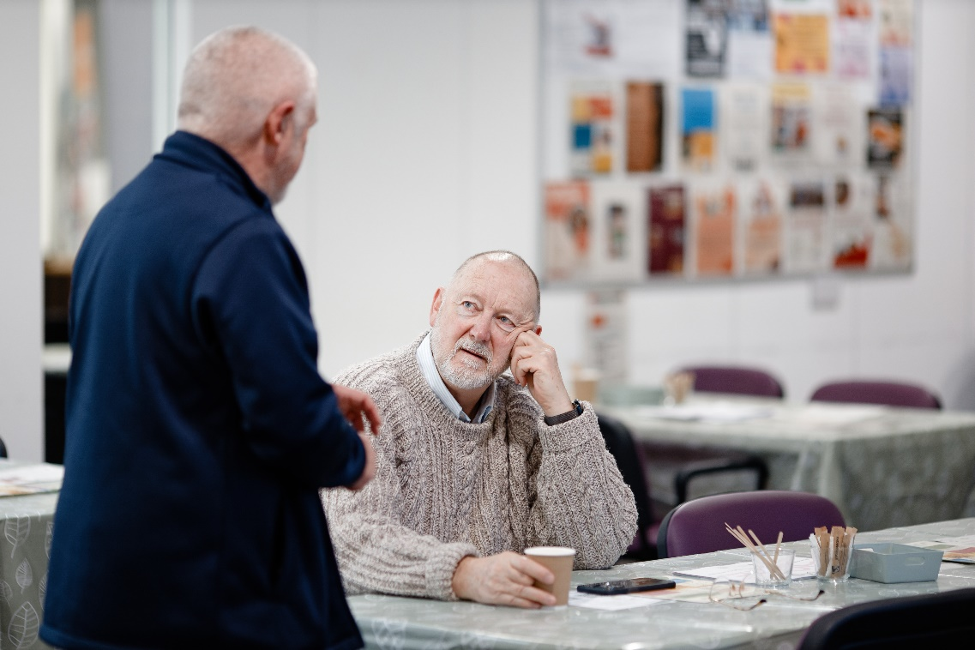
Post Vaccine & Community Space

Slide 8
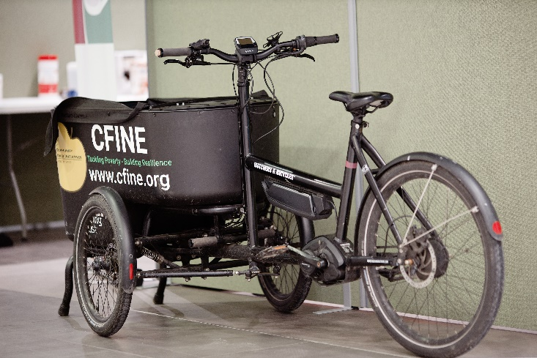
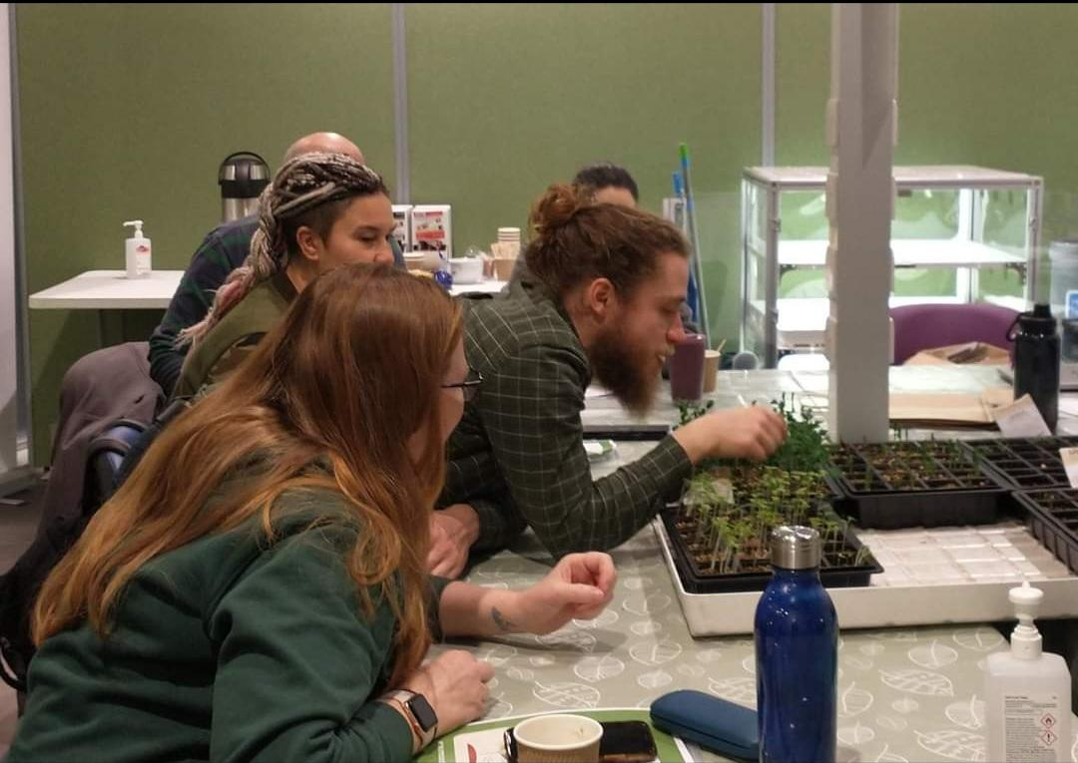
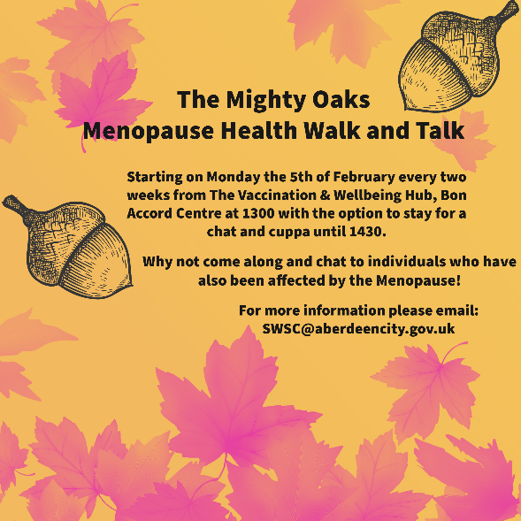
Workshop Space

Slide 9
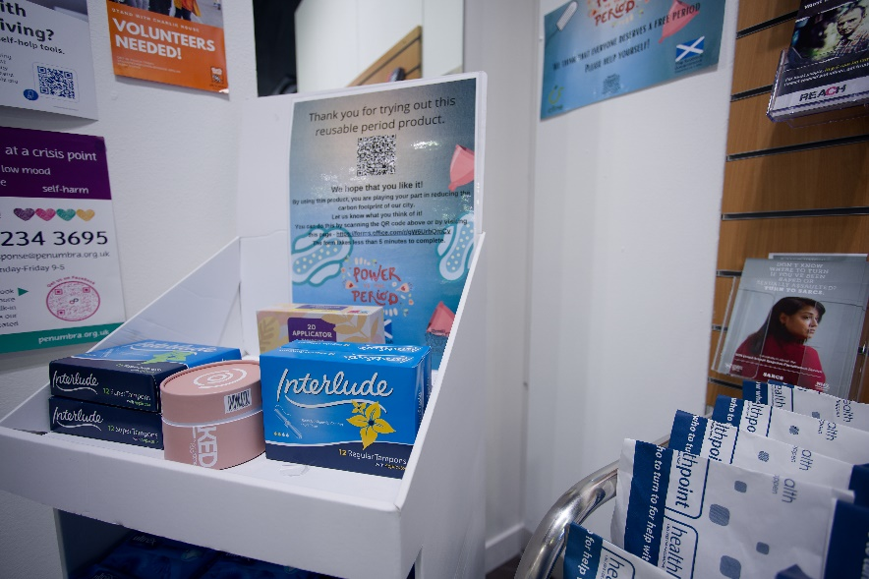
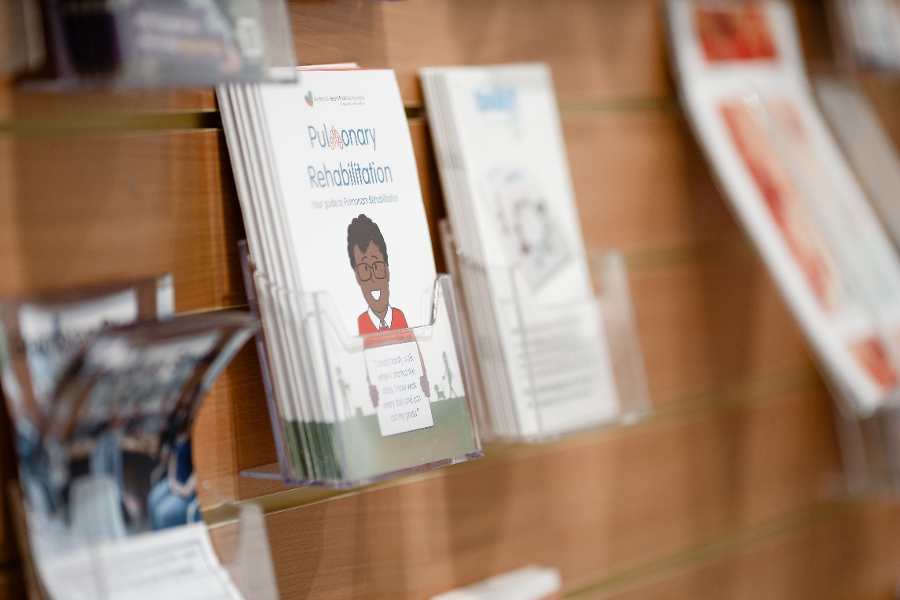
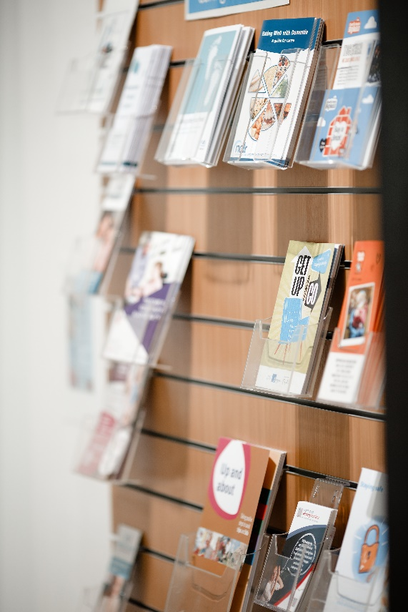
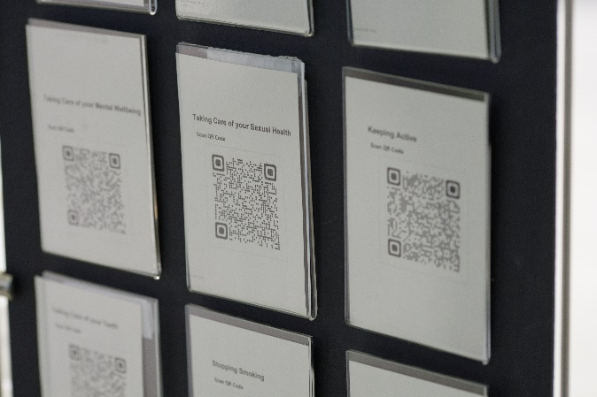
Community Healthpoint

Slide 10
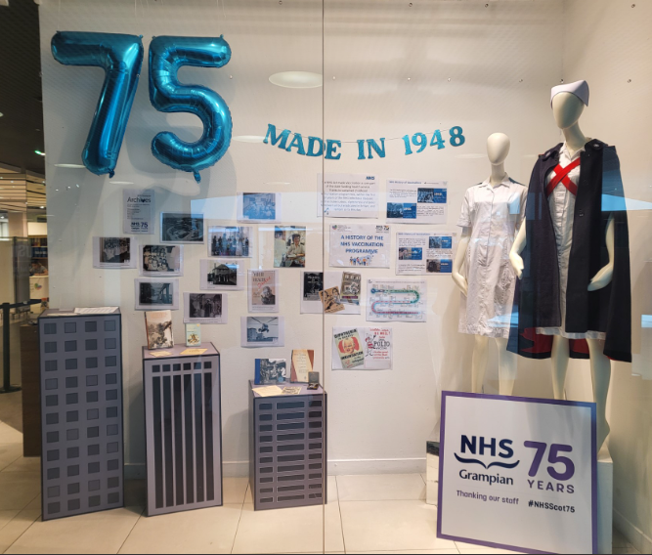
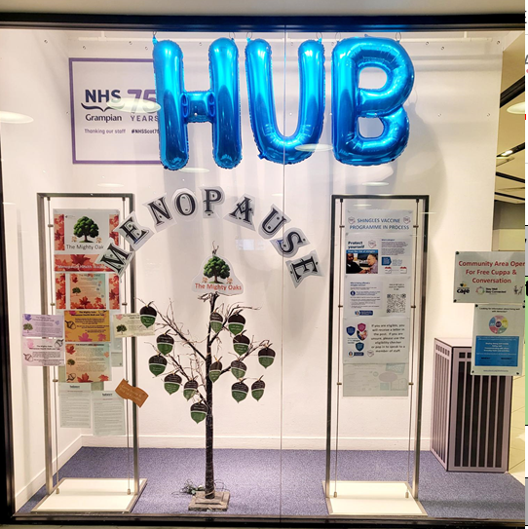
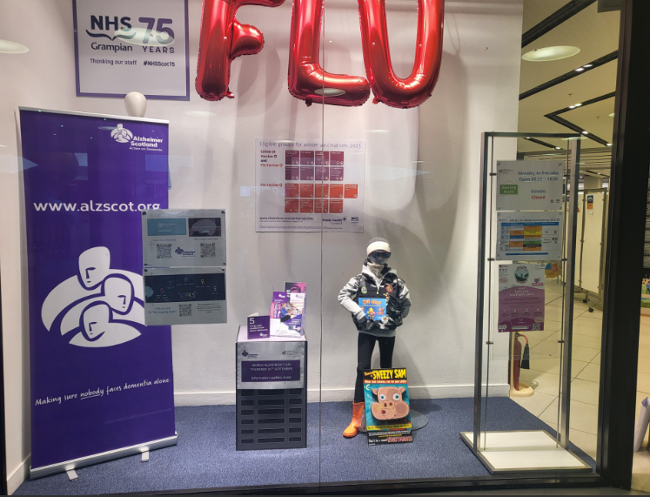
Window Displays

Slide 11
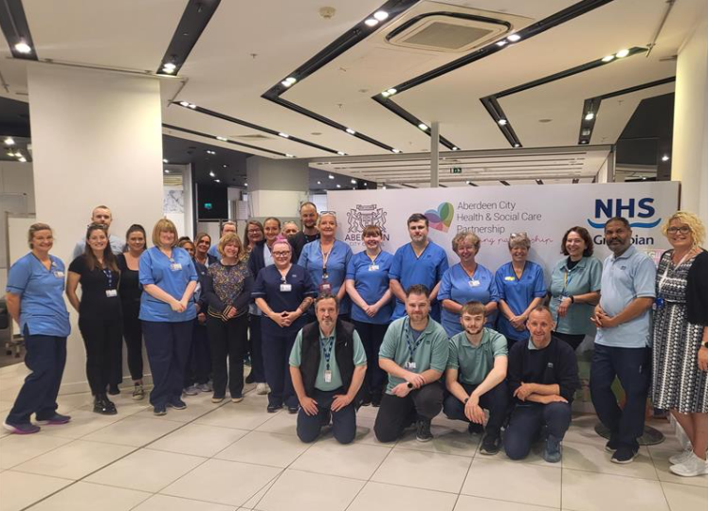
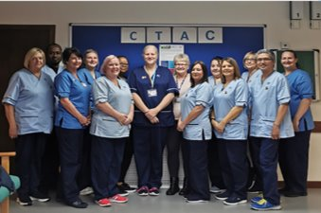
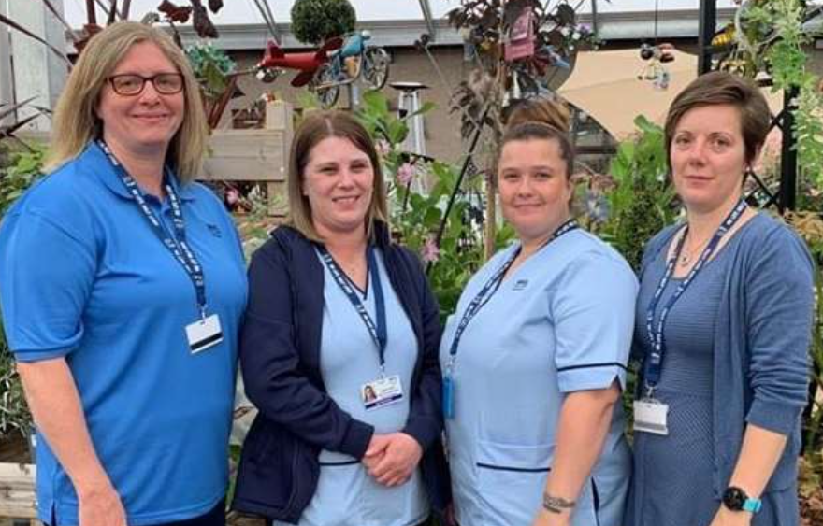
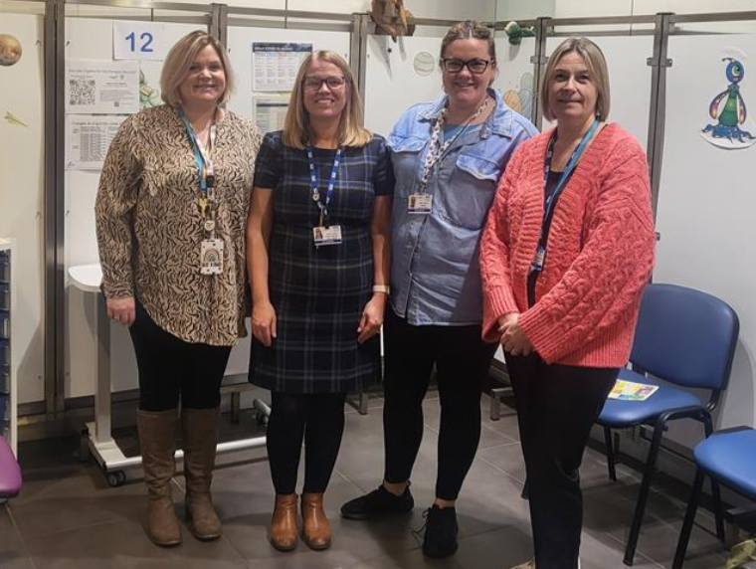
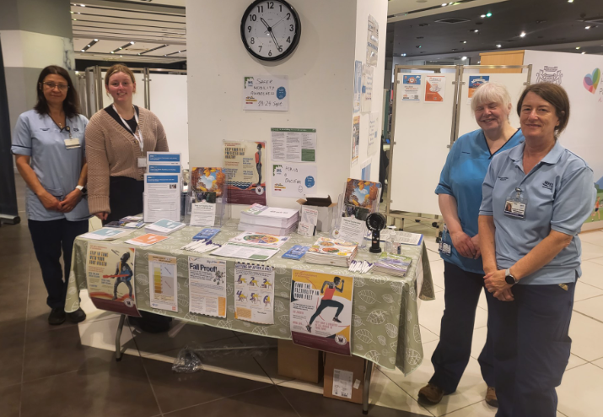
Clinical Services
Vaccination Team
Community Treatment & Care (CTAC) Hub
Community Respiratory Team
Community Assessment
And Rehabilitation Service (CAARS) & Sport Aberdeen
Health Visitor Service
Spina Bifida Adult Assessment Clinics
Notes:
Vaccinations
Pre-school
School Mop Ups
Adult Routine / Non Routine
Flu & COVID
Vitamin B12 Injections
Bloods
Suture Removals
Chronic Disease Management
Vitamin B12 Injections
Support people living with lung disease/COPD to manage their conditions at home and prevent admission.
Falls Prevention / Safer Mobility
General health & wellbeing advice
Walking Aids

Slide 12
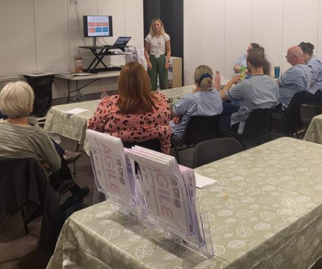
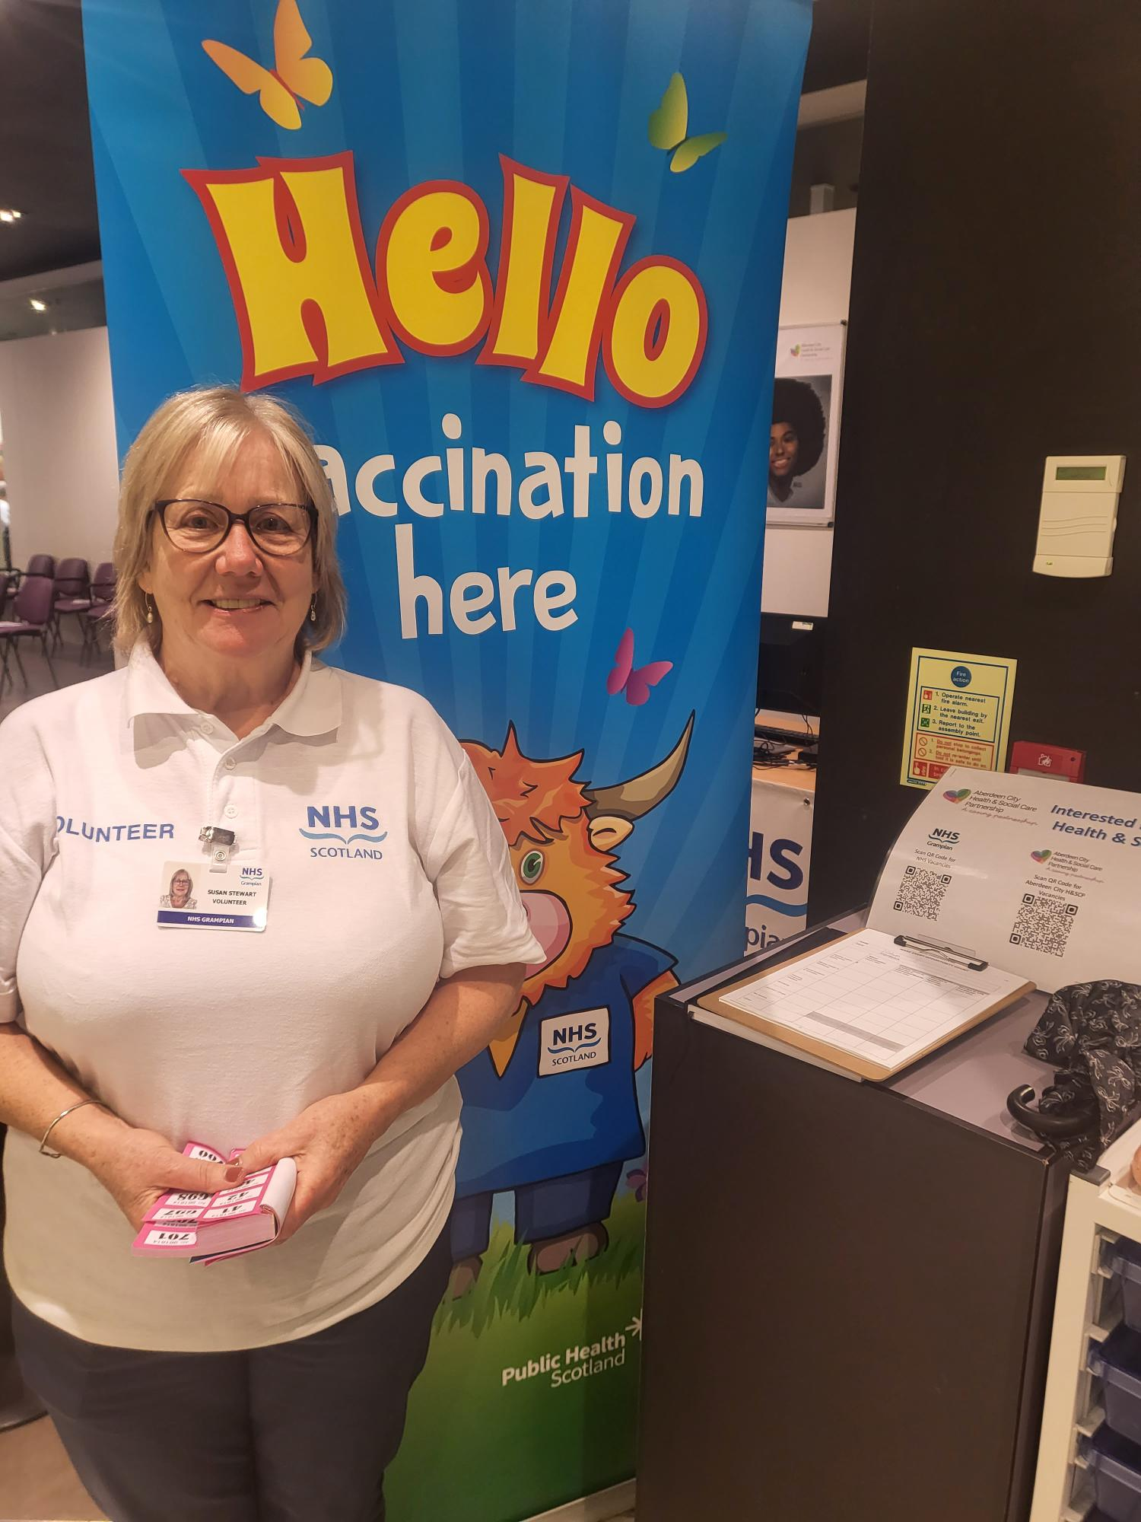
Making Every Opportunity Count
Notes:
65 trained
5 trained vounenteers

Slide 13
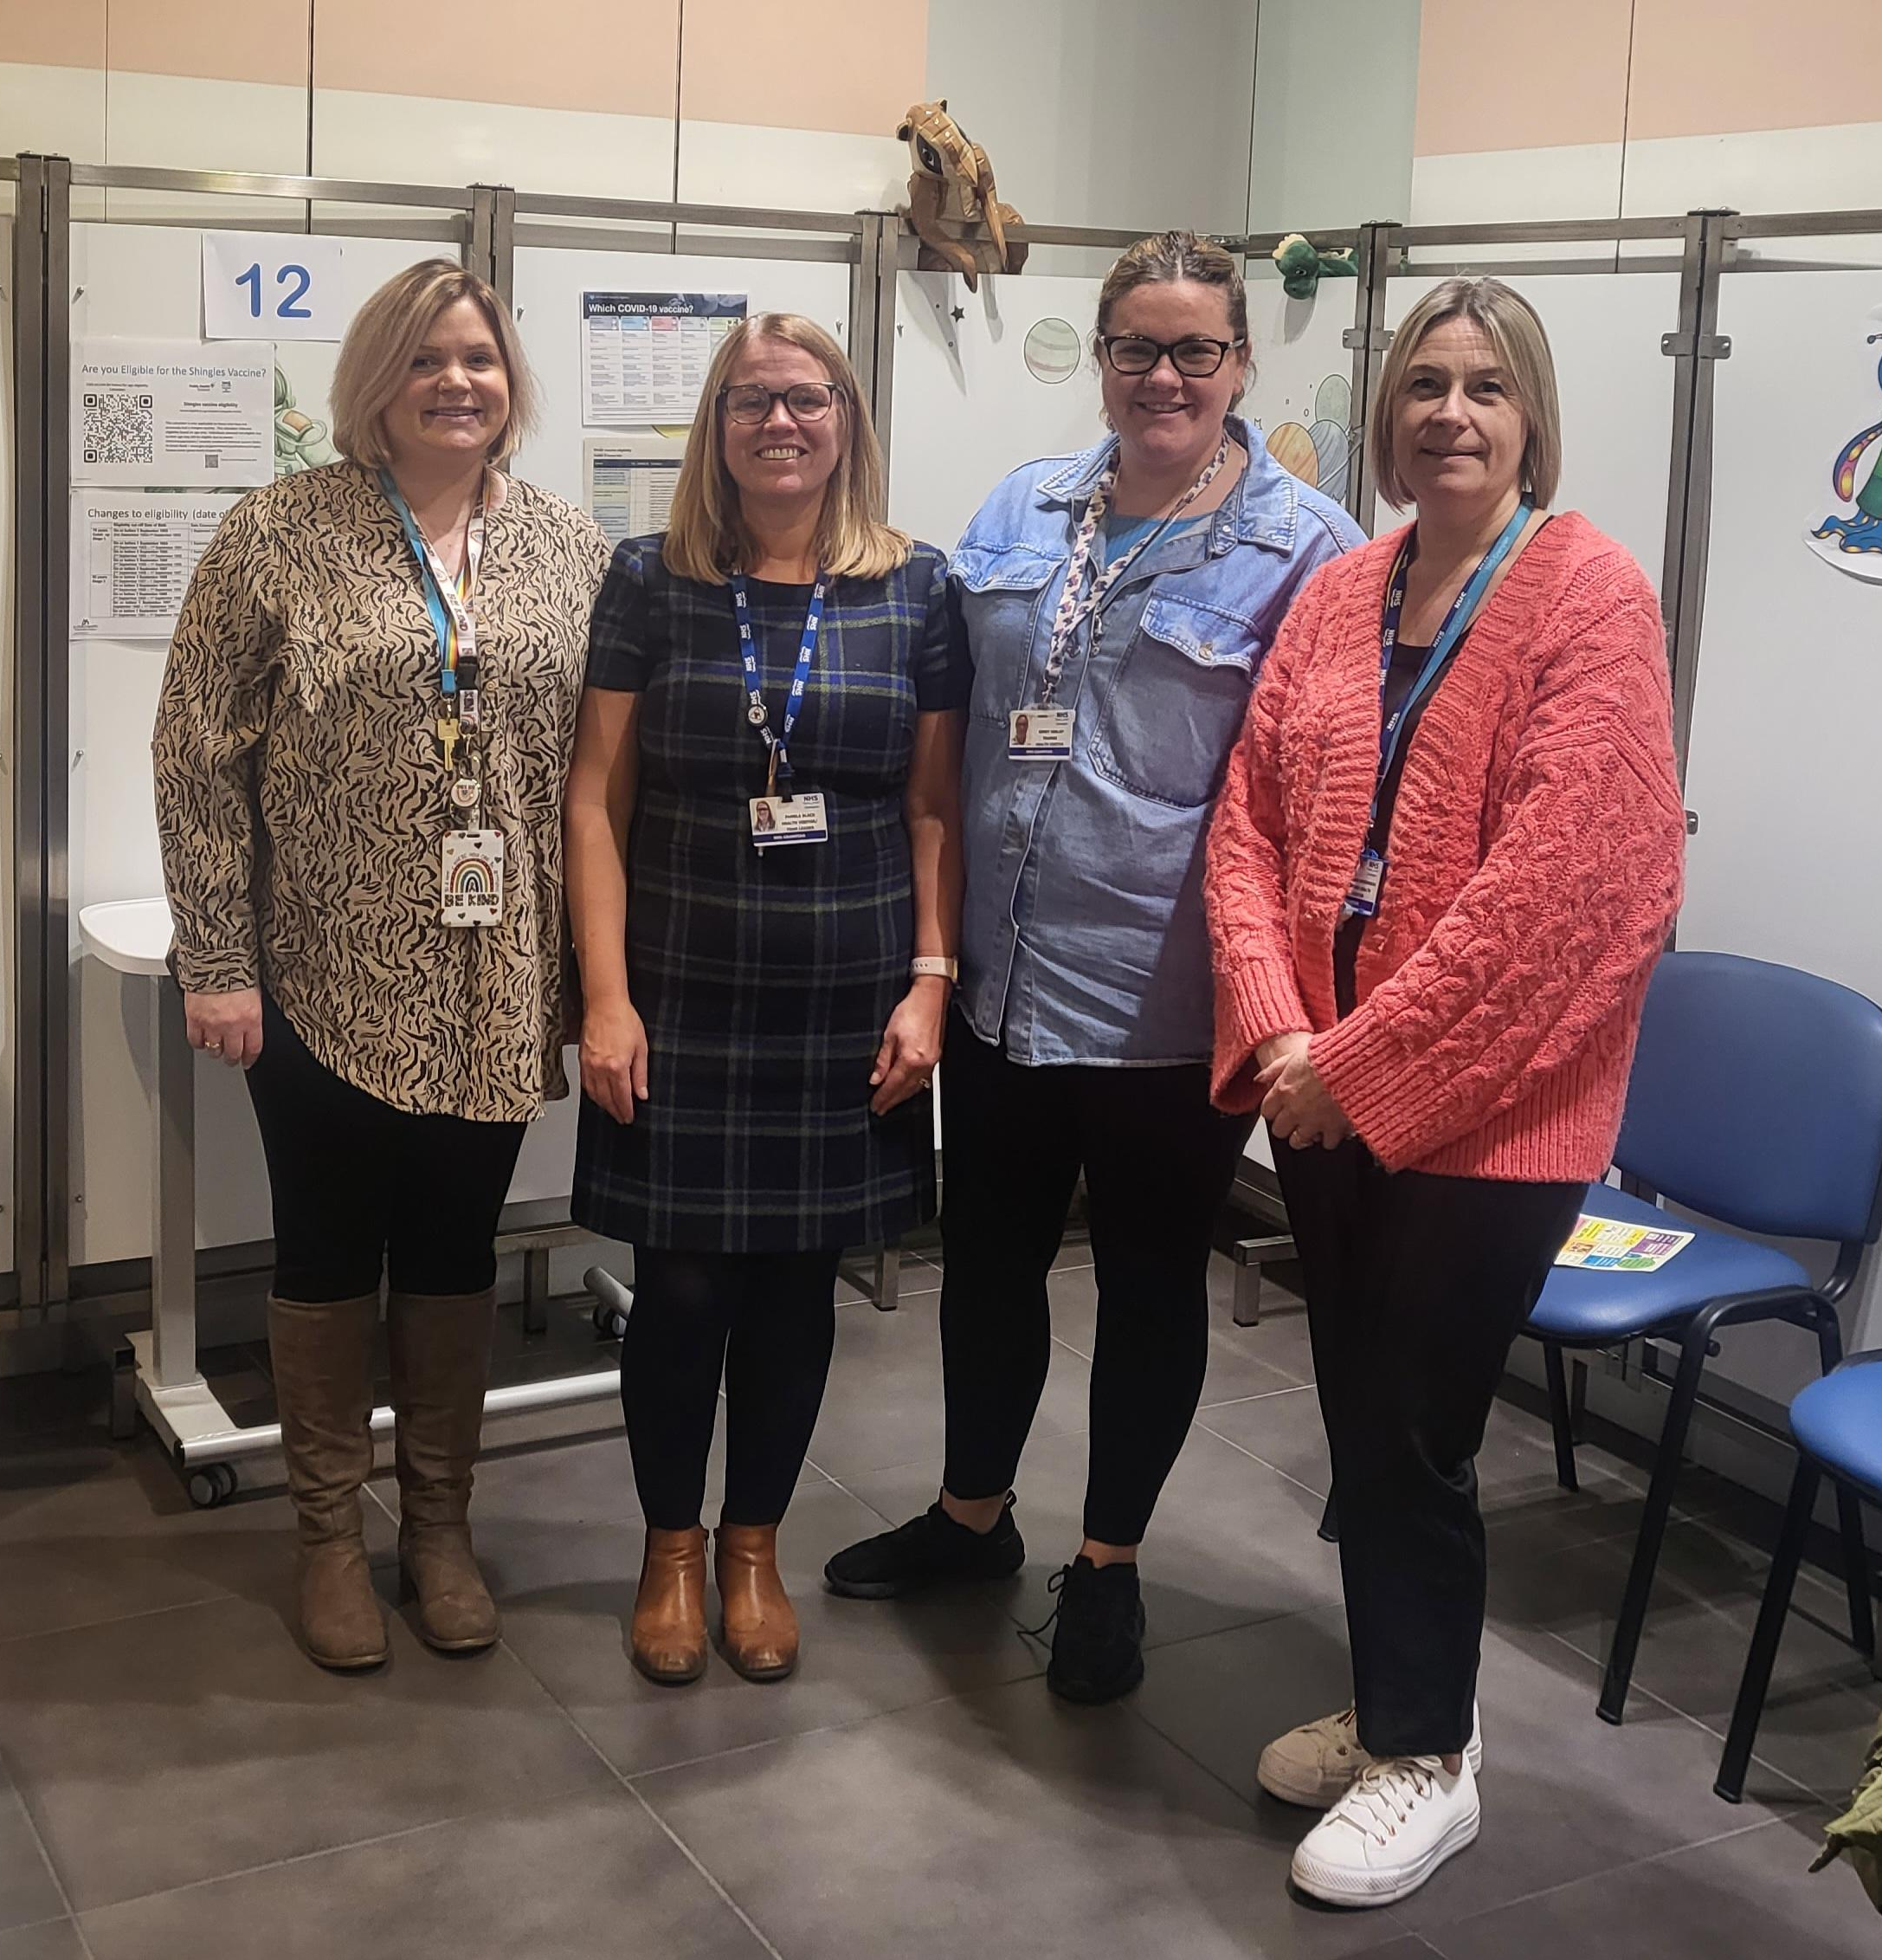
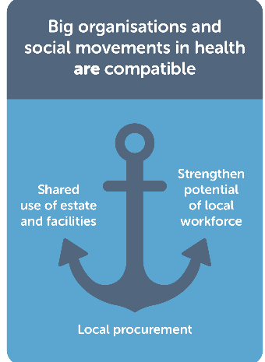
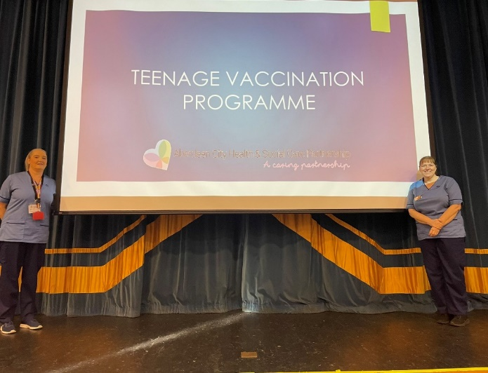
Collaborative Working
Notes:
CTAC and Secondary Care
Health Visitors and Pre-school Team – Childsmile
Schools – Excellerate Programme (Education)
AFCCT

Slide 14
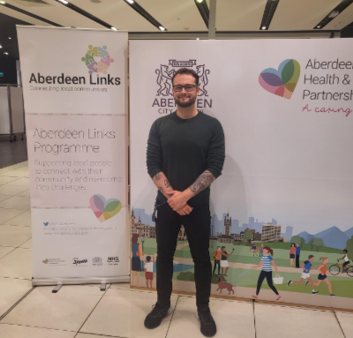
Mental Health & Wellbeing Support
At Hub:
Monday to Friday
Service Promotion:
Information & Practical support linking people to services and support in their local communities.
Notes:
Aberdeen Links – GP Referrals & Service promotion
Penumbra – Aberdeen 1st Response Mental Health Service – Walk in (Every Friday
Pathways Employment Keyworker - Every Thursday
Alziemer Scotland – Braine Health Every Thursday

Slide 15
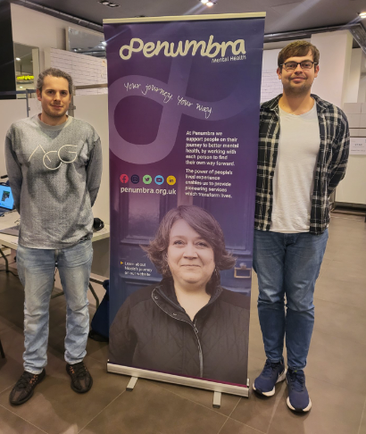
Mental Health & Wellbeing Support
At Hub:
Every Friday
Promotion & Support:
Drop In Service for people in distress offering a listening ear and practical support
Notes:
Aberdeen Links – GP Referrals & Service promotion
Penumbra – Aberdeen 1st Response Mental Health Service – Walk in (Every Friday
Pathways Employment Keyworker - Every Thursday
Alziemer Scotland – Braine Health Every Thursday

Slide 16
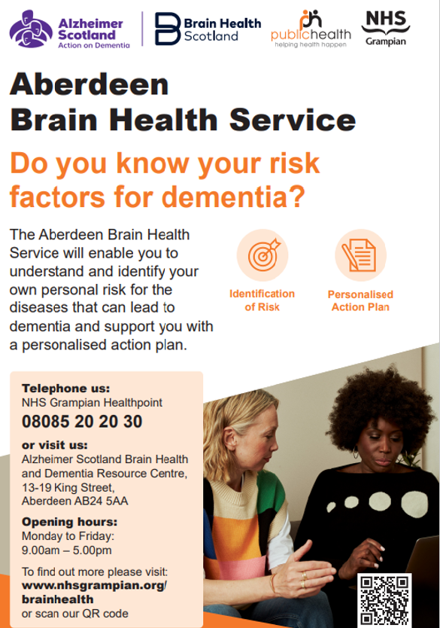
Mental Health & Wellbeing Support
At Hub:
Every Thursday
Promotion & Support:
Promoting Aberdeen Brain Health Service
Notes:
Aberdeen Links – GP Referrals & Service promotion
Penumbra – Aberdeen 1st Response Mental Health Service – Walk in (Every Friday
Pathways Employment Keyworker - Every Thursday
Alziemer Scotland – Braine Health Every Thursday

Slide 17
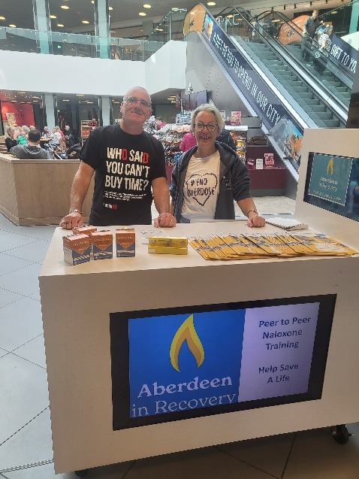
Reducing Stigma – Drugs & alcohol
At Hub:
Every Wednesday
Promotion & Support:
Lived Experience Peer Support and Naloxone Training
Notes:
AIR – Lived Experience Peer Support and Peer Naloxone Training
ADA – Aberdeen Drugs Action attend to promote Overdose Awareness
Development with Aberdeen City Drugs & Alcohol Services – Alcohol Brief intervention, naloxone Training – Future Distribution and Information & Guidance to support staff to “Make Every Opportunity Count”.

Slide 18
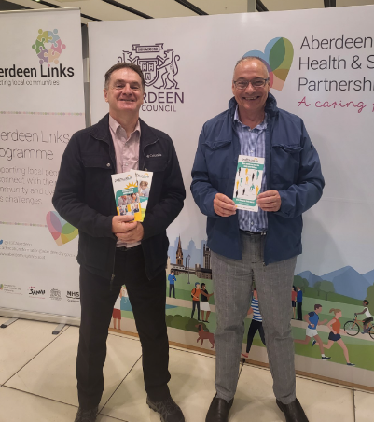
Independent Living & Employability
At Hub:
Every Thursday
Promotion & Support:
Providing one-to one support to help people find the job they want.
Notes:
Aberdeen Links – GP Referrals & Service promotion
Penumbra – Aberdeen 1st Response Mental Health Service – Walk in (Every Friday
Pathways Employment Keyworker - Every Thursday
Alzheimer Scotland – Braine Health Every Thursday

Slide 19
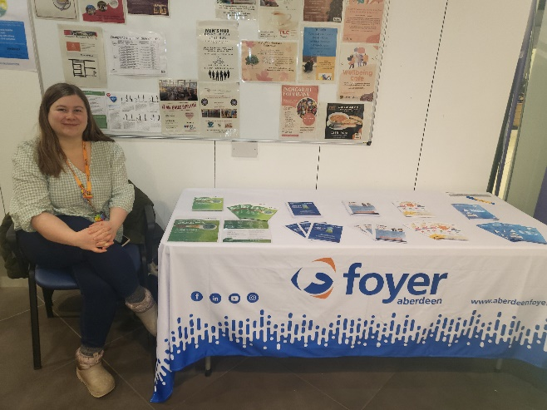
Independent Living & Employability
At Hub:
Ad Hoc Bookings
Promotion & Support:
Supporting people with independent living, learning and work.

Slide 20
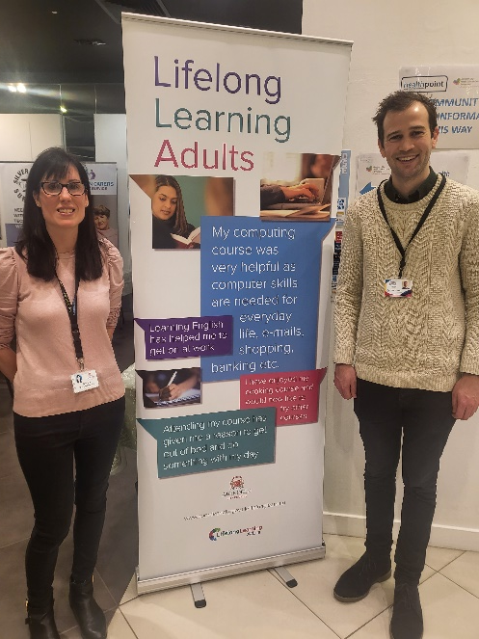
Independent Living & Employability
At Hub:
Ad Hoc Bookings
Promotion & Support:
Service Promotion
Adult Learning

Slide 21
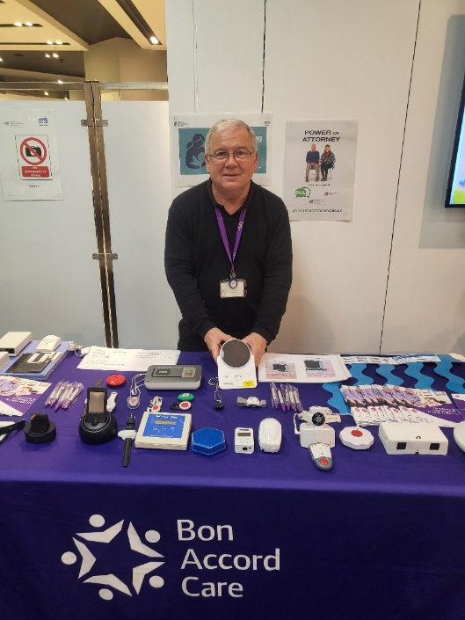
Carers & Independent Living
At Hub:
Every Thursday
Promotion & Support:
Promoting the benefits of Community Alarm Telecare

Slide 22
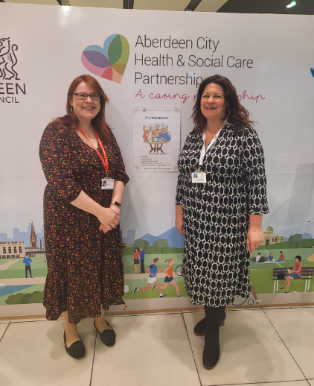
Carers & Independent Living
At Hub:
Every Friday
Promotion & Support:
Wee blether – Conversation Café providing support to Carers
Carers
Conversation
Café
Every Friday 12 – 2pm

Slide 23
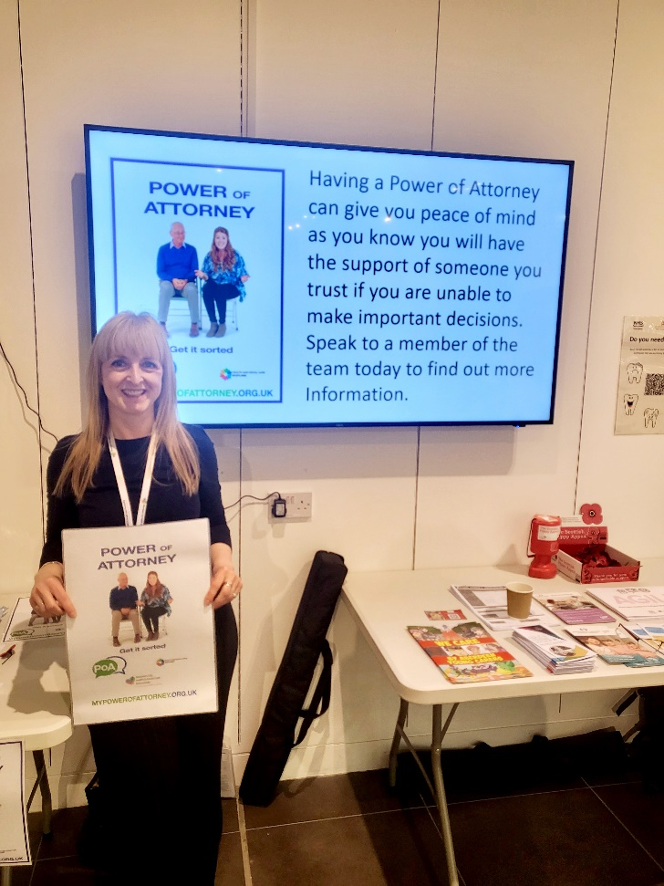
Carers & Independent Living
At Hub:
Ad Hoc Bookings
Promotion & Support:
Promoting Power of Attorney

Slide 24
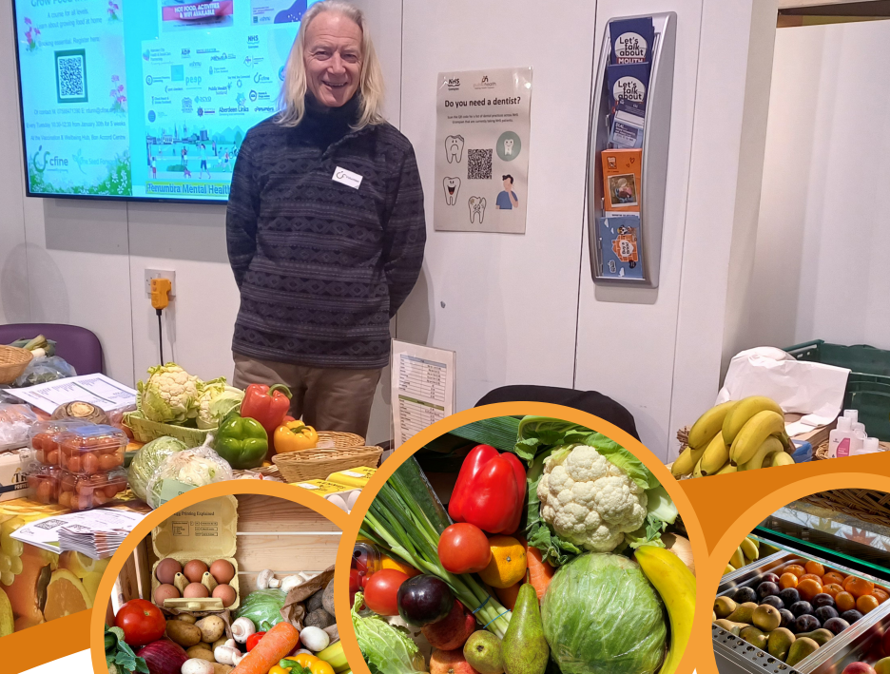
Tackling Poverty & Inequalities
At Hub:
Every Tuesday
Promotion & Support:
CFINE Community Food Outlet selling affordable fruit, veg, eggs and healthy snacks

Slide 25
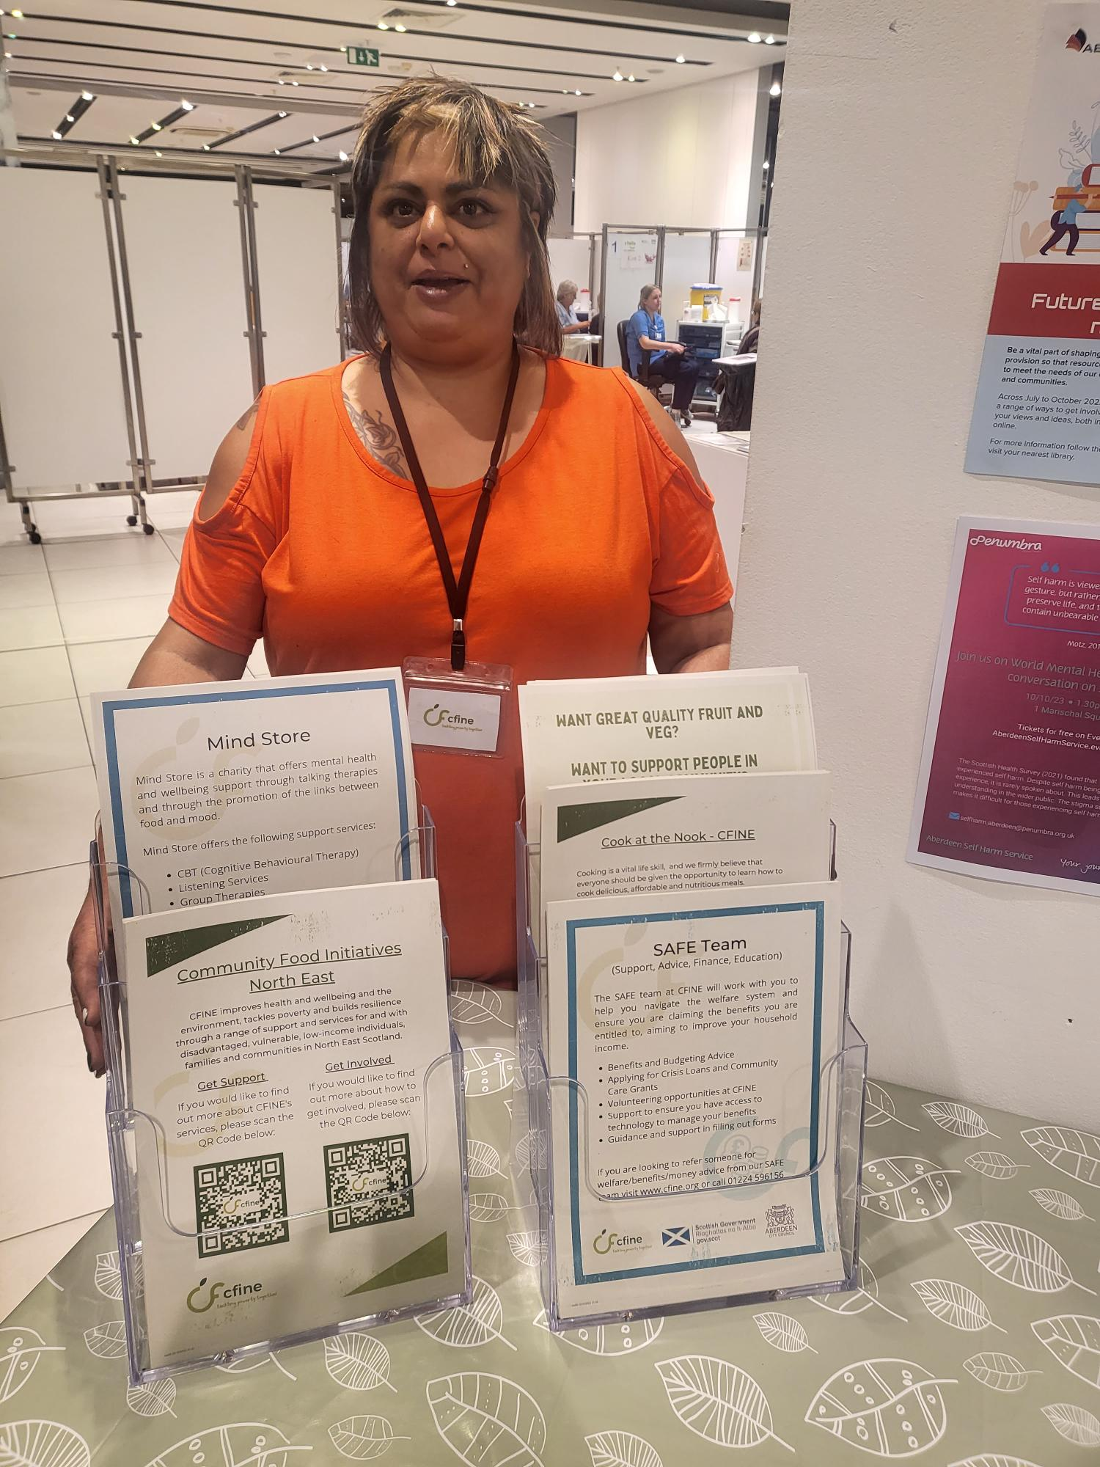
Tackling Poverty & Inequalities
At Hub:
Ad Hoc Bookings
Promotion & Support:
CFINE Safe Team – helping people to navigate the welfare system to improve household income

Slide 26
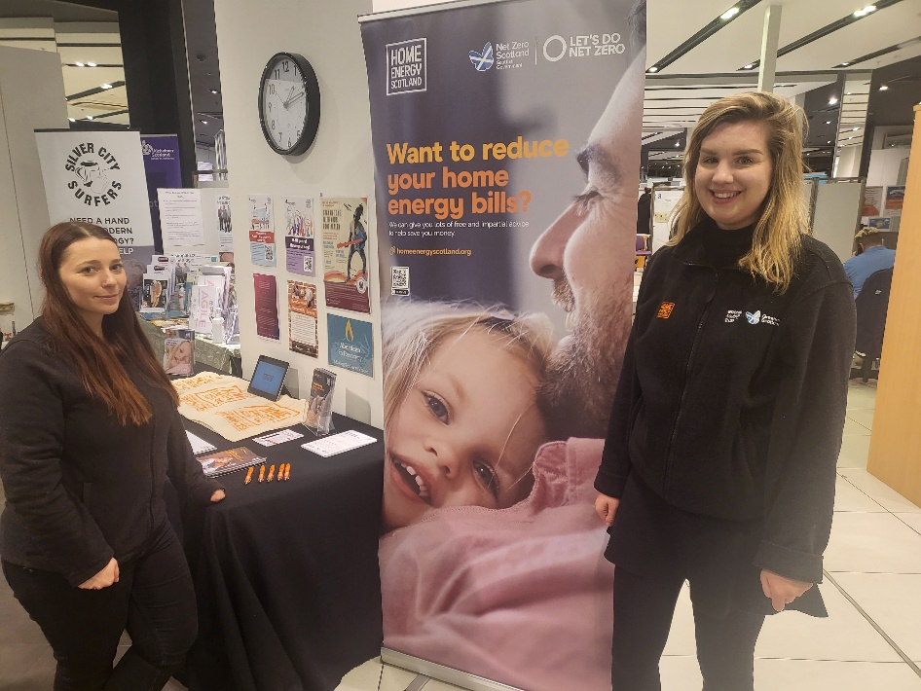
Tackling Poverty & Inequalities
At Hub:
Fortnightly (Tuesdays)
Promotion & Support:
Providing free impartial advice on saving energy, keeping warm at home, funding grants and more

Slide 27
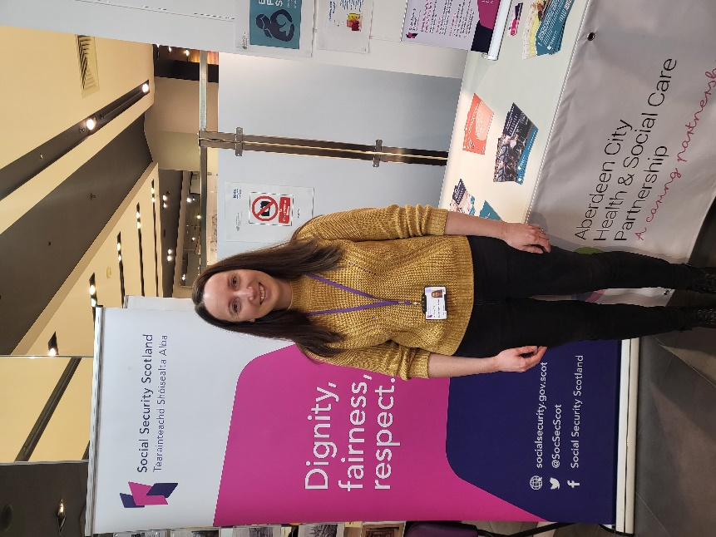
Tackling Poverty & Inequalities
At Hub:
Every Thursday
Promotion & Support:
Benefits Support, Debt Advice, Job Start Payments, energy bills payments, disabilities support & more

Slide 28
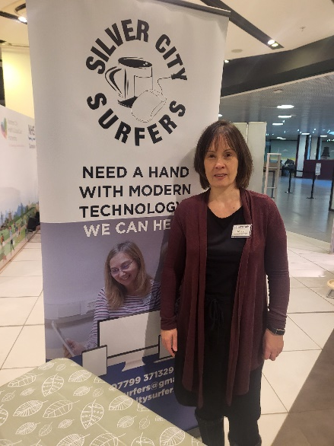
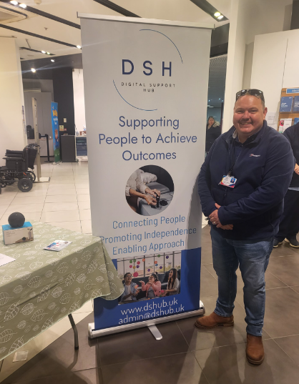
Digital Inclusion
At Hub:
Ad Hoc Bookings
Promotion & Support:
Supporting people with modern technology & access to Technology enabled care

Slide 29
Other Community Partners
At Hub:
Weekly
Promotion & Support:
Providing Home Safety Advice

Slide 30
Other Community Partners
At Hub:
Ad Hoc Bookings
During Health Visitor or Pre-school Clinics
Promotion & Support:
Children’s Oral Health Advice & healthy eating

Slide 31
Consultation & Engagement
Carers Strategy Consultation

Slide 32
Coming Soon……..
Grampian Stroke Club
Sporting
Memories
Sessions

Slide 33
People have reported that
they find the Hub a great venue to meet, as it is easy to find and also the anonymity of going into the Centre provides them as they could be attending for a number of reasons.
Visiting Service
It is great to hear that I can now book my bloods and Vitamin B12 in the hub when I am attending for other appointments. The centre is easy to get to by bus.
Service User
The Impact
My appointment included incredibly valuable advice on the use of my asthma inhalers. Focussed, conscientious care from a lovely nurse.
Service User
Excellent Idea with lovely friendly and informative staff. The city needs a wee hub like this for people to pop into for advice etc.
Service User
Thank you so much.
I asked for extra info about anorexia for a relative and the staff were so kind and helpful. I really appreciate their help. Also delighted by the leaflets all the information available.
Service User
It was really helpful to be able to engage in conversation
with members of the public regarding safer mobility, community services and engagement in meaningful activity. We were able to share information with people who may not otherwise access our services. The relaxed atmosphere over a cup of tea allowed everyone to relax and engage better.
Visiting Service

Slide 34
What can you do to help?
Arrange to
Visit the
Centre
Would your
Service be
interested
In using the
space?
Spread the
Word?
Signpost to
To the Hub
How can we
Work together?
Do you have promotion materials to display?
Contact:
Caroline Anderson
Programme Manager
Caroline.anderson2@nhs.scot

