Slide 1
At the ACHSCP conference on 29th February 2024 we considered how to make our organisation a place where people feel truly valued at work.

Slide 2
Imagine you wake up in a year's time you see an article about how ACHSCP is a place of work where people feel truly valued
What’s the story that is being told?
What are colleagues saying, thinking, feeling, hearing, doing?

Slide 3
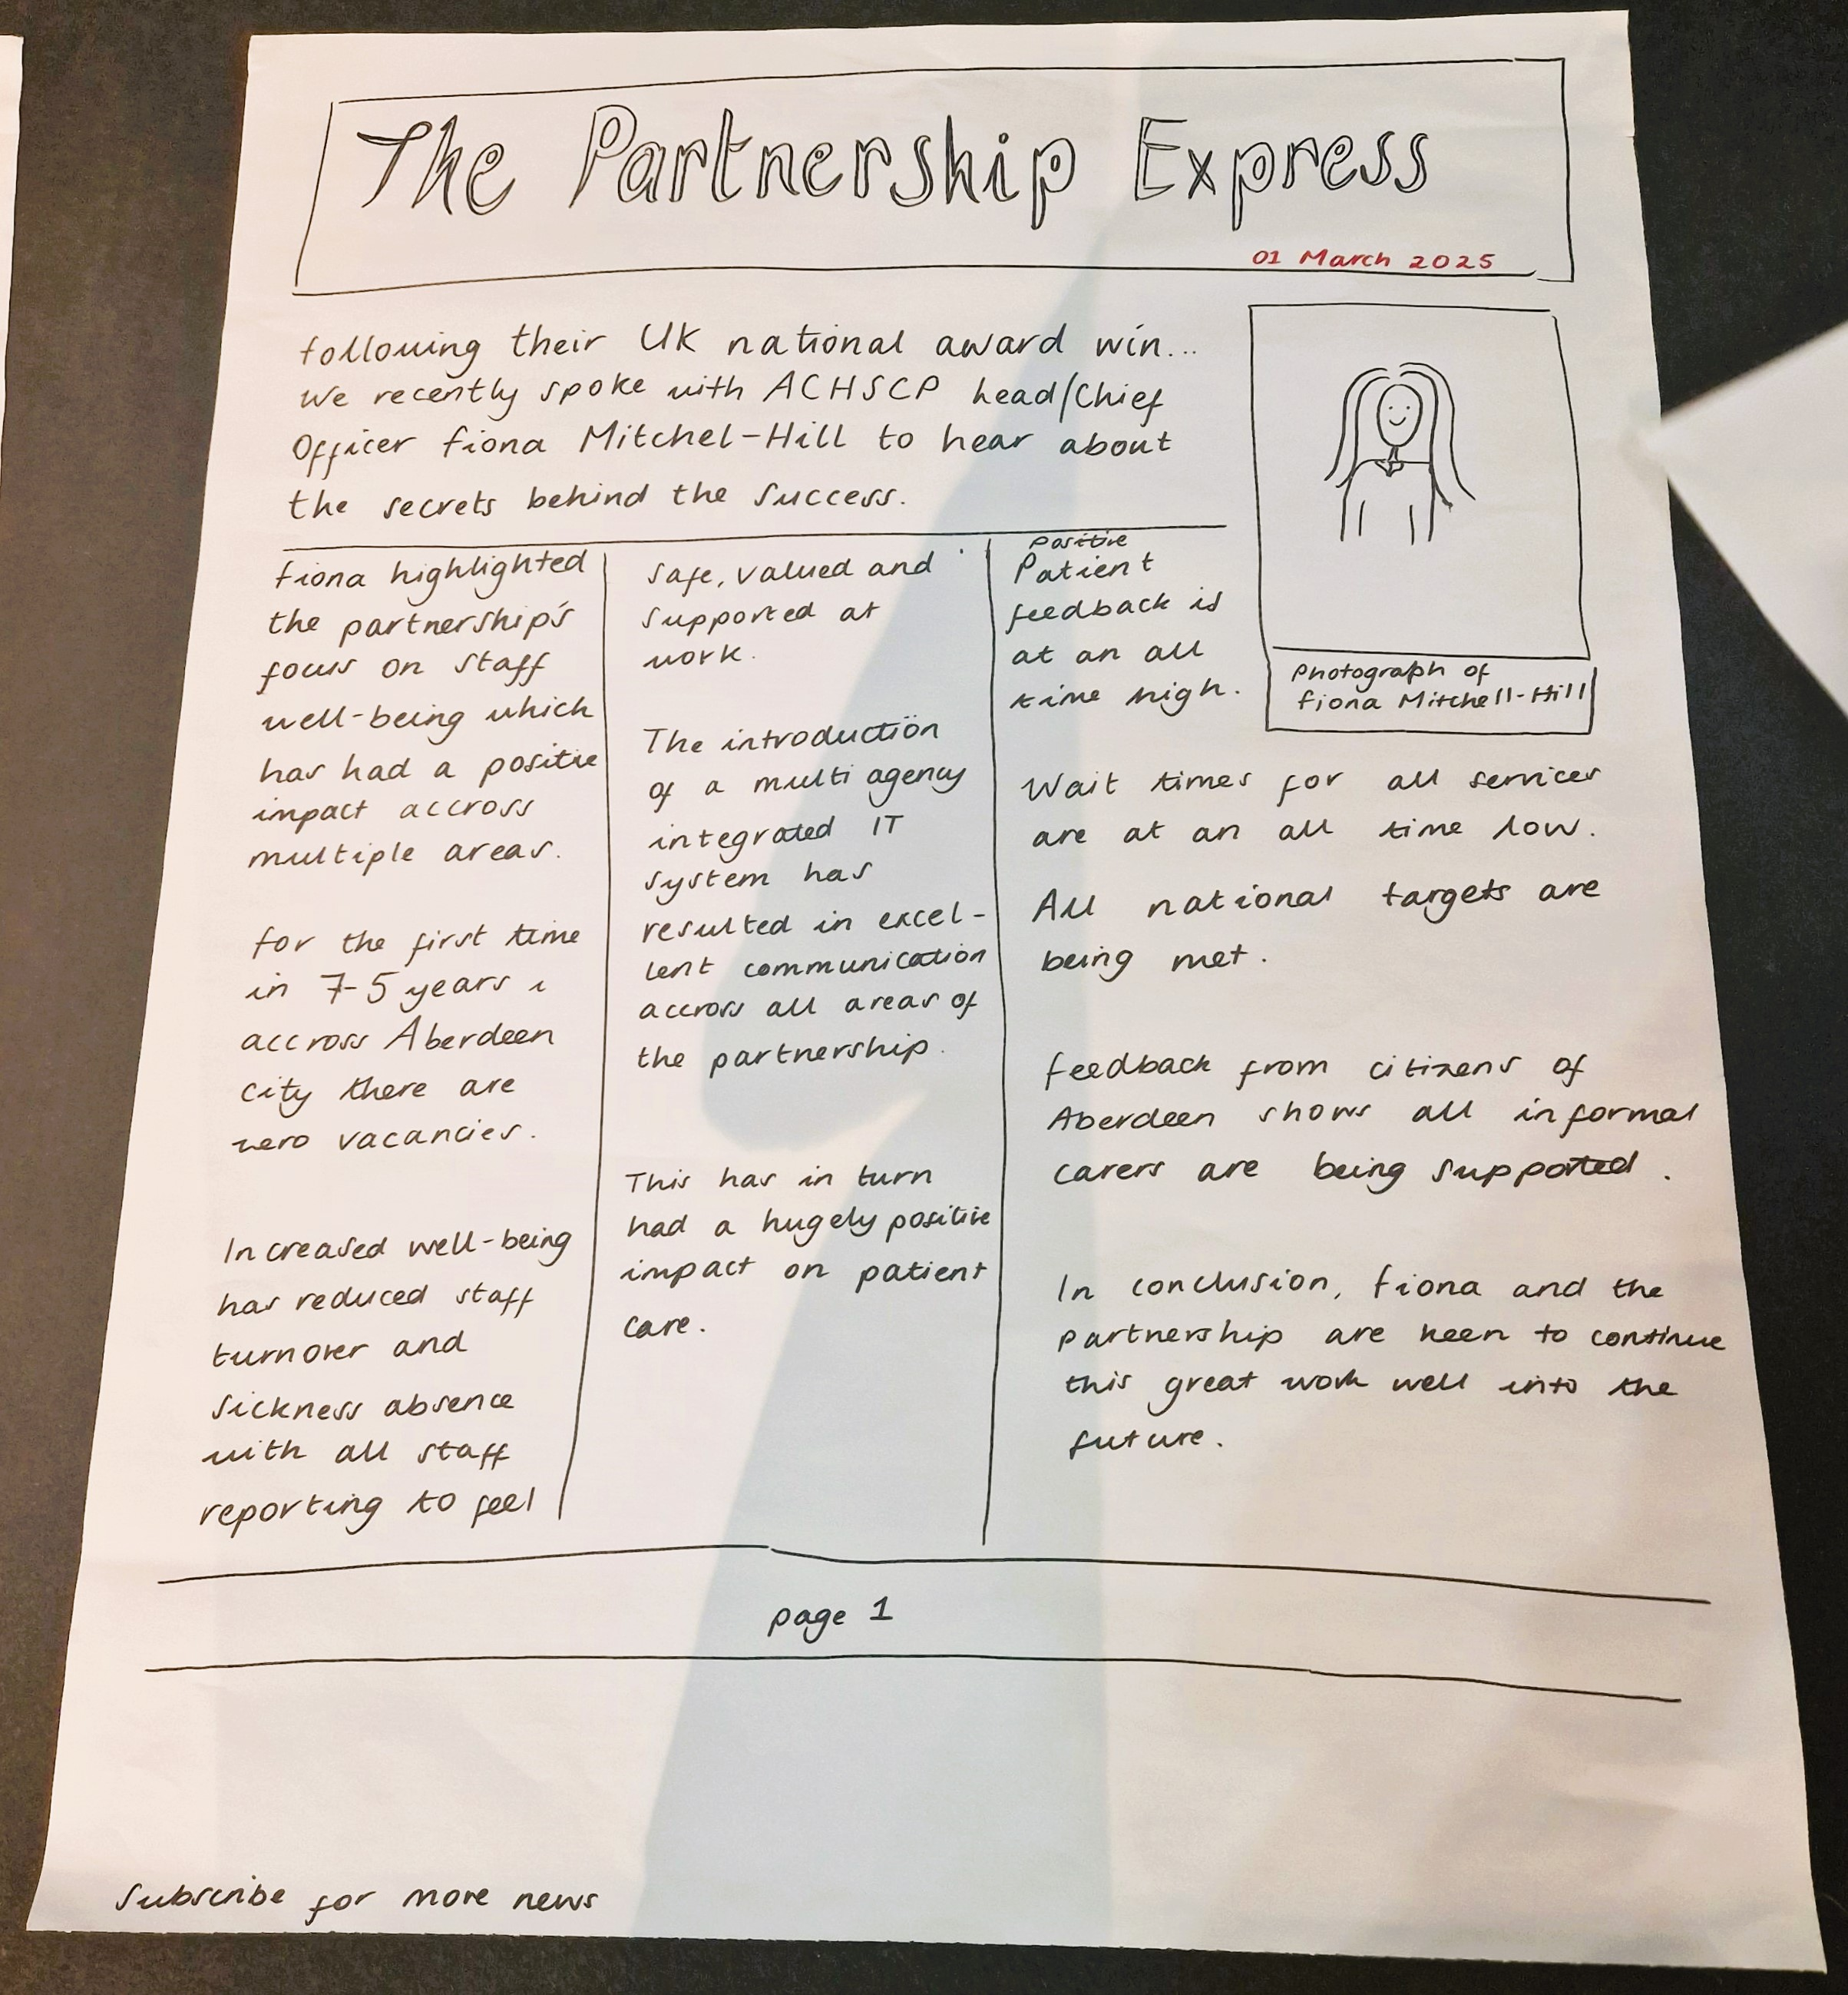
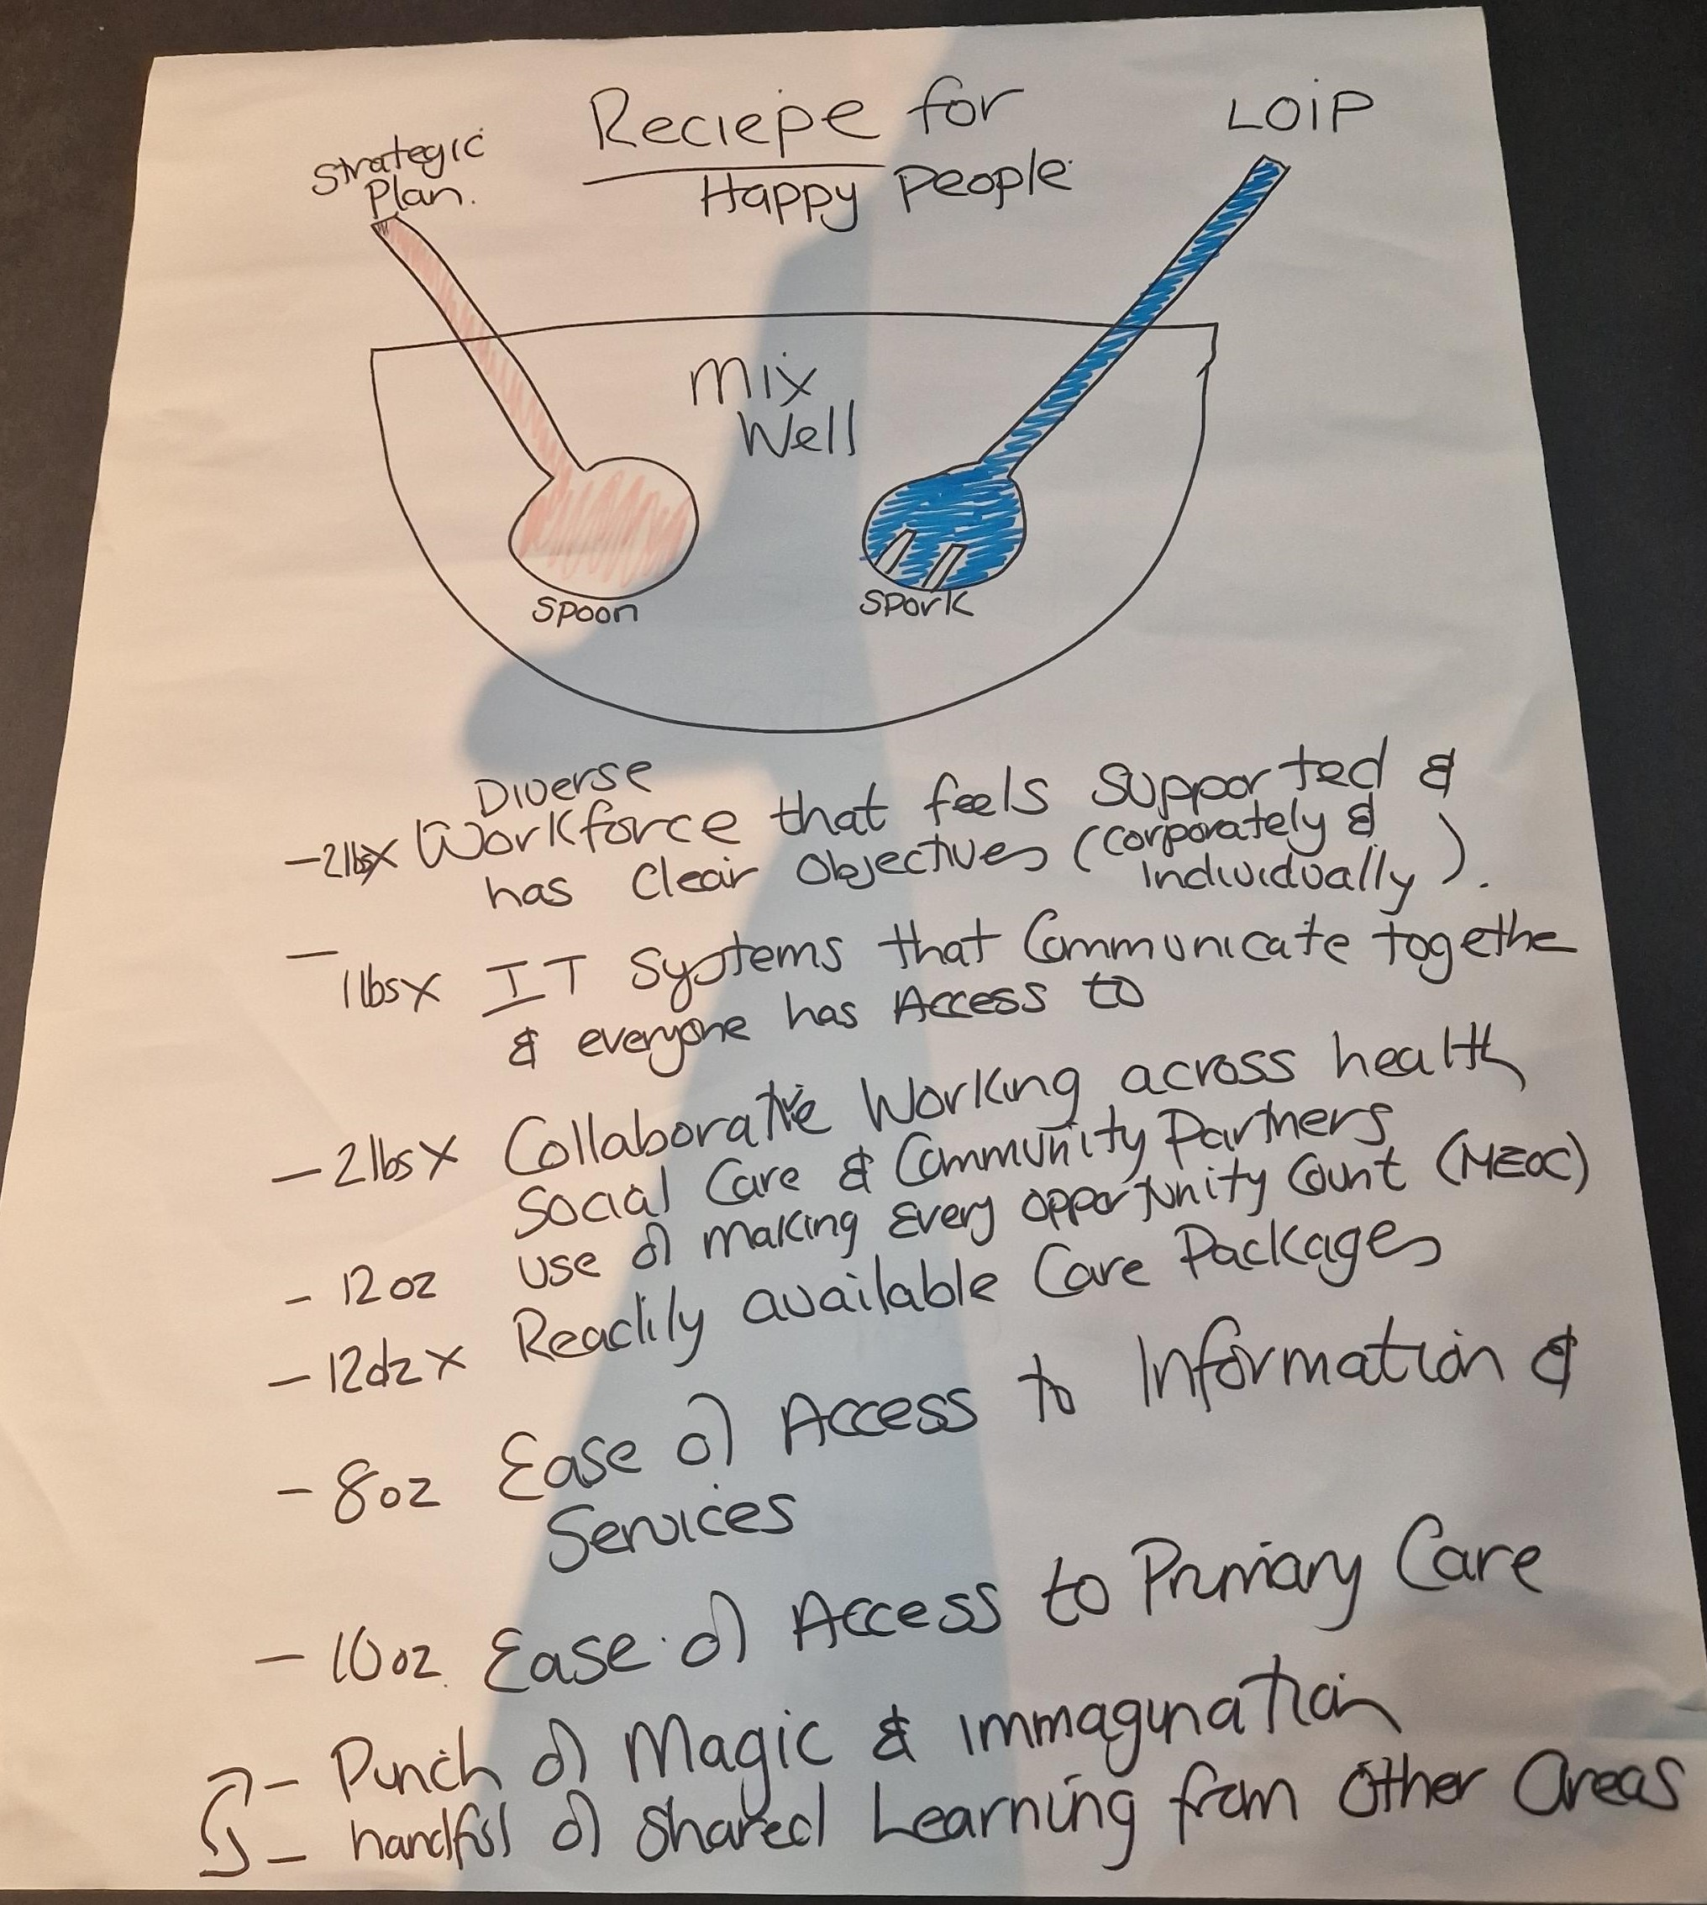
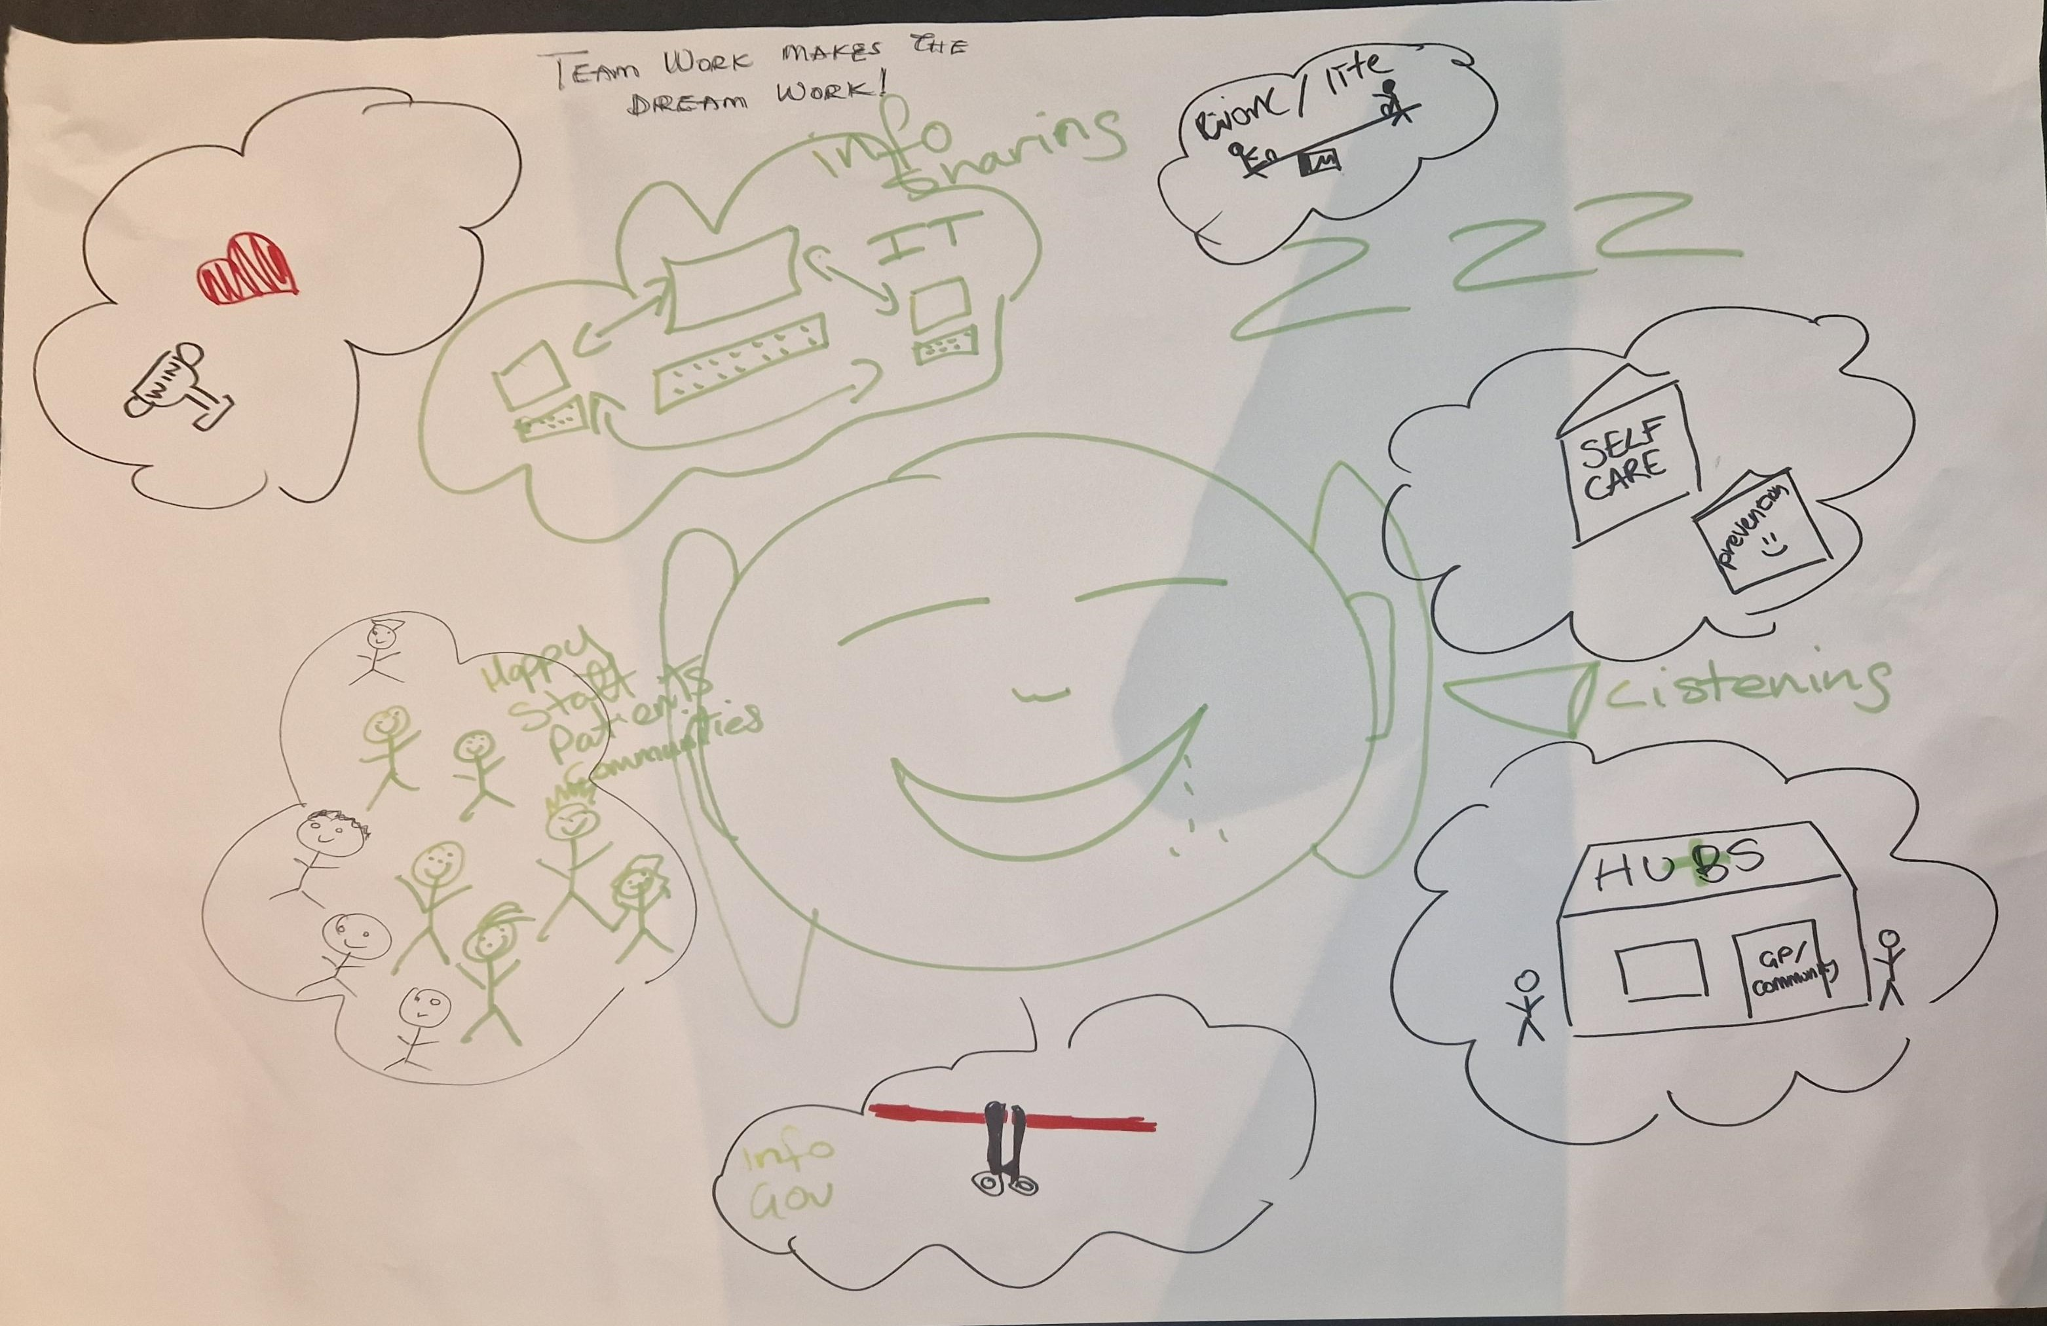
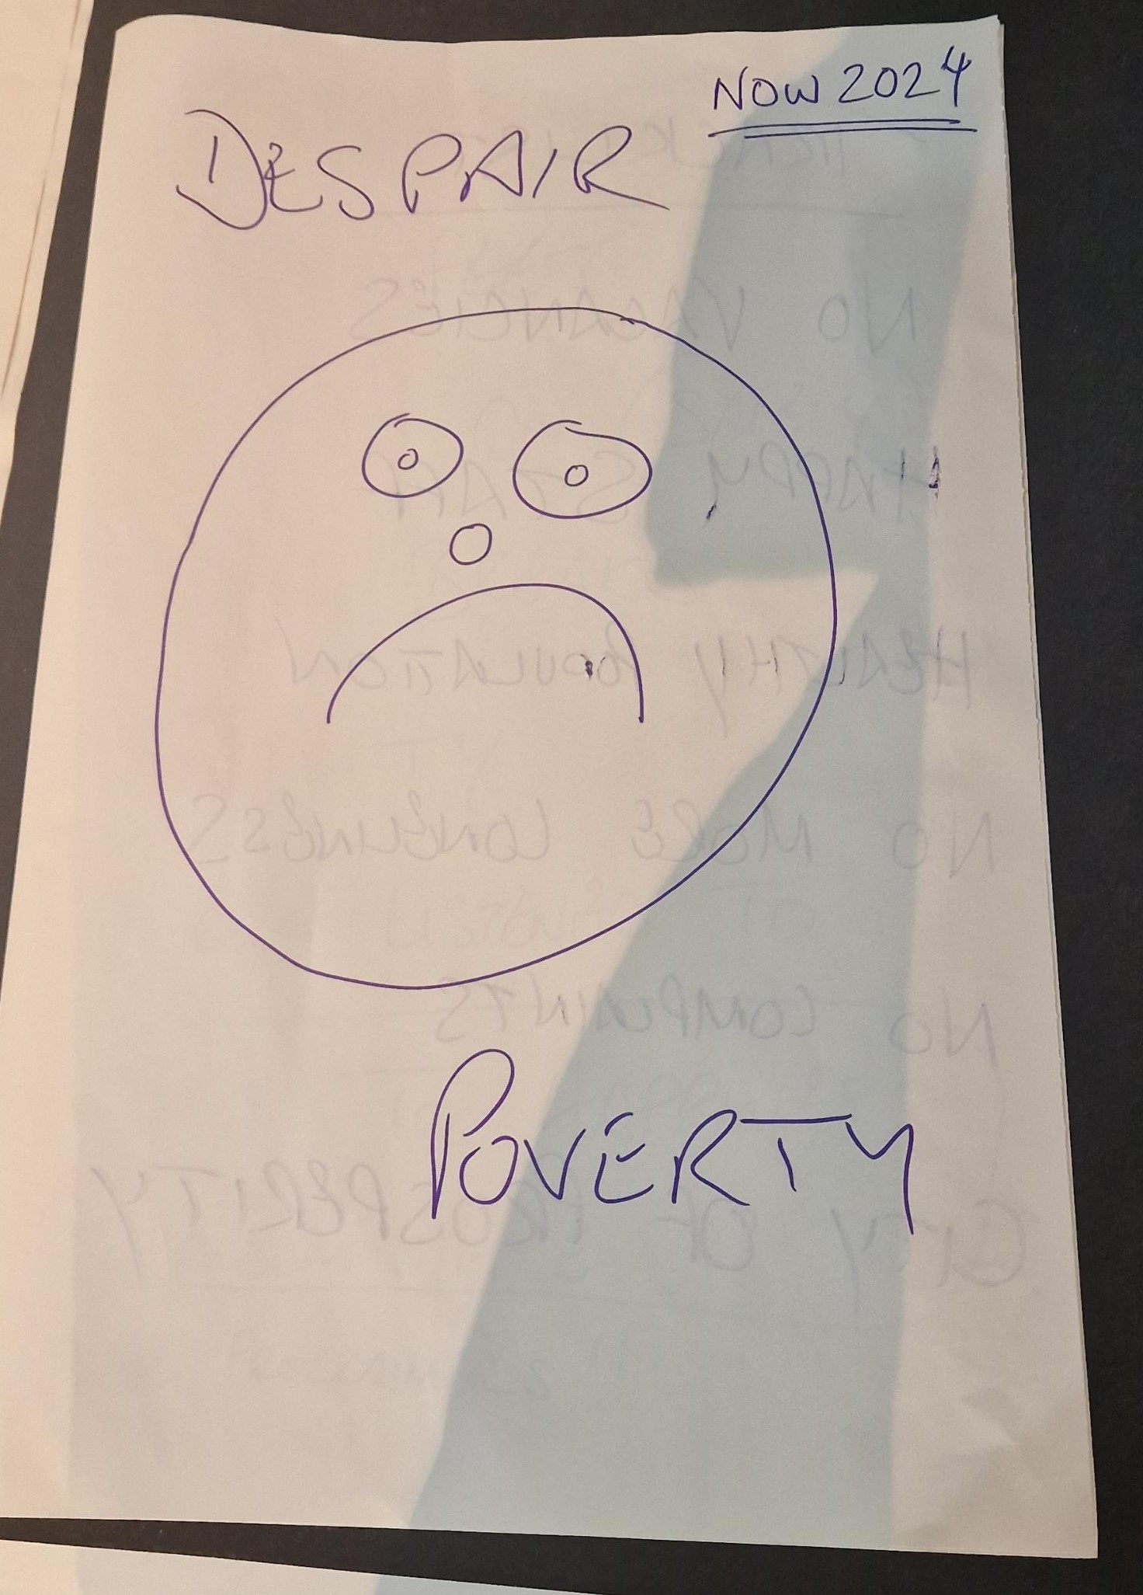
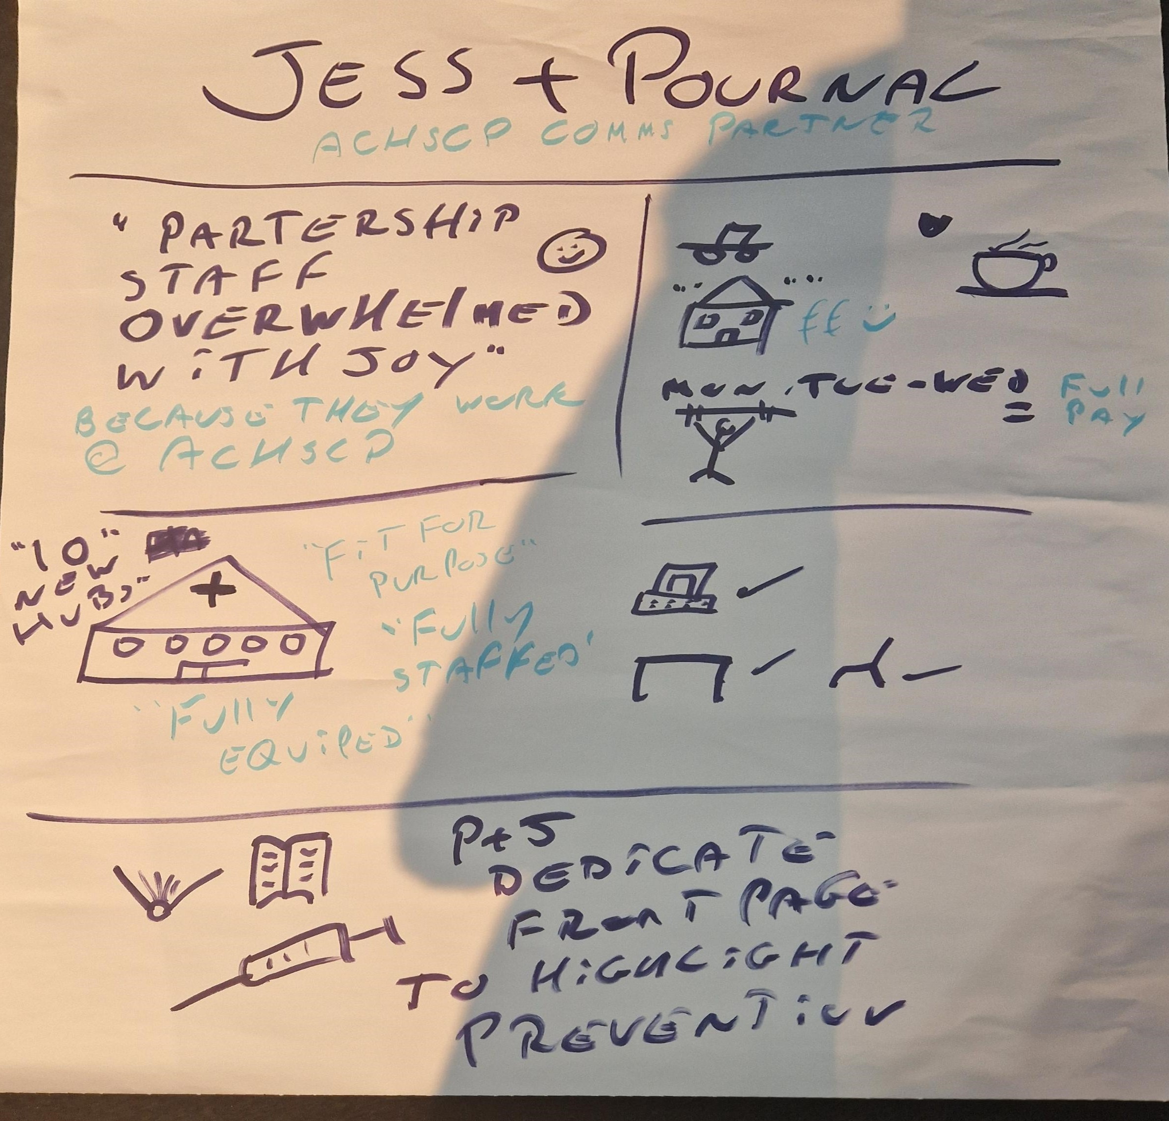
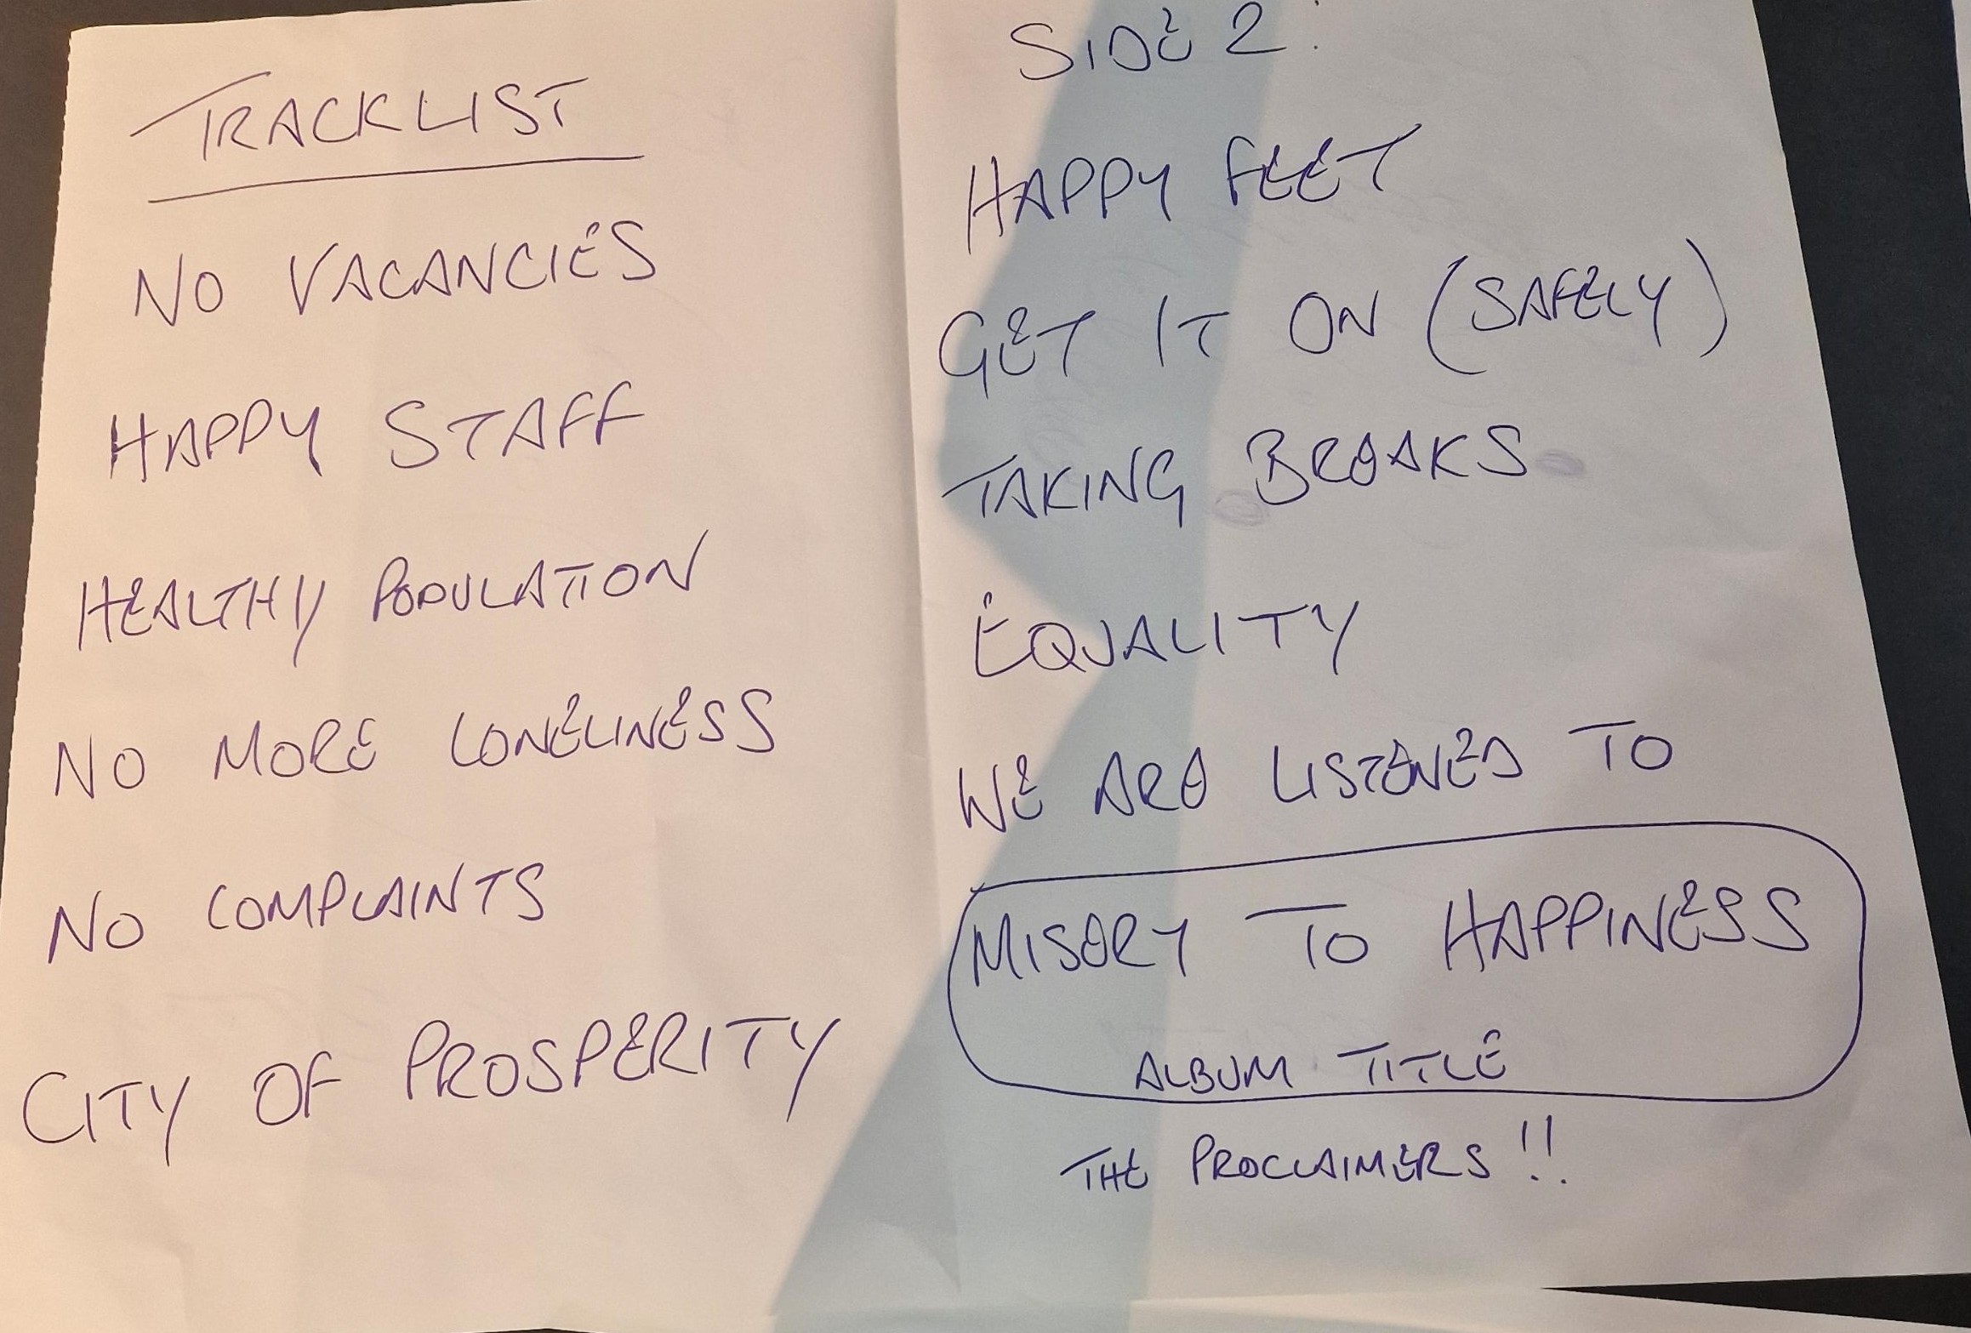
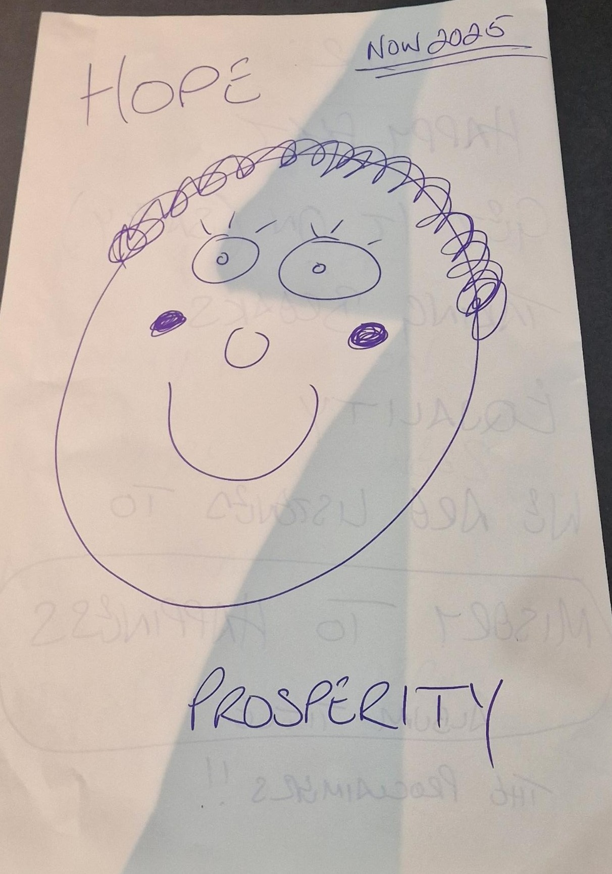
ACHSCP is a place of work where people feel truly valued.
These are the dreams they have of a perfect Health and Social care Partnership in 2025

Slide 4
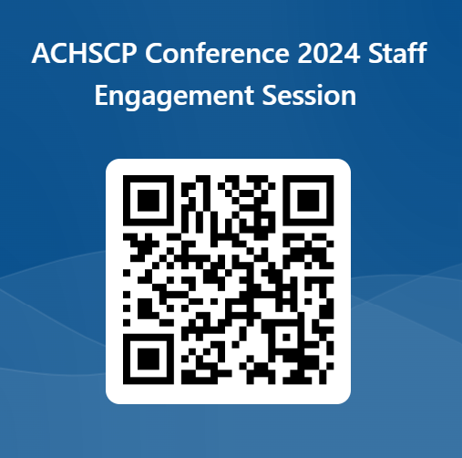
We want to know about how you feel valued at work?
Join the Conversation
What makes you feel valued at work?
What does not make you feel valued?
At work, in what ways do you show value to others?
https://forms.office.com/e/LCbqqRhZAc
This form will close on the 29th March 2024

