Slide 1
Aberdeen City Health & Social Care Partnership
Strategic Plan
ACHSCP Conference – 29 February 2024

Slide 2
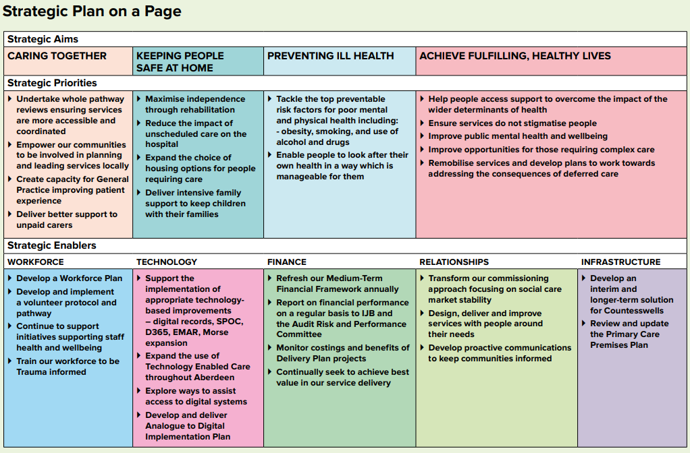

Slide 3
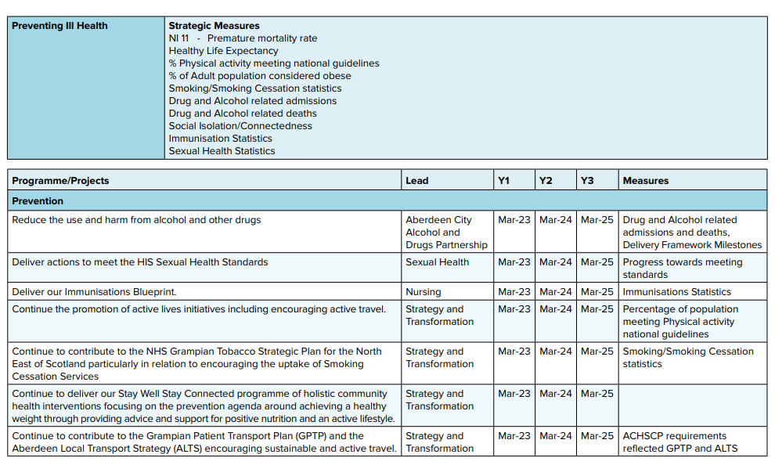

Slide 4
Delivery Plan Year 3 – What’s Changed
11 x Y2 Projects Closed
4 x Y2 Projects Completed
Total Projects increased from 64 to 82 BUT only 12 ‘brand new’.
6 Projects with savings targets
24% increase in Tier 1 Projects
Project v Programme
Performance
Population Needs Assessment
Capacity
Budget
4

Slide 5
Strategic Plan 2025 -20?? Timeline
Mid-April – Mid-June Engagement with staff, partners, communities, unpaid carers and other stakeholders
April 2025 Strategic Plan Launch
February 2024 Conference Launch
March 2024
SLT Approval re timeline and approach
Mid-June –Mid- Sept Revisit Engage-ment Cohorts
April 2024
IJB and SPG review of performance, identification of strategic context and priorities
June 2024
SLT, IJB and SPG review feedback from engage-ment and impact on priorities
19th
Nov 24
Draft Strategic Plan to IJB
20th Nov 24 – 22nd Jan 2025
Public Consultation
18 Mar 2025 – Final Strategic Plan to IJB
October 2024
Draft IJB Report develop-ment, review and deadline
Aug/Sept 2024
SLT, SPG and IJB review outcome of revisits
Feb 25
Final drafting and sharing with engage-ment cohorts
Engagement - Streamlined approach
Do we need to change the Strategic Aims – Sense check rather than offer change.
Do not change for change's sake – consistency to support stability.
Emphasis on Finances – risks and opportunities
Public Engagement
Early organisation for maximum numbers and connections.
Different formats and ways of communication
Impact Assessment and Equalities groups

Slide 6
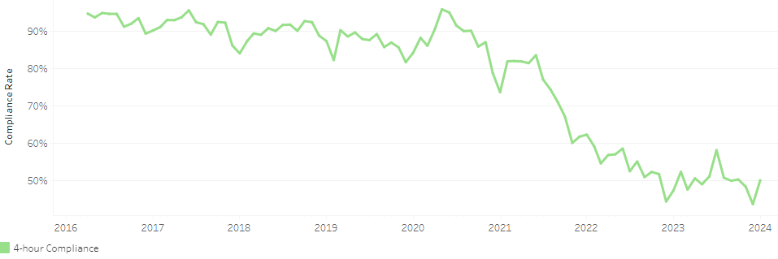
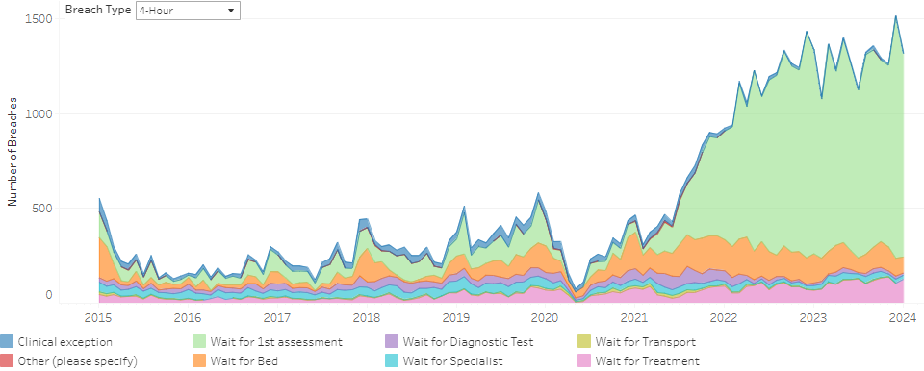
ARI ED 4 Hour Compliance Rates – Aberdeen City Patients Only

Slide 7
Aberdeen City ED Attendances – (ARI, Dr Gray’s & RACH)
Aberdeen City ED Attendances – (ARI Only)

Slide 8
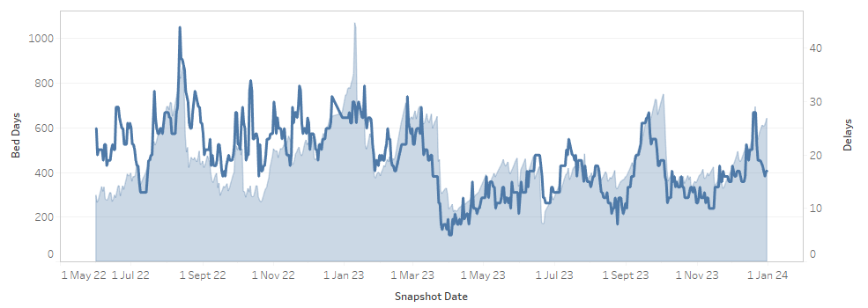
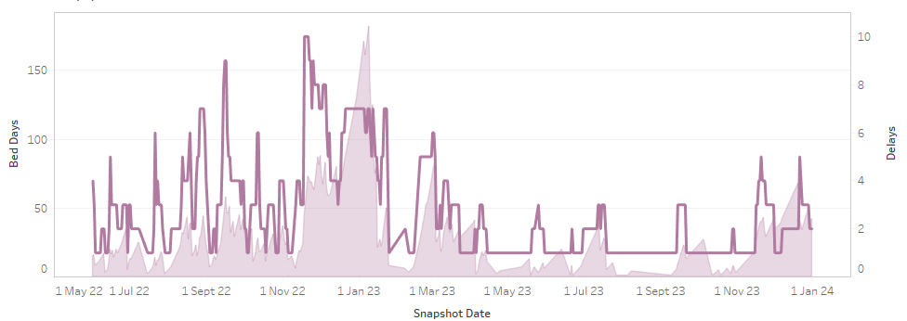
Aberdeen City Standard Delayed Discharges and Bed Days
Aberdeen City Standard Delayed Discharges and Bed Days – Care Arrangements Only

Slide 9
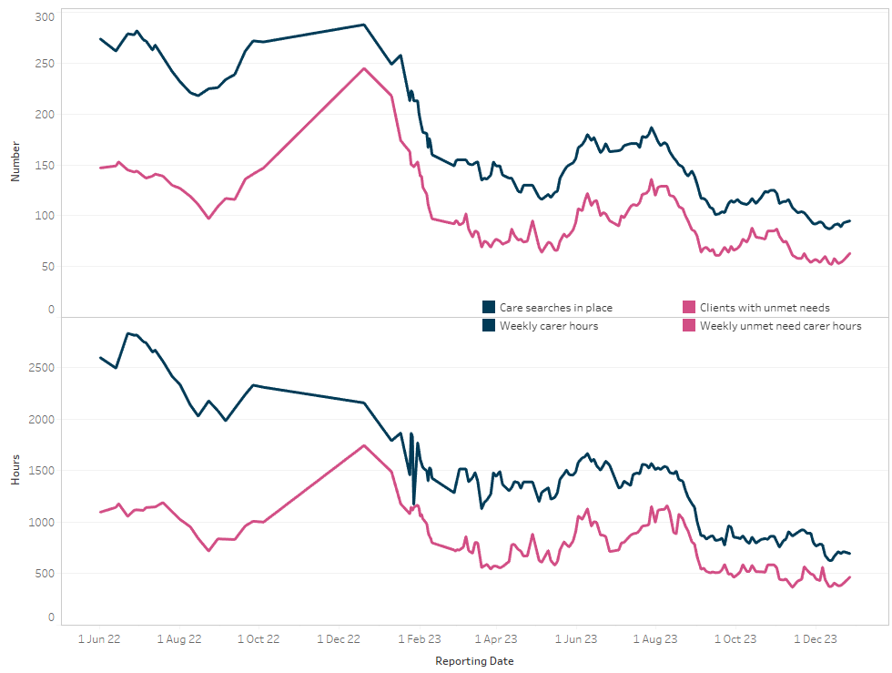
Aberdeen City - Unmet Needs

Slide 10
Other Performance (from Q3 Dashboard)
Increasing Trend in H@H Admissions and Overnight Occupancy
Increasing Ward Starts and Daily Boarders in Ward 102
Downward trend in use of ‘step-up’ beds in Rosewell House
# of DDs in Woodend have reduced by 26% but bed days have increased by 25%
No Harm Falls had been on an upward trend but now reducing
Complex DD Bed Days on significant downward trend in RCH
Average overnight occupancy in RCH has significantly increased.
10

Slide 11
Other Performance (from Q3 Dashboard) contd.
Alcohol related admissions reduced by 25%
Drug related admissions reduced by 22%
Both 4 and 12 week Quit Rates reduced
71.3% increase in numbers of unpaid carers supported
Stable levels of those GP practices offering a full service or in Level 1.
No GP practice has recorded level 2 or 3 since 2024 Q2.
11

Slide 12
So What?
Significant Progress
More To do
Demographics, Acuity, Comorbidity
Funding
Recruitment and Retention of Staff

Slide 13
Networking Questions – Available today on tables.
Are the current aims, priorities and enablers in our Strategic Plan still relevant or does anything need to change?
Do you have any ideas in terms of how we can make our services more sustainable given the challenges around budgets and workforce?
How can we best engage with you as we go through the refresh process?
How can we best represent your service and its contributions in the ACHSCP Strategic Plan refresh and show your progress within the Annual Performance Report?

