Slide 1
Workforce Plan Progress 2023 leading into 2024

Slide 3
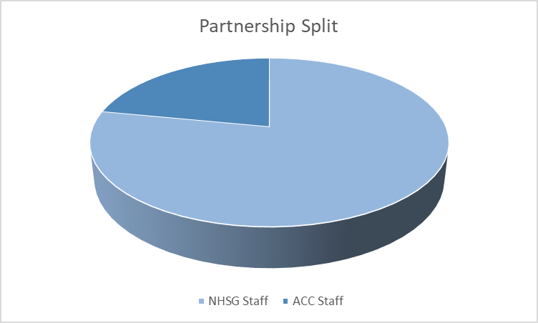
Workforce Overview
Our workforce over 2022 – 2023 has supported a year for recovery for Health and Social Care in the community, remobilising services from the pandemic period and supporting patients back to face to face appointments and services.
Increased headcount and Whole Time Equivalent (WTE) posts, will support the increased demand on our services. Our Workforce Plan reported that we will have a percentage of our staff due to retire in the next 15 years, our figures show that there has been increases from the previous year in our younger staff demographics, which helps support our succession planning and staff development for the future of our services. However, there is still work to do to support Grow our Own and future staff development.
Our internal services are split between NHSG Staff (78.25%) and ACC Staff (21.75%) which 90 percent of our staff are females. Our Commissioned workforce is also a large part stretching across 166 Contracts across Aberdeen, supporting people across Aberdeen City.
ACHSCP Actual WTE (Whole Time Equivalent) and Headcount
2020 |  | 2021 |  | 2022 |  | 2023
Actual WTE | Head Count | Actual WTE | Head Count | Actual WTE | Head Count | Actual WTE | Head Count
1744.21 | 2164 | 1741.31 | 2122 | 1830.54 | 2197 | 1933.13 | 2265

Slide 4
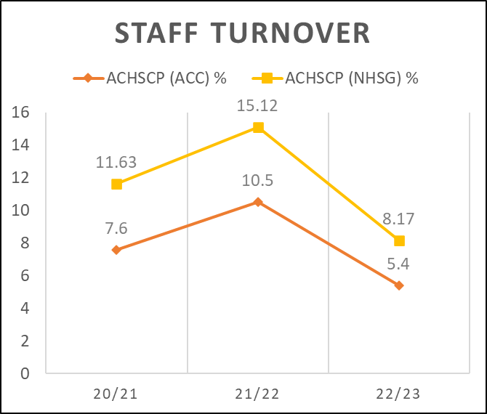
Staff Turnover
ACHSCP Staff Turnover has stabilised this year dropping to 7% for employed NHSG Staff and 5% for employed ACC staff.
Absence
Absence are represented here for our services, with main causes being reported as;-
Colds, Coughs and Flu
Gastro and Stomach related issues
Anxiety, Stress and Mental Health related issues

Slide 5
Sandy Reid, Lead for People and Organisation
Staff Health and Wellbeing Initiatives

Slide 6
"the therapists are absolutely lovely"
"I really appreciate the work you do, the therapy is wonderful and just what I needed"
Healthy Working Lives
There has been 979 staff and colleagues attending Healthy Working Lives initiatives this year. Initiatives such as, complimentary therapies, reflexology, pedicures, reiki, reflexology and mindfulness sessions. These are delivered by the partnership to help support work and life balance and wellbeing.
Understanding, Developing and Maintaining Individual Resilience
The Organisational Development Team have piloted sessions to build on staff individual resilience. The feedback from this initial sessions will help support future programme of sessions for staff to attend.
WE CARE
We Care is a staff health and wellbeing programme established to deliver, co-ordinate and enhance staff wellbeing across NHS Grampian and Health and Social Care Partnerships. Our workstream will look to further promote and embed the programme within the workforce teams across the partnership and record its impact. More information here on the We Care Hub
ACC Learn Courses
Mental Health Awareness for Managers 1/2 day course
11 ACHSCP Staff have attended over the last year. Scottish Mental Health First Aid 2 day training:
19 ACHSCP Staff have attended over the last year.
There are many other wellbeing initiatives and session run through ACC available to partnership staff, we will be working on increasing partnership staff uptake for 23/24.

Slide 7
Career Ready
Aberdeen City Health and Social Care Partnership (ACHSCP) have been supporting young people through the Career Ready mentoring scheme since 2018. The mentoring scheme matches mentors in the Partnership with young people in S5. The programme runs for 18 months and includes a 4 week paid internship where the young people attend work within the Partnership.
The cohort of young people for 2022/2024 undertook their internships during July 2023. There were 4 young people who were mentored by Partnership staff and 1 additional young person who was mentored by an Aberdeen City Council colleague but who undertook their internship in the Partnership.
The 5 interns were very enthusiastic and were involved in a whole range of activities across the Partnership, including community nursing, clinical psychology, pharmacy, public health and wellbeing. On their last day they did presentations to their mentors, teachers and representatives of Career Ready where they outlined what they had done during the 4 weeks, what they had learned and also how the experience had helped them in terms of their career aspirations.
Supporting the Career Ready programme not only helps the young people, but also increases mentoring skills in the Partnership and helps promote the work of the Partnership whilst showcasing the Council and NHS Grampian as potential future employers, thus assisting the Partnership’s Workforce Plan.
Future development of the young workforce will continue to be progressed through the Recruitment and Retention Workstream of the Workforce Plan.

Slide 8
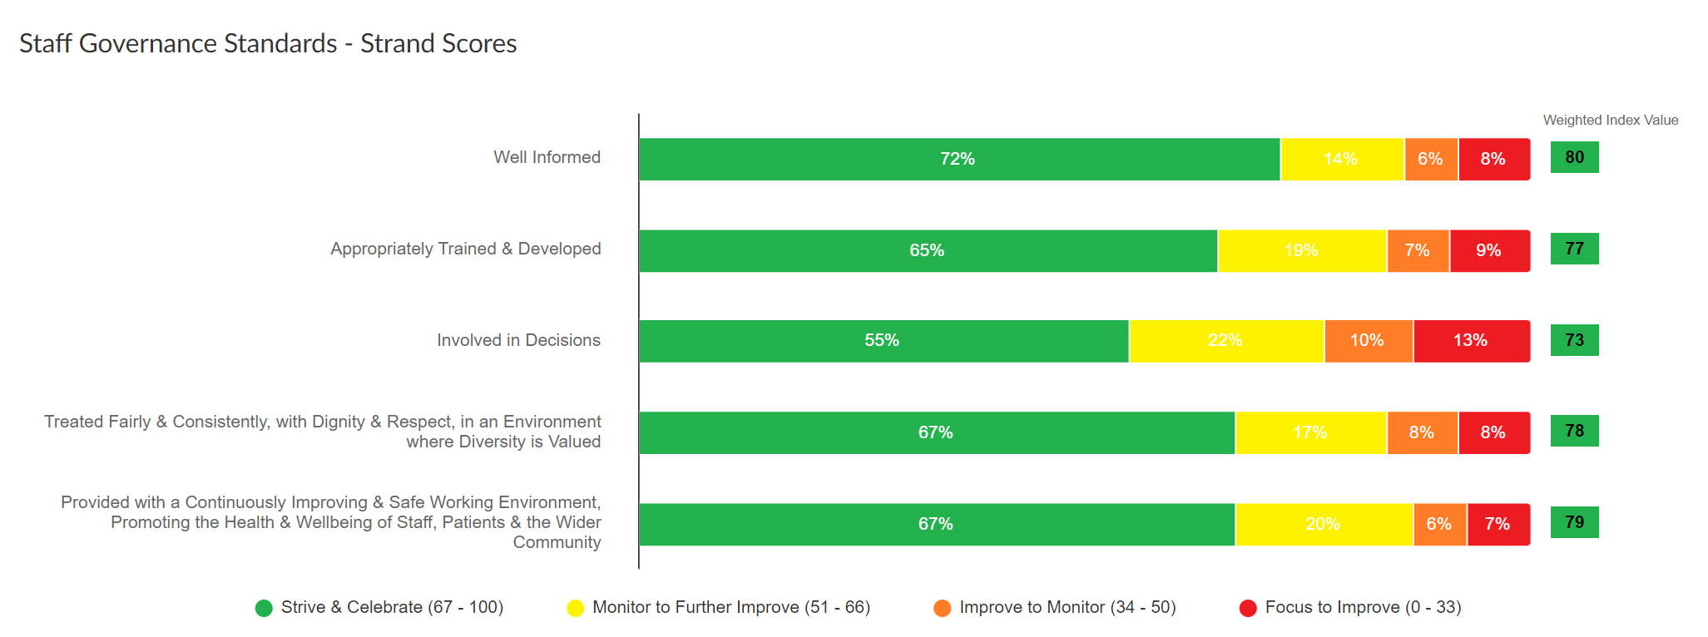
National Care Service
The Aberdeen City National Care Service Programme Board was established in 2022 to prepare for the possible creation of a National Care Service in Scotland. The multi-agency Board is chaired by the ACHSCP Chief Operating Officer. One of the Board’s workstreams is to monitor and prepare for any potential impact on workforce. The detail of how a National Care Service may operate in practice, including any impact on workforce, is currently going through a process of co-design. The ACHSCP will continue to actively engage with the process.
iMatter – Staff Annual Survey
Improvement in response rates and completed actions plans this year. Continued development and encouragement for services to engage with this annually.
Survey results are generally positive across the partnership with high scores. The trend for responses relating to 'Involved in Decisions' are and have been in previous years lower than the other topics. This is a focus area to work on and challenges services, teams and management to consider how we involve or engage with our workforce to link our decisions to our discussions.
iMatter Response Rates |  | iMatter Response Rates
 | 2019 | 2021 | 2022 | 2023
Annual response rate | 63% | 58% | 58% | 64%
Completed Action plans | 48% | 35% | 39% | 45%

Slide 9
Workstream Approach and Future Developments
It was agreed at the August Senior Leadership Team meeting, a new approach to structure the actions and progress priorities from the Workforce plan.
Three Workstreams for each priority was to be created and have oversight group of Senior Leadership members and partnership colleagues. This is to work in partnership and provide updates to the Joint Staff Forum and information to feed up into the Grampian Integrated Workforce Planners Meeting.
Each workstream has an action plan to progress over the lifespan of the Workplan. We anticipate that this new approach will help support annual reports in the coming years and be a focus to support and assure the IJB with Workforce Strategic risk mitigations.
Staff Mental Health and Wellbeing Actions include; -
Continued support for Health Working Lives initiatives
Broaden use of We Care approach and framework
Re-establish annual workforce engagement events and celebrating achievements
Recruitment and Retention Actions include;-
Recruitment Events and ACHSCP Job Promotion Media
Induction and Training Review
Developing Young Workforce
Growth and Development Opportunities Actions include;-
Map and explore emerging technologies to support staff
Continued promotion of iMatter and other Staff Feedback
Shared learning and best practice, including test of change ideas
Integrated Workforce Planners Meeting (Grampian wide)
ACHSCP Workforce Oversight Group
Staff Mental Health and Wellbeing
Recruitment and Retention
Growth and Development Opportunities
ACHSCP Joint Staff Forum

