Slide 1
Transitions for Children with Learning Disabilities in Aberdeen

Slide 3
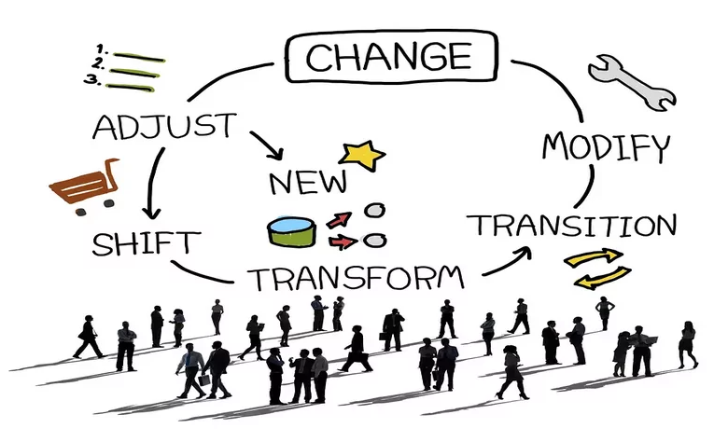
Identifying the Need for Change Improvement
Why change?
What needs to change?
How can we positively implement change?
Who can help us on this journey?
How will we measure improvement?

Slide 4
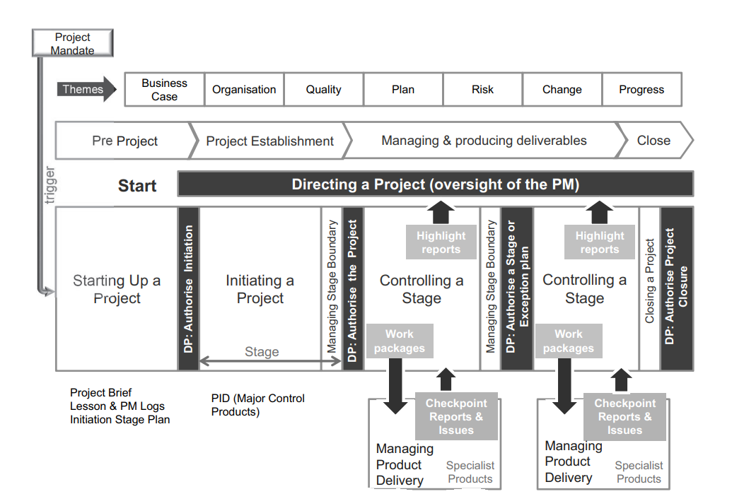
Project Management Approach

Slide 5
Getting the full picture of the current transitions landscape
Understanding what’s been done previously
Journey Mapping
Stakeholder identification
Lived experience at the heart of our transitions project strategy
Stakeholder engagement
Communication planning
Understanding limitations/ issues and risks
Identifying the main objectives of the project
Agreeing with stakeholders of project direction

Slide 6
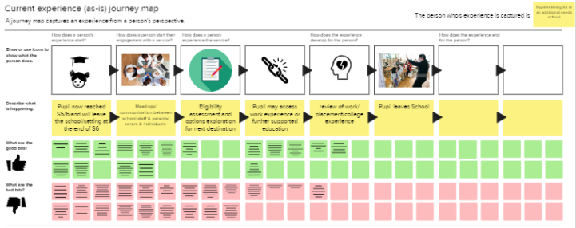
Journey Mapping
Map out the current transitions journey to show the current experience
Map out some of the journeys of those currently transitioning (lived experience perspective)
Map out the best case transitions journey based on the range of stakeholder views within the framework restrictions.

Slide 7
Developing Meaningful Project Outcomes/ Objectives
Early identification of LD transitions cases & case management process initiation
- Creation of professional transitions guide
- Identification of roles and responsibilities
- Accountability and stage ownership
Support & empower family networks caring for individuals with LD
- Public engagement events arranged to educate and inform
- Networking and sharing of ideas
- Access to professionals and post school destinations
Improved communication and collaboration between ACW, CSW and Schools
Notes:
Bullet Point 1 –
Cases to be identified at 12 years old (S1) in alignment with HSCP strategic priorities of early intervention and prevention.
All relevant stakeholders involved in initial conversations (school representatives, CSW, ASW, individual and care network.
Clear visibility of cases will allow for better planning (staff resource allocation & financial).
Conduct a thorough review/ assessment of the current LD transitions processes (including case management system) and analyse results.
Adopt a collaborative approach to service review and co-production of service improvements.
Bullet Point 2 –
Early engagement of ASC with families and care networks ensuring that they are aware of eligibility criteria and service provision once their child leaves school and or children's services.
Work alongside & actively engage with families and care networks to empower them with the tools they require to own their child’s journey as they transition into adulthood.
Mentally prepare families and care networks for the eventual change in service provision for their child once they leave school and transition into adulthood.
Adopt a person-centred approach with the young person at the centre of planning and delivery with a real say on their future provision and aspirations.
If public engagement is sought, ensure that public related communications are easy to digest and use language that does not exclude individuals.
Bullet Point 3 –
Review of processes of each touch point in the transitions journey and establish roles and responsibilities of each stakeholder (ACW, CSW, Orchard Brae & Bucksburn school colleagues).
Identification of process efficiencies that can be made to streamline the process – change improvement.
Communication channels established at key gateways, any process pinch points identified and effectively negated.
Ensure more multi-Agency and departmental Collaboration – joint working, communication channels & information Sharing.

Slide 8
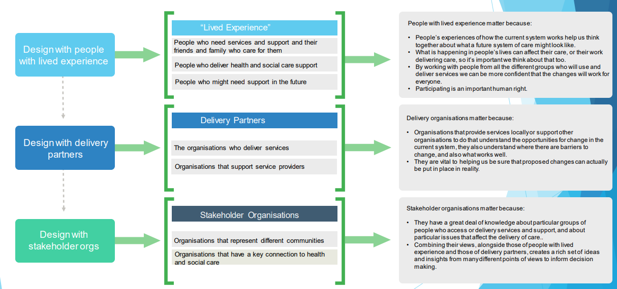
Engagement Planning
Public transitions futures event for networking and knowledge sharing
Journey mapping engagement sessions to inform on the lived experience perspective
Co-design engagement sessions to gain input on the parent and carer transitions guide document
Notes:
Bullet Point 1 –
Cases to be identified at 12 years old (S1) in alignment with HSCP strategic priorities of early intervention and prevention.
All relevant stakeholders involved in initial conversations (school representatives, CSW, ASW, individual and care network.
Clear visibility of cases will allow for better planning (staff resource allocation & financial).
Conduct a thorough review/ assessment of the current LD transitions processes (including case management system) and analyse results.
Adopt a collaborative approach to service review and co-production of service improvements.
Bullet Point 2 –
Early engagement of ASC with families and care networks ensuring that they are aware of eligibility criteria and service provision once their child leaves school and or children's services.
Work alongside & actively engage with families and care networks to empower them with the tools they require to own their child’s journey as they transition into adulthood.
Mentally prepare families and care networks for the eventual change in service provision for their child once they leave school and transition into adulthood.
Adopt a person-centred approach with the young person at the centre of planning and delivery with a real say on their future provision and aspirations.
If public engagement is sought, ensure that public related communications are easy to digest and use language that does not exclude individuals.
Bullet Point 3 –
Review of processes of each touch point in the transitions journey and establish roles and responsibilities of each stakeholder (ACW, CSW, Orchard Brae & Bucksburn school colleagues).
Identification of process efficiencies that can be made to streamline the process – change improvement.
Communication channels established at key gateways, any process pinch points identified and effectively negated.
Ensure more multi-Agency and departmental Collaboration – joint working, communication channels & information Sharing.

Slide 9
Final Project Outputs
We aim to deliver the following outputs in order to meet our transitions objectives:-
Deliver successful engagement events that deliver the specific engagement aims.
Create a co-designed transitions guide document that serves to inform and empower individuals transitioning and their families/ carers.
Create a co-designed transitions guide document for professionals to ensure effective communication, collaboration and alignment to facilitate process ownership.
Notes:
Bullet Point 1 –
Cases to be identified at 12 years old (S1) in alignment with HSCP strategic priorities of early intervention and prevention.
All relevant stakeholders involved in initial conversations (school representatives, CSW, ASW, individual and care network.
Clear visibility of cases will allow for better planning (staff resource allocation & financial).
Conduct a thorough review/ assessment of the current LD transitions processes (including case management system) and analyse results.
Adopt a collaborative approach to service review and co-production of service improvements.
Bullet Point 2 –
Early engagement of ASC with families and care networks ensuring that they are aware of eligibility criteria and service provision once their child leaves school and or children's services.
Work alongside & actively engage with families and care networks to empower them with the tools they require to own their child’s journey as they transition into adulthood.
Mentally prepare families and care networks for the eventual change in service provision for their child once they leave school and transition into adulthood.
Adopt a person-centred approach with the young person at the centre of planning and delivery with a real say on their future provision and aspirations.
If public engagement is sought, ensure that public related communications are easy to digest and use language that does not exclude individuals.
Bullet Point 3 –
Review of processes of each touch point in the transitions journey and establish roles and responsibilities of each stakeholder (ACW, CSW, Orchard Brae & Bucksburn school colleagues).
Identification of process efficiencies that can be made to streamline the process – change improvement.
Communication channels established at key gateways, any process pinch points identified and effectively negated.
Ensure more multi-Agency and departmental Collaboration – joint working, communication channels & information Sharing.

