Slide 1
Models of Support
Kay Diack
4 May 2023

Slide 2
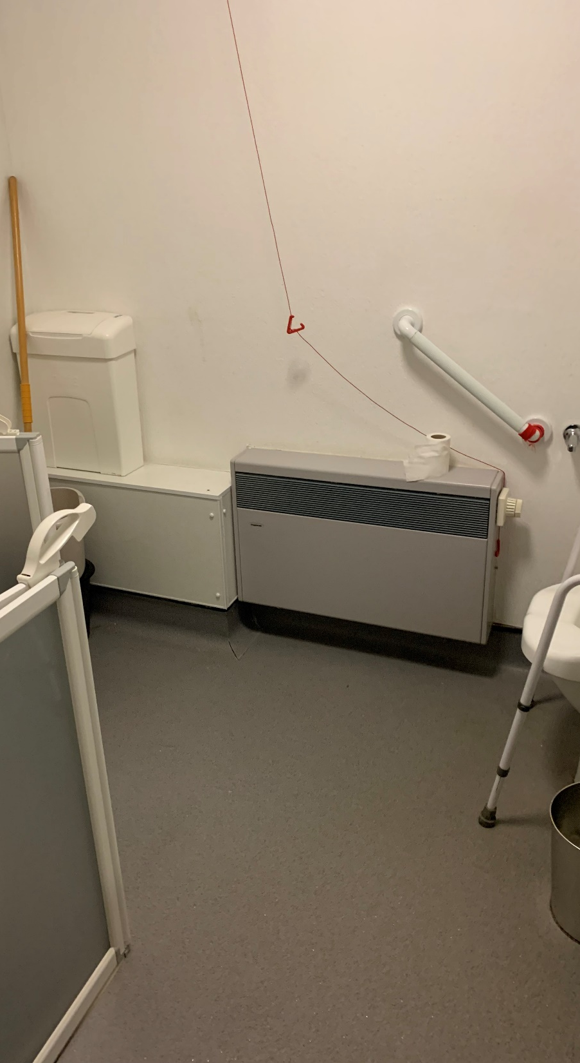
What we are doing well:
Sheltered Guest Rooms
Reducing delayed discharges
Improving stakeholder engagement
What we are starting soon:
Very Sheltered housing provision expansion with RSL
Out of Area solutions
Redesignation of Provost Hogg Court (and more) to provide assisted living hybrid solutions
Relationship building to enable further tests of change and subsequent development
How NCS can support:
Whole system budgeting
Adequate resourcing
Breaking silo thinking and silo working
Losing the labels and moving to “Supported Living”
Designing systems round people

