Slide 1
Children's Services Plan

Slide 2
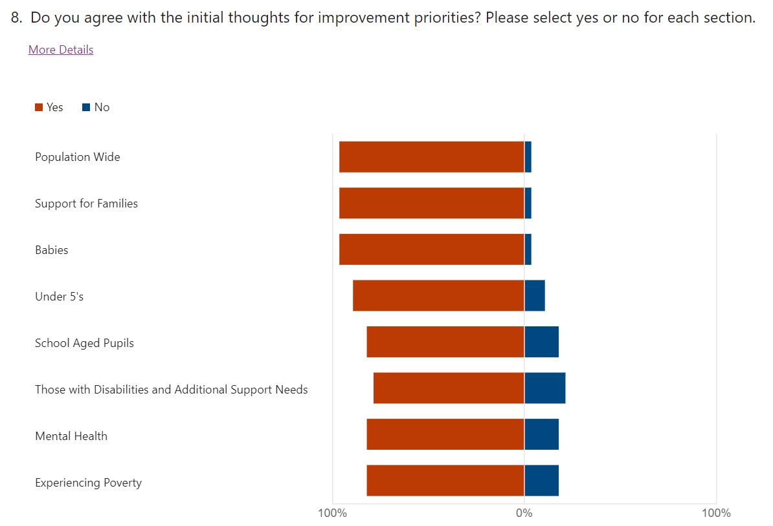
Developing the Plan for 2023-26
In November 2022, the Children’s Services Board started to gather, analyse and update performance management information drawn from across all services for children and families. We looked at data for the whole population, for more vulnerable groups, by age and stage and considered the co-dependencies that occur at key transition points to ensure we took a whole system approach.
463 stakeholders considered the key data and emerging themes and fed back their views through 28 engagement sessions.
In parallel, the Children’s Services Board considered and mapped all anticipated legislation to ensure it was reflected in the Plan. The National Care Service was included in this mapping.
31 adults and 342 children took the opportunity to respond to a formal consultation on the Plan. The consultation responses endorsed the focus of the Plan.
Notes:
Eleanor

Slide 3
Learning we take into this Plan
We need to further develop our integrated approaches to evaluation to help us to make more holistic judgements on the strength of our system as we develop our Family Support Model.
Integrating data helps provide a far fuller picture of need and vulnerability and prioritise the most vulnerable
There is considerable evidence that co-located and co-delivered services make a real difference to Families. Positive examples include:
Childcare provision during the pandemic
Fit Like Family Wellbeing Hubs
The Links Hub
Settle in the City programmes
Edge of Care Pilots
We are committed to keeping The Promise and the children’s rights agenda and have placed both at the heart of the Children’s Services Plan.
We need to work cross system to help keep families together where safe to do so.
Poverty is an overriding factor in almost all risks to wellbeing identified.
Our processes generally work well, but families tell us that they want to be able to access information more easily and don’t always know where to look.
A need to bring all statutory Plans (single and multi-agency) together to clarify our commitments and co-dependencies whilst releasing capacity.
Notes:
Eleanor

Slide 4
The Plan aims to achieve 6 Stetch Outcomes
95% of all children will reach their expected developmental milestones by their 27-30 month review by 2026.
90% of children and young people report they feel listened to all of the time by 2026.
By meeting the health and emotional wellbeing needs of our care experienced children and young people they will have the same levels of attainment in education and positive destinations as their peers by 2026.
95% of children living in our priority neighbourhoods (Quintiles 1 & 2) will sustain a positive destination upon leaving school by 2026.
83.5% fewer young people (under 18) charged with an offence by 2026.
100% of our children with Additional Support Needs/disabilities will experience a positive destination.
Notes:
Eleanor

Slide 5
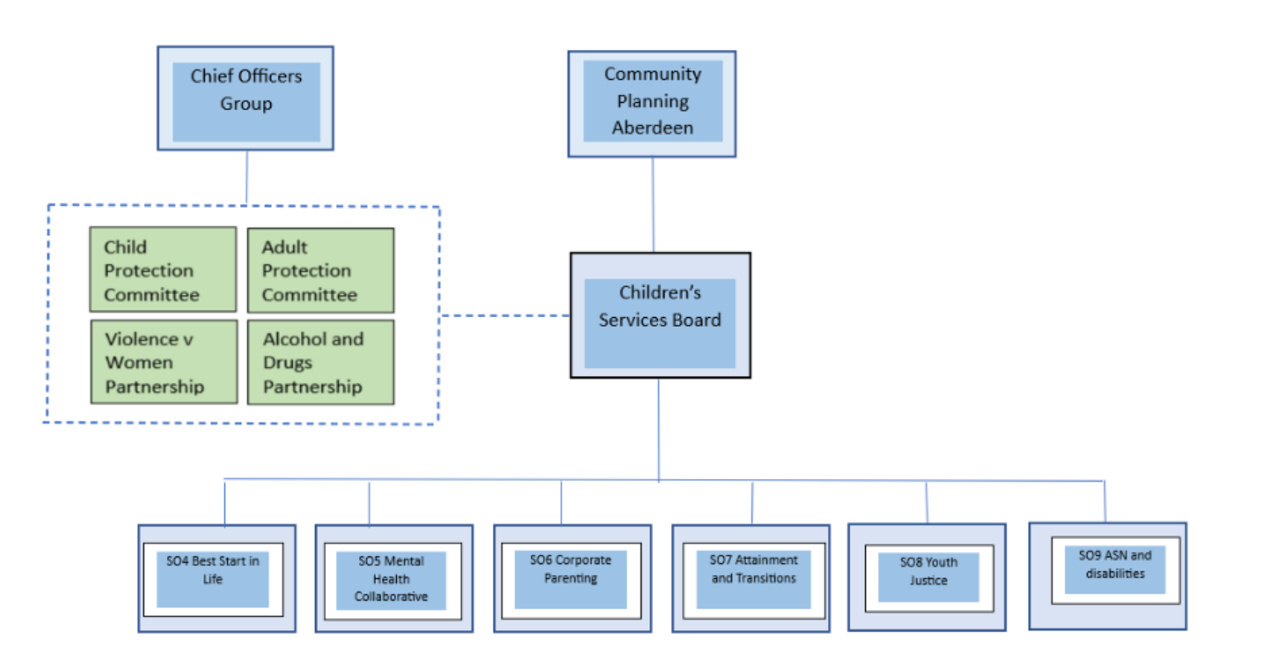
A complex landscape being aligned through Aberdeen Protects
.
Notes:
Eleanor

Slide 6
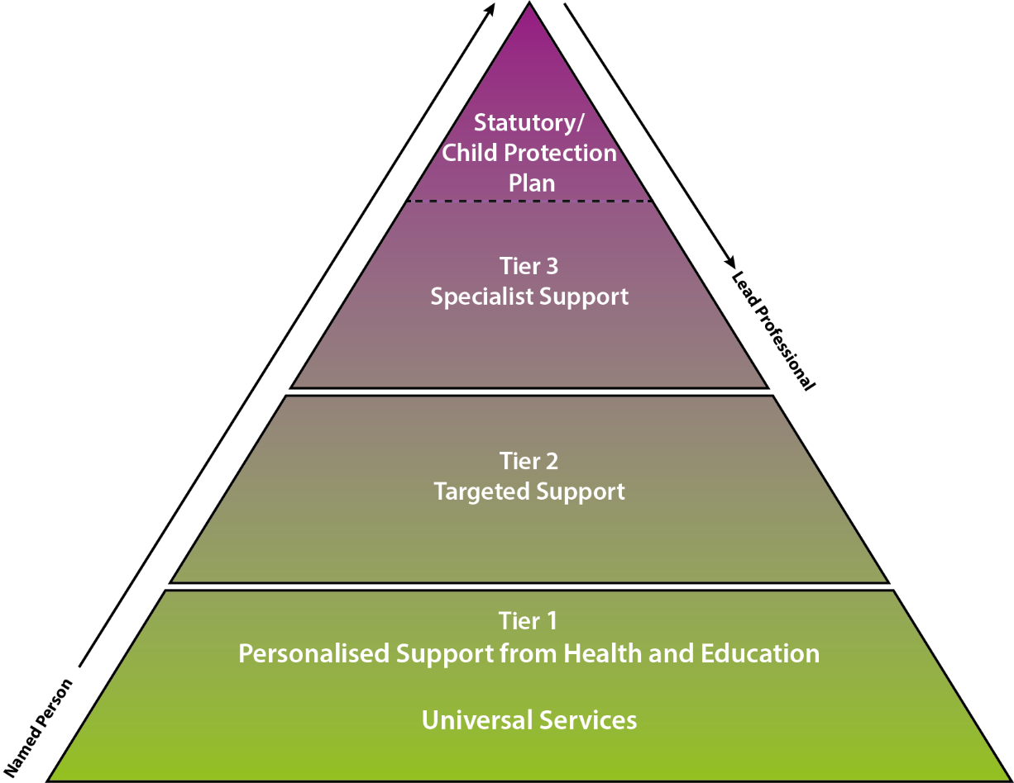
Our GIRFEC Framework - relies on shared data, shared commissioning and the pooling of resource
Tier 3 The supports or concerns are such that the child or young person will require specialist support from at least two agencies to address their wellbeing and welfare needs.
Tier 2 In consultation with the child/young person and parent/carer, more targeted support may be required to alleviate identified challenges. This may be a multi-agency approach, which will require a multi-agency Child’s Plan
Tier 1 Universal Services support children, young people and their families, providing personalised support to address concerns before they escalate.
Notes:
Eleanor

Slide 7
So how do we organise ourselves?
CAMHS, MHLD, OOH SW, Justice Social Work, SW Adult - Physical Disability
Children’s Social Work
Fit Like
Links Hub
Settle in the city
Place 2 Be
Edge of Care pilots
Specialist teams such as AHPs, duty SW and adult/child protection teams
Community Learning and Development, Family Learning, commissioned services, counselling, Educational Psychology
Health Visiting and school nursing, midwifery, Primary Care etc.
Early Learning and Childcare, schools and Family information Service
Notes:
Eleanor and Fiona

Slide 8
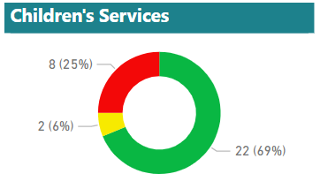
How well are current arrangements improving outcomes for children and young people?
LGBF Outcomes
68% of LGBF outcomes are improved (national average is 64.5%)
6% of LGBF outcomes are unchanged
25% of LGBF outcomes are decreasing
Only 4 Local Authorities improved at a faster rate.

Slide 9
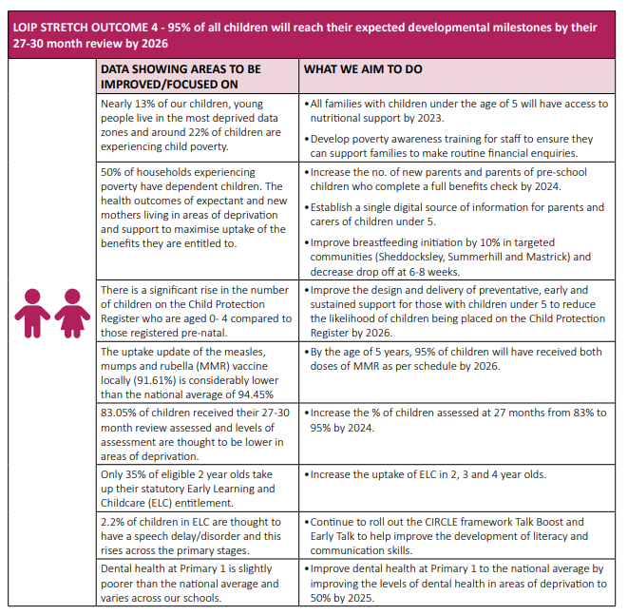
Stetch Outcome 4 95% of all children will reach their expected developmental milestones by their 27-30 month review by 2026 What do our prospective parents need to help them raise healthy children? What can each partner do to ensure appropriate nutrition for babies, the under 5s and their parents and carers? How can we work together to better predict risk and address risk to children and families? How can we join up delivery of services for those with children under 5 and take advantage of the progress we have made? How can we hold each other to account?
Notes:
Fiona

Slide 10
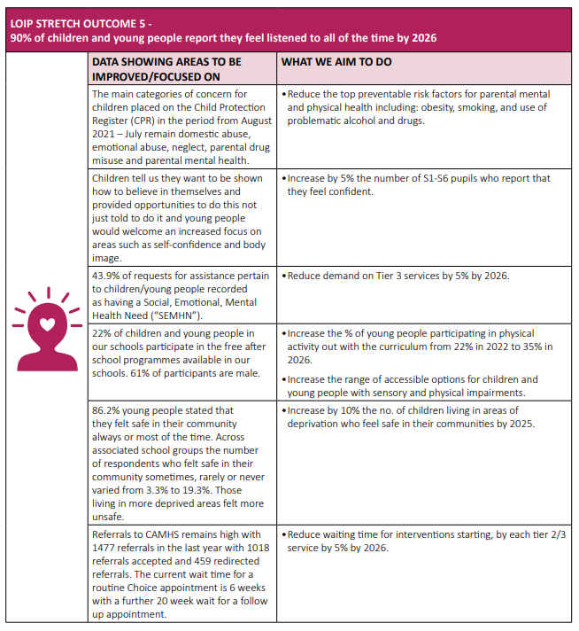
Stetch Outcome 5 90% of children and young people report they feel listened to all of the time by 2026. How can we work together to better address the established risk factors across children and adult services and avoid any unintended consequences resulting from silo working? How can we pool resource to strengthen the continuum of support for mental and physical wellbeing with a focus on prevention? How can we take decisions on the use of resource together to make sure that we look at the whole picture? How can we build the resilience of children and families together?
Notes:
Fiona

Slide 11
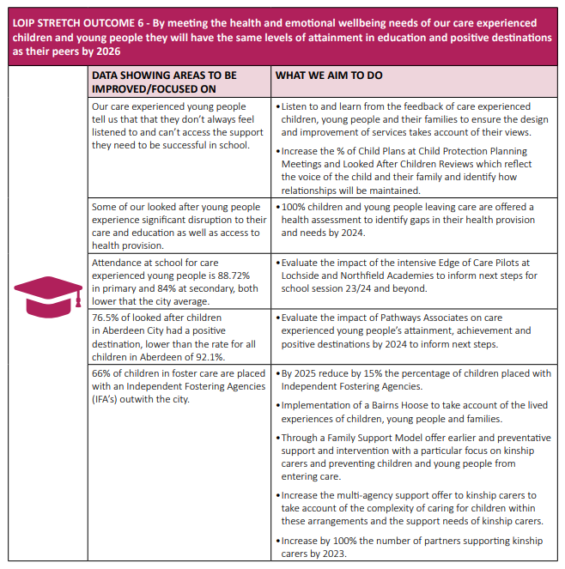
Stetch Outcome 6 By meeting the health and emotional wellbeing needs of our care experienced children and young people they will have the same levels of attainment in education and positive destinations as their peers by 2026.
How can we fully integrate to improve outcomes for those who have care experience?
How can we organise ourselves to built shared responsibility and accountability for the outcomes of the care experienced? How do we better manage the transition from children’s to adult services for those who have experienced care? How can we better prepare the care experienced for parenthood?
Notes:
Graeme

Slide 12
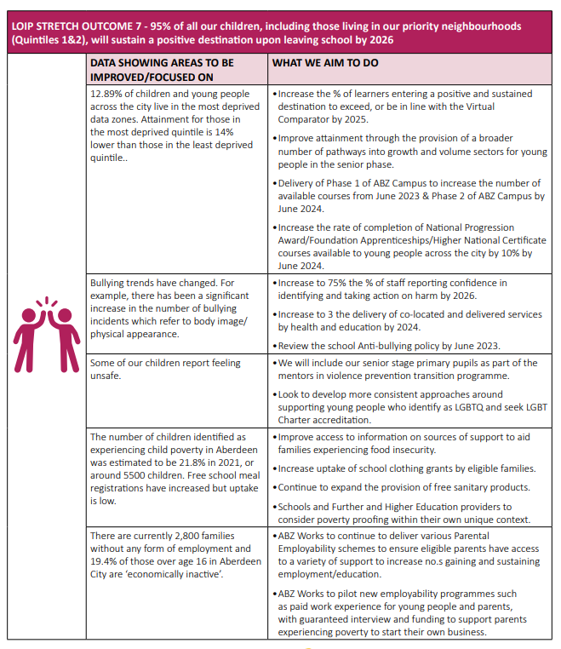
Stetch Outcome 7 95% of children living in our priority neighbourhoods (Quintiles 1 & 2) will sustain a positive destination upon leaving school by 2026.
How can we use the school senior phase to reduce the recruitment challenges in some health and social care roles? How can we reshape the senior phase to address growth sectors to support the economic property of the region? How can we build further co-location and co-delivery opportunities across education, health, social work and beyond?
How can we address the employability needs of the region and our families by greying some established areas of responsibility?
Notes:
Eleanor and Fiona to jazz hand

Slide 13
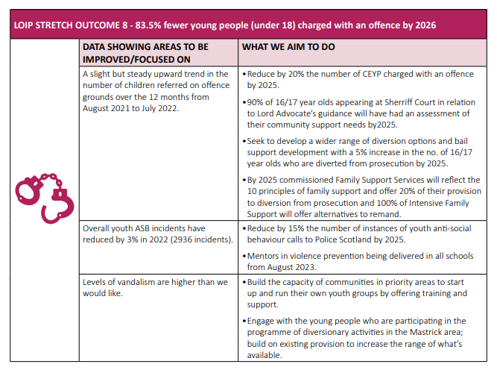
Stetch Outcome 8 83.5% fewer young people (under 18) charged with an offence by 2026.
How can we work with partners to increase the range of diversionary options How can we strengthen the universal offer made in schools? How can we increase the provision of preventative support?
How can we engage young people more positively in their communities?
Notes:
Graeme

Slide 14
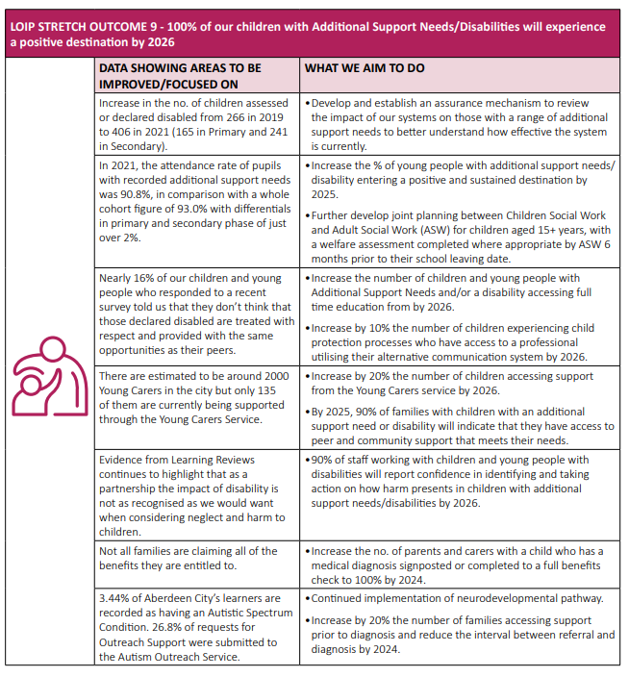
Stetch Outcome 9 100% of our children with Additional Support Needs/disabilities will experience a positive destination
How can we join up provision more fully so that it feels like one unified continuum of support from cradle to grave? How can we improve our use of shared data to help determine the impact of our continuum? RfA
How can we provide a more responsive continuum of support to better meet the needs of children and families?
Notes:
Fiona

Slide 15
Alignment to our Child Protection Programme
The Children’s Services Plan requires “partners to deliver high quality, joined-up, trauma-informed and responsive and preventative support to children and families….”
Aberdeen City’s current Child Protection Programme (2021 -24) has seven identified priorities and 5 of those are well embedded in the Children’s Services Plan
Child protection and disability
Neglect
Exploitation and missing children
Children protection and domestic abuse
Listening to children, their families and hearing their voice
30% of all improvement activity in the Children’s Services Plan is aligned to the Child Protection Programme.
Early delivery of a Bairns Hoose.
Notes:
Graeme

Slide 16
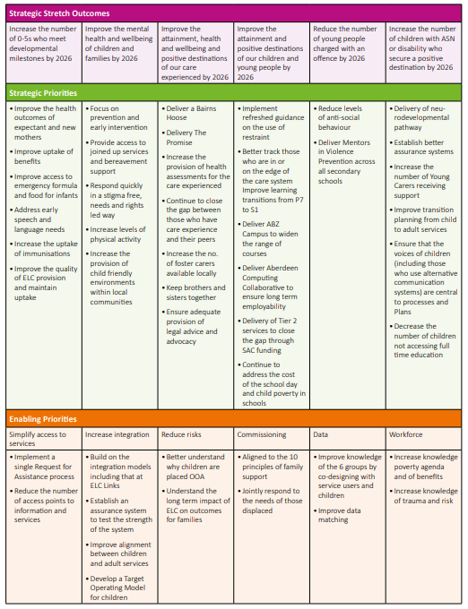
Strategic Plan on a page Enabling priorities Simplify access to services Increase integration Reduce risks Shared commissioning Joining up data and D365 Joint workforce development
Notes:
Eleanor

Slide 17
Children’s Services Strategic Plan 2023-26 Children and young people's version Summary

Slide 18
Getting it Right for Everyone
GIRFEC and GIRFE

Slide 19
Joint delivery of services We have well established approaches to the joint design and delivery of services, these were accelerated during the pandemic. We have moved past organisational boundaries, share physical office space and work as a whole system.
Notes:
Eleanor

Slide 20
Particular successes include:
Hub provision during the pandemic
Settle in the City provision
The Links Hub
Fit Like Service
Edge of Care pilots
Our default position is how can we address risk together. Approaching planning and delivery in this way has changed out default position.
Notes:
Hub Provision – Eleanor
Settle in the city and Links Hub – Fiona
Fit Like service and Edge of Care - Graeme

Slide 21
Focus on transitions
Notes:
Graeme

Slide 22
GIRFE
Now that our refreshed GIRFEC Operational Guidance is in place we are looking at how we can work to get it right for all with disability in the first instance.
Notes:
Graeme

