Slide 1
Care at Home Provision Wednesday 3 May 2023

Slide 2
Current Picture
On average 47 referrals per week
Waiting times for assessment fluctuates between 6 – 11 weeks
Oct 22 – 161 clients waiting for assessment. Today it is 120. Target is to be below 50 by mid May
Since 2017 there was 80% increase in unmet need and 119% increase in hours required.
Significant drop in unmet need
Notes:
for 18 months the aim is to provide an additional 1500 hours to bring the unmet need down to zero.
8 week project to target waiting list

Slide 3
Managing Unmet Need - Community
Notes:
You will see our data taking on 5th April over the last 3 years. You can see the increase in demand. Our figures for this year show the marked difference in our unmet need and care searches.
The focused approach we have taken across the partnership has enabled us to focus on flow, build capacity. This consisted of a redesign of social work teams to fundamentally change how we worked to enable us to meet demand. We changed the way we triaged referrals so signposting could be done immediately. We created a central team for all referrals and assessment is based on reablment and TEC. A review team was established with the same reablement and TEC focused pulling on community resources which has led to a number of packages being reduced. The hospital team are aligned to high referring wards which allows early discharge planning and a home first focus. We meet daily with providers to ensure care searches are prioritized and picked up.
I will give an overview of other work that was done that has helped to get us to this point. But of course there is still more to do.

Slide 4
Commissioning Model
Outcomes focused C@H contract with Granite Care Consortium (Nov 2020)
10 providers
1,302 packages of care provided every week
11,655 hours per week
4 additional C@H providers commissioned over winter 2022/23
Currently providing +522 hours of care
Potential for +2,000 hours of care (dependant on recruitment)
Interim Care at Home model with BAC 2022/23
Provides EOL care at home
Short term emergency care
Notes:
Work was undertaken to target the growing demand and create more capacity. Focus was on reducing waiting times for assessment and reduce unmet need. Goal is to get to zero unmet need. Aim to get point of referral to care is 4 weeks

Slide 5
GCC
Population Overview
1202 individual clients (1302 packages of care)
92 x 2:1 support packages = 1294 clients total
Contracted indicative number of clients is 1261, so we are 33 above that currently.
Planned hours 11,665 (vs. goal of 11,600)
92.1% of packages - 1 GCC provider
7.9% of packages - 2 or more GCC providers

Slide 6
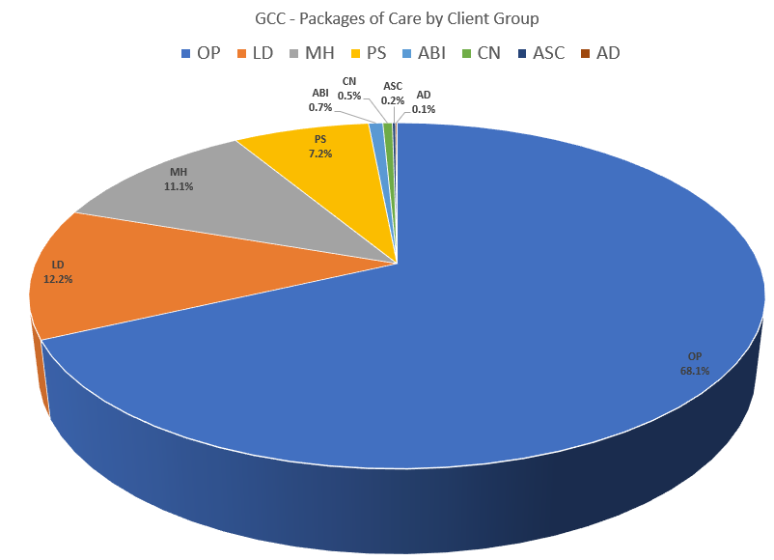
GCC Population Overview
OP = 68.1%
LD = 12.2%
MH = 11.1%
PS = 7.2%
Other Needs = 1.4%

Slide 7
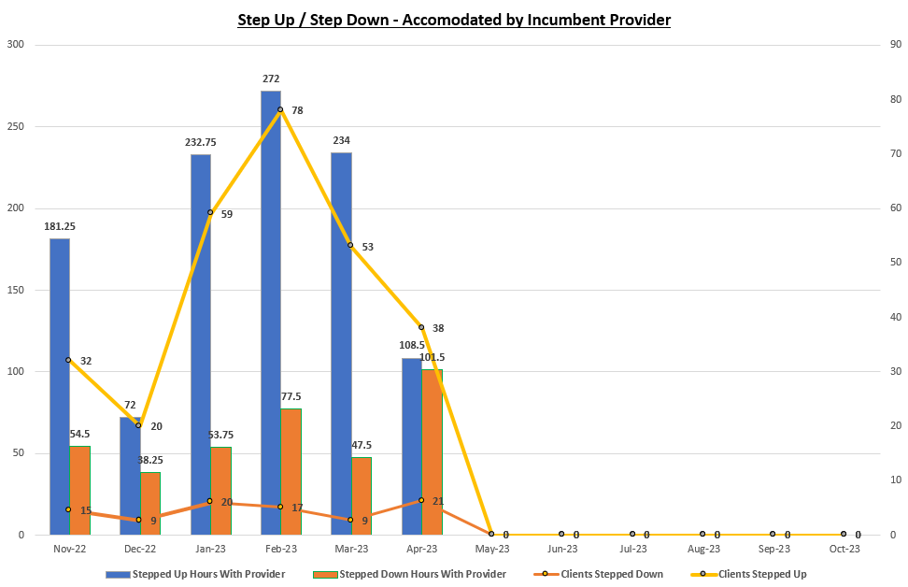
Step-up / Step-down – Accommodated by Incumbent Provider
From Nov 2022
To Date (Year 3)
280 clients have had their packages stepped up (1100.5 hrs)
91 clients have had their packages stepped down (373 hrs)
By their existing provider
Within the existing financial envelope

Slide 8
Key Successes
Key Challenges
Collaboration
Flexibility
Market Stability
Provider stability
Relationships
System revision
Hospital discharges
Admin benefit
System benefits
Pandemic
Recruitment and retention
Moving from hours to outcomes
Complexity and range of packages
Implement our Workforce Plan
Notes:
Daily – DSC plus those with BAC and GCC

