Slide 1
NCS Study Visit
Integration of Public Protection
Friday 5th May 2023
9.30 – 10.15 am

Slide 2
Pre-Pandemic
Public protection committees / partnerships overseen by / accountable to COG, but not fully integrated
Child Protection ‘ahead of’ Adult Protection
Joint Independent Chair
Alignment of some key components of public protection disjointed (eg ADP, VAWP, MAPPA, Homelessness) – Public Protection Lead Officers
Notes:
Graeme

Slide 3
During the Pandemic
Journey towards alignment -
Development of:
Integrated COG Data Dashboard (including ADP, homelessness, MAPPA)
Integrated Covid Public Protection Risk Register
Increased alignment of Child and Adult Protection focus on alignment of other Public Protection forums.
Significant Learning Reviews
Context: CPA Vision / LOIP (early intervention and prevention)
Notes:
Graeme

Slide 4
National Drivers
Joint Inspection 2016
Executive Leadership Group for Public Protection
Joint Independent Chair
Adult Protection Committee review
Governance Framework for Adult Protection
Early Intervention and prevention
Notes:
Claire?

Slide 5
The vision
Evidence outcomes
Culture of learning and improvement
Skilled, supported and knowledgeable workforce
System wide working
Using data to drive service improvement
Preventing harm
Notes:
Claire?

Slide 6
ASP Inspection Findings June 2022
Our Key Processes are effective, with areas for improvement which are outweighed by clear strengths supporting positive experiences and outcomes for individuals;
Our Strategic Leadership is very effective, demonstrating major strengths in supporting positive experiences and outcomes for individuals.
Notes:
Claire
4.2. Key Strengths were identified as:
• The new Adult Protection Social Work Team undertaking collaborative and effective screening of referrals;
• Communication and information-sharing, at every stage of the process;
• Our commitment to joint learning and development;
• Our Vision being well embedded, with a strong culture of strategic change and improvement; and
• Our user engagement strategy and initiatives – including seeking feedback from users at the end of the process, and the Adult Protection Committee’s User Forum.
4.3. Priority Areas for Improvement were identified as:
• Quality of chronologies and protection planning (albeit the inspectors noted that we have well-designed tools and templates in place);
• Length of time taken to complete some investigations and case conferences;
• Lack of consistent and accurate recording by Health staff of their involvement in ASP;
• Need for more adults at risk to access independent advocacy; and
• Need to develop multi-agency evaluation approach, and better involve staff in change and improvement work.
It should be noted that all of these issues had previously been identified as areas for improvement, through local quality assurance and self evaluation work, and related activity had been incorporated into the Adult Protection Committee (APC) Improvement Plan.

Slide 7
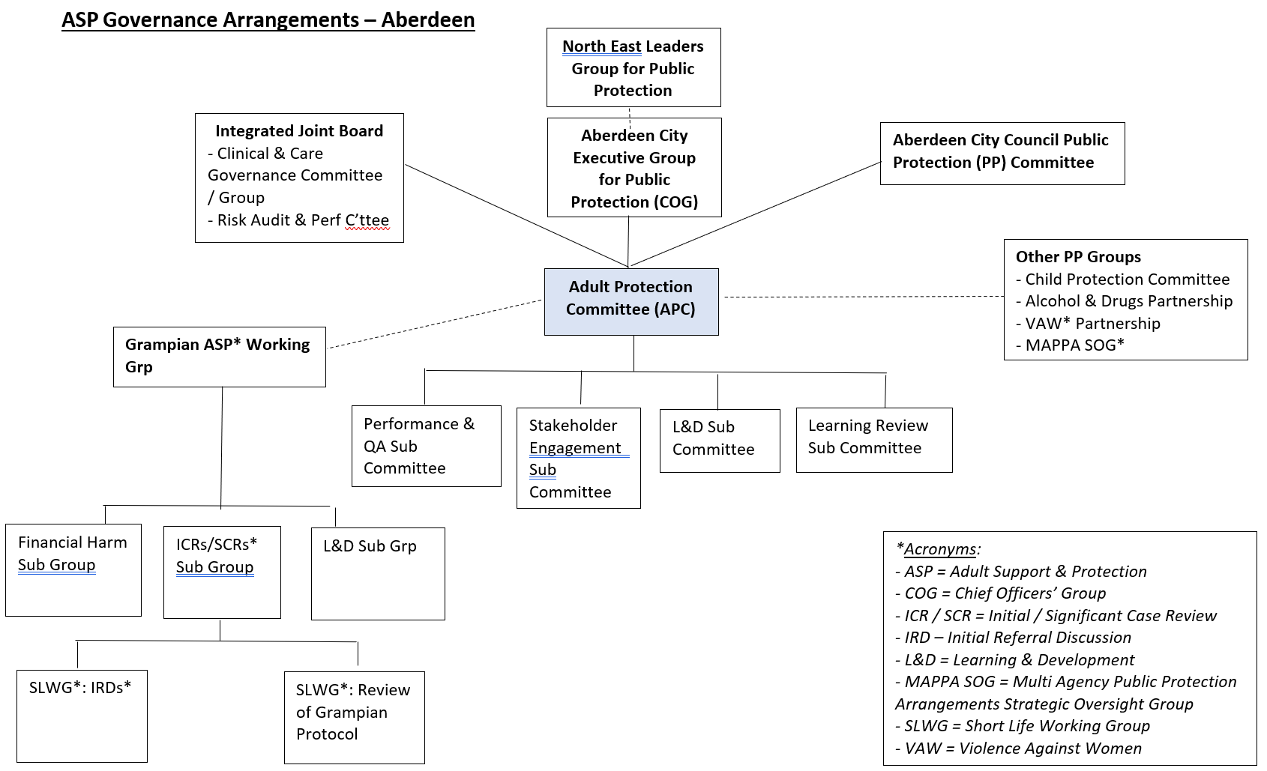
ASP Governance Structures
Notes:
Claire

Slide 8
An Integrated Approach
Common governance structures - Child and Adult Protection
Joint Independent Convener of CPC and APC
Consistent approach to Learning Reviews (same chair of CPC and APC Learning Review Sub Committees)
Aberdeen Protects website
Increased coordination of policies
Joint working (eg Bairns’ Hoose, Family Support Model, etc etc)
Multi agency Public Protection events
Public Protection Leads group
Notes:
Graeme. Mention the event on 31st May

Slide 9
The journey continues …
Future work to be considered / progressed / supported by the Public Protection Leads group on behalf of COG:
Alignment of L&D (Driver Diagram already developed)
PP Risk Register
Further development of an integrated public protection dataset
Alignment of ‘Comms’/public messaging around PP
A ‘cross-Public Protection’ annual report
And – D365
Notes:
Graeme

