Slide 1
Aberdeen Health Determinants Research Collaboration
Data, Evidence, Research and Evaluation
Martin Murchie, CO Data & Insights
Director of Aberdeen Health Determinants Research Collaborative

Slide 2
Chief Officer Data and Insights, objective:
“to support people make good decisions”

Slide 4
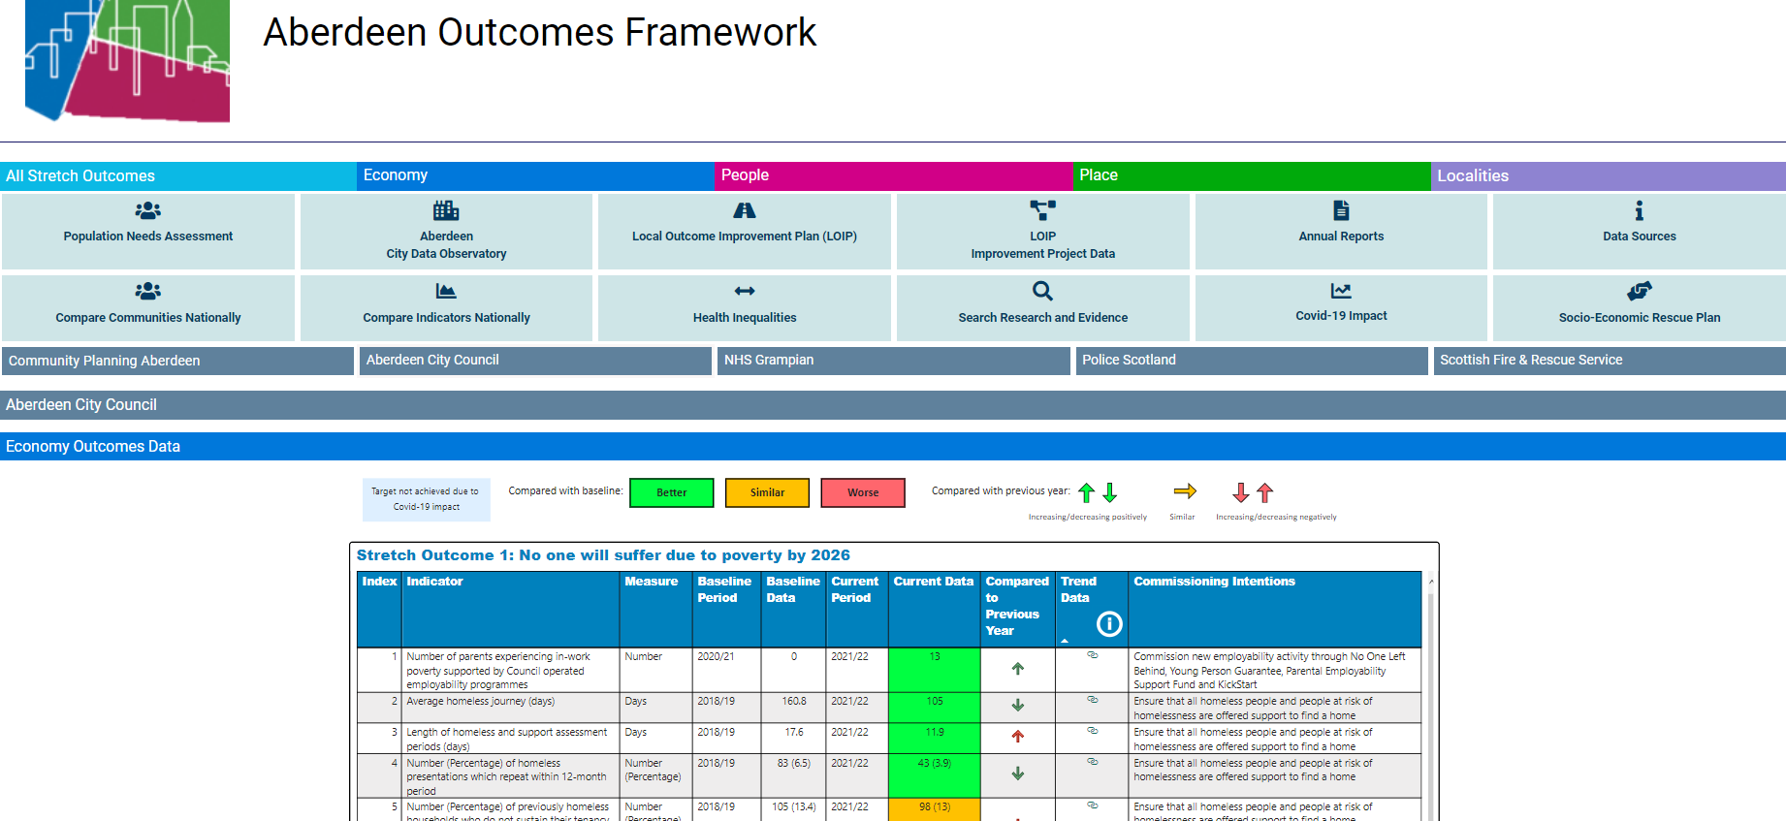

Slide 5
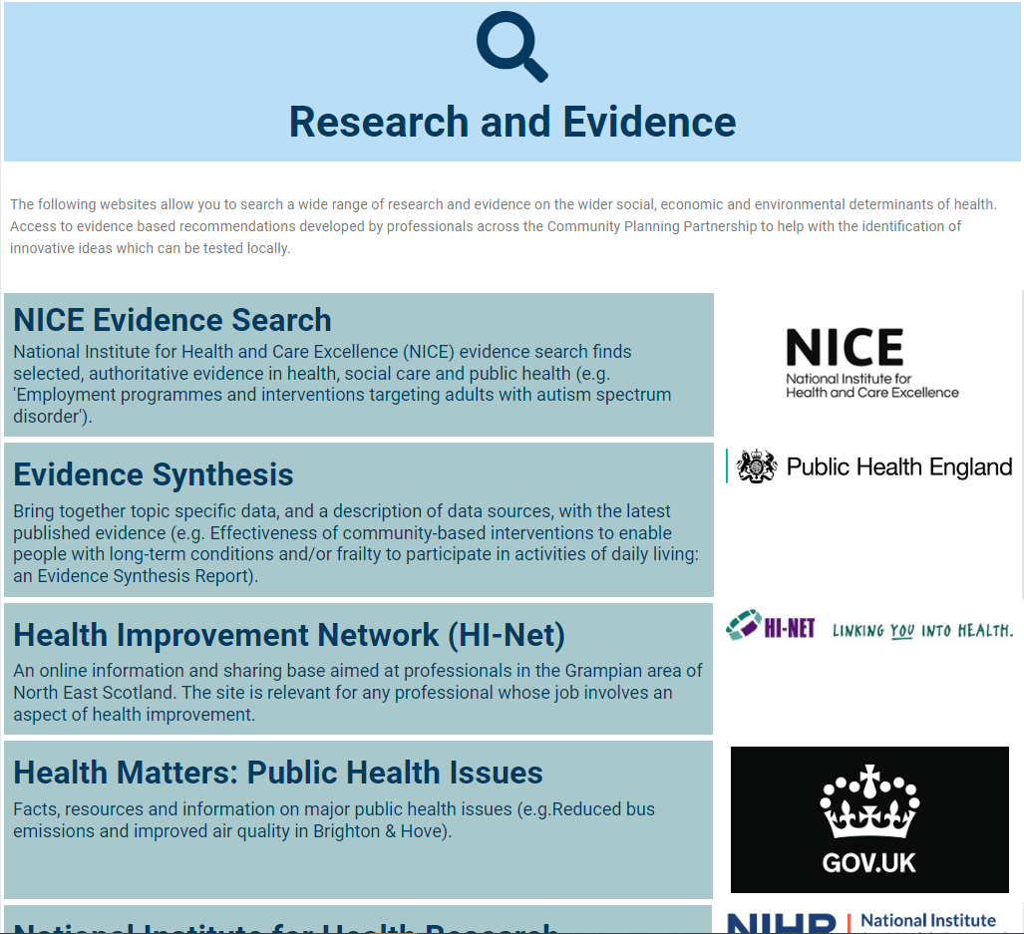

Slide 8
Collaborative Vision
Aberdeen City Council is a research active organisation, commissioning and generating research, curating and translating research evidence to support people to be healthy, happy and prosper regardless of their background or where they live.
The AHDRC facilitates a supportive and sustainable research environment, enabling the acquisition of skills and training, and generating and translating interdisciplinary research that will support a post-pandemic recovery, a sustainable and just economic transition, reduce current and prevent future health inequalities, and improve health in the City, Scotland, the UK and internationally.

Slide 9
Headlines
Firmly within the governance of Community Planning Aberdeen
£1M per year for 5 years, for capacity and capability (not to fund specific research)
Only Scottish collaborative (currently)
Growing community of academic collaborators
Connected to national organisations (Public Health Scotland; Research Data Scotland; Chief Scientist Officer; Improvement Service; etc)

Slide 10
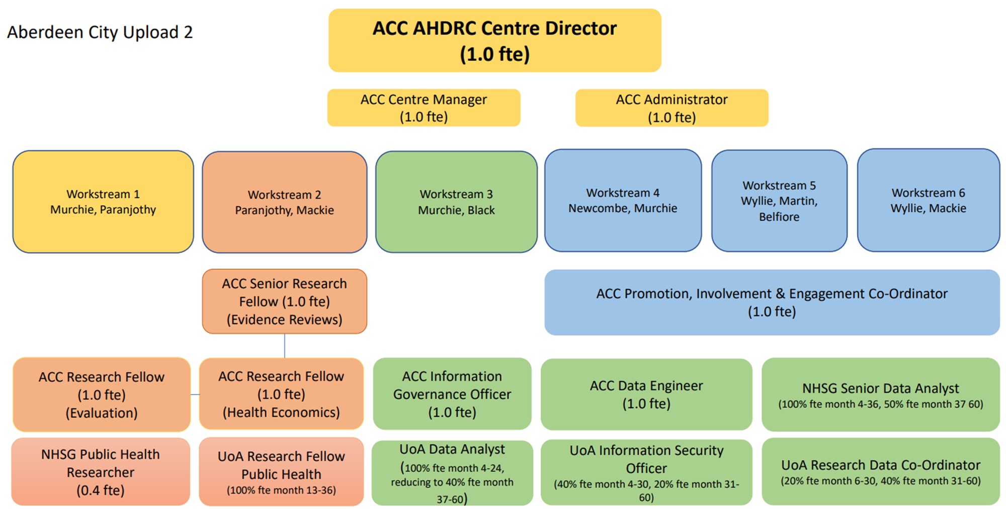
Workstreams and Posts
Research Capacity & Leadership
Generate Evidence to Support Decision-making
Research Data Eco-System
Research Culture & Skills
Engagement
& Involvement
Knowledge Dissemination

Slide 11
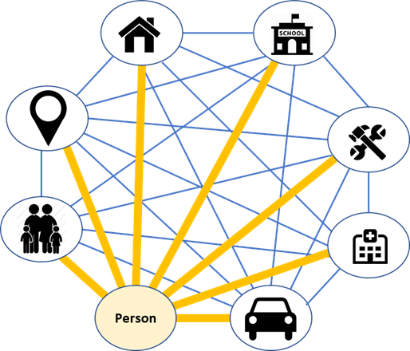
Research Data Eco-System

Slide 12
Generate Evidence to Support Decision Making

Slide 13
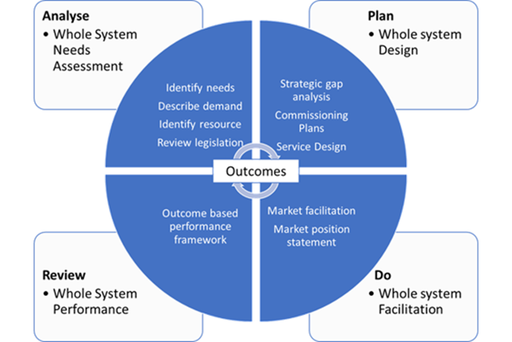
Planning evaluation when commissioning
Evaluating impact
Based on your assessment of need, what problem are you trying to solve through this commissioning? (Analyse)
What do stakeholders think, want and need to address the problem? (Analyse)
What are the specific outcomes we want to achieve? (Plan)
How will we get there and who will collect and monitor the data? (Plan / Do)
What outcome were you trying to improve?
What metrics (output or indicators) did you use to measure success?
Did we do what we said we would or did changes have to be made based on the emerging data?
How are our success indicators moving over time?
Did the intervention work as expected?
What was the impact? Who/why?
Was the intervention cost effective?
What are the outputs and indicators that might signal improved outcomes and how could we monitor them? (Plan)
Commissioning & Evaluation ...

Slide 14
Academic Collaborators
Priority Questions
Potential Actions
AHDRC Resources
Early Learning & Childcare
Social Prescribing
Food insecurity
Housing condition
Drug related deaths
City Centre Masterplan
… etc
Evidence reviews
ACC insights
Supported evaluation
PhD / Masters students
Support funding for research
Academic collaborators
Community led research
Advice, guidance, mentoring
…
ACC Services
ACC Insights
Multi-agency
External Funding
National Networks

Slide 15
So what questions are we trying to answer?

Slide 16
Theme | Topic Areas | Potential research focus in these topics
Children and Young People | Whole Family Well-being | Many of the above topics can be intersectional, so options for research covering multiple topics focusing on “whole family”
 | Care experienced children | The “edge of care” - factors and prevention
 | Early, Learning and Childcare | Early years assessment of developmental needs Parental employment
 | Mental health & wellbeing | Impact of lifestyle, relationships on mental wellbeing
 |  | Identifying and responding to neglect and harm
 | Additional Support Needs | The growing numbers of C&YP with ASN;
 | Transitions | Starting primary school Starting secondary school Positive destinations for children leaving school
 | Young people charged with an offence | Prevention
Adults | Housing Condition | Refurbishment of existing local social housing – imperatives and challenges re energy efficiency, climate and health impact The impact of housing physical and social environment, including ASB, on mental health
 | Homelessness | Effectiveness of prevention and response
 | Alcohol consumption | Effectiveness of prevention and response
 | Drug related deaths | Effectiveness of prevention and response
 | Criminal convictions & reconvictions | Violence Against Women
 |  | Antisocial behaviour
 | Healthy life expectancy | Social Prescribing
 |  | Active ageing
 | Food insecurity | Household food insecurity
Economy | Poverty / Financial Inclusion | Financial support Disparity and needs of groups at higher risk of child poverty
 | Employment, employability & fair work | Economic impact on parents and carers Occupational change
 | Energy transition | Just transitions
Place | Active travel | All populations / demographics
 | Land use | Housing, open space, climate
 | Climate change | Resilience / sustainability
 | Nature crisis / biodiversity | Impact / mitigation
 | Place Planning | Blue / green open spaces
 |  | City Centre Masterplan
PPIE | Engagement and Inclusion | Whole system Arts based

