Slide 1
Same data system for 20+ years
Anomaly – Disparaged v Trusted
Clunky;
slow;
not intuitive;
closed permissions.
Shelf life
User Experience
Social Work Perspective Pre D365
Change frequently imposed occurred offsite
No collaboration with SW needs.
SW comfortable looking at human relations
Digital lens under developed suspicious.
Multiplele ‘work arounds’
Plethora of spreadsheets.
Outcome reporting very limited
Collaboration
‘Old Friend’
Improved Management
Notes:
10.05 – 10.10
How the world will be a better place. Stressed workforce, streamlined processes,
Aging 20 year old system
Frontline services are really stretched
Dynamics365 will release time and free up time for you to see your clients.
Maximising new tech
Cross cluster benefit
Build much clearer sight of individual contact with council and what that looks like.
Predictive stuff

Slide 2
No need for
Hard copy templates
Written notes
System re-keying
Email notifications
Access and update information on the go
No need to return to the office to update CareFirst
More meaningful reports
Spot patterns, trends and areas of concerns
Take action earlier
Save Time and Effort
Work from Anywhere
Better data, easier to input, easier to analyse
Social Work Perspective D365
Easier performance reviews
Improved case load allocation
View of every interaction in the system
Fully auditable and traceable
More consistency in ways of working, across all areas of social care
Improved processes
Build picture of an individual’s contact with the council
See who else is working on a client’s case
Collaboration
Clear View of Client
Improved Management
Notes:
10.05 – 10.10
How the world will be a better place. Stressed workforce, streamlined processes,
Aging 20 year old system
Frontline services are really stretched
Dynamics365 will release time and free up time for you to see your clients.
Maximising new tech
Cross cluster benefit
Build much clearer sight of individual contact with council and what that looks like.
Predictive stuff

Slide 3
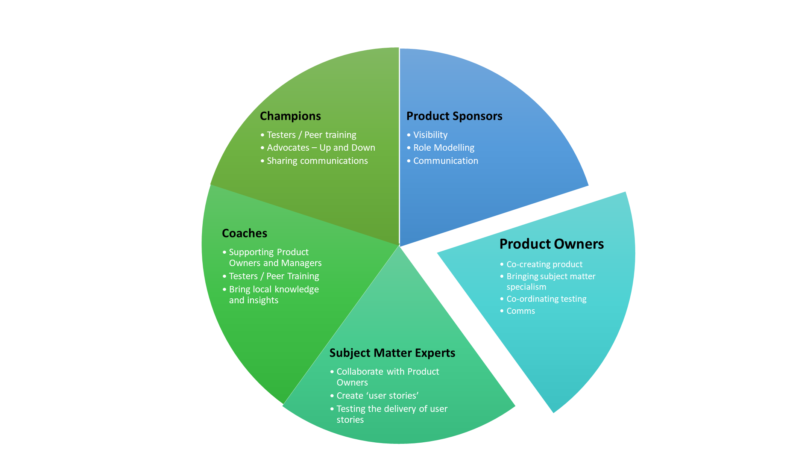
Leaders &
Managers
Roles undertaken by
social work practitioners
Notes:
10.05 – 10.10
How the world will be a better place. Stressed workforce, streamlined processes,
Aging 20 year old system
Frontline services are really stretched
Dynamics365 will release time and free up time for you to see your clients.
Maximising new tech
Cross cluster benefit
Build much clearer sight of individual contact with council and what that looks like.
Predictive stuff

Slide 4
Digital Learning Methods
% USING METHOD TO LEARN SHAREPOINT
% WHO SAID METHOD WAS “VERY HELPFUL”
Percent Using Learning Method vs. Helpfulness
Learning via peers is among the most effective and most used methods
Co-Worker
(Non-Manager, Non-IT)
My Manager
IT Employee
Formal Training (External)
Formal Training (Internal)
Community
Forums
User Guide
or Manual
Microsoft’s Website
Online Tutorials or Webinars
Search Engine
Myself, Through
Trial and Error
Source: SharePoint End-User Study Apr 2013, Microsoft Corporation.
Notes:
People find peer based learning most effective formal training a close second. Interestingly while self-led learning is the most popular is was the least helpful way to learn.
We were also helpfully challenged by the product owner to ensure that the approach met the expectations and needs of the workforce.
With this in mind, we set out to find out how colleagues across Social Work and Finance like to learn and 305 people responded.
What we learned was… CLICK

Slide 5
Getting Ready for Dynamics 365
How are other Service Managers getting ready?
Regular catch ups my product owner
Supporting the tidying up of processes, existing documentation and data reporting and ensuring then can transfer to D365. Calling for sharing of relevant info to be transferred, particularly that held on spreadsheets!
Having been involved in pre elaboration and sprints, I’ve been able to share stages of the process with colleagues
Regular management meeting agenda discussions; feedback from team who are leading on aspects of the design.
Team meetings, supporting Digital Champions, releasing staff to attend sessions during the development and build.
Getting familiar with the technical requirements, and helping teams to appreciate the change and use the facility affectively when it rolls out.
Having digital champion in place within my area of practice. A shift in culture is needed – so I’m attempting to begin to role model some expectation re further move towards digitisation, like live collaborating on documents with colleagues.
Staff have been waiting for a replacement for CareFirst for years. They have been consulted and updated throughout the 365 development process and are keen to got started.
I’ve been in attendance for update meetings in terms of the development of D365. My team managers have also shared their input in terms of being involved in the development of D365.

