Slide 1





Slide 2

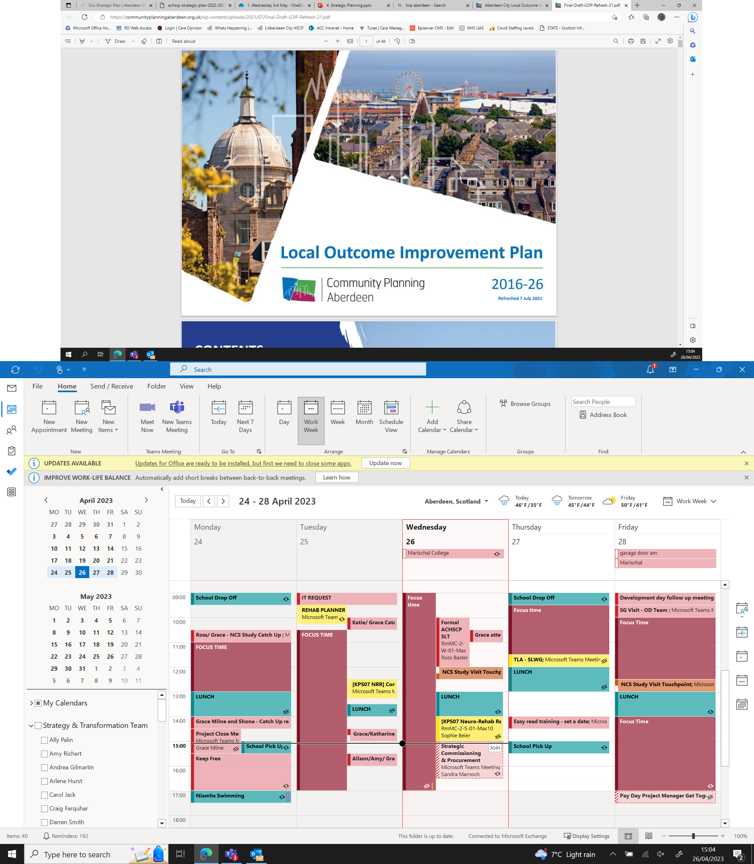


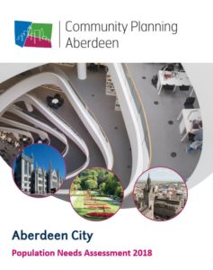
Strategic Planning in Aberdeen
Alison MacLeod

Slide 3
Strategic Planning - Consultation Timelines and Themes
June 2021
LOIP Refresh
NHS Grampian Plan for the Future
December 2021
ACHSCP Strategic Plan
August 2021
Theme | Consultation Source
Prevention/Stay Well Stay Connected | NHSG
Access to Services | ​ACHSCP & NHSG
Quality of Services | NHSG
Whole System, Collaboration, Partnership Working, Relationships | ACHSCP
Sustainability and Recovery from Covid | ​ACHSCP
Engagement/Involvement | ACHSCP, NHSG
Action on Poverty | ​LOIP
Support for Mental Health (all ages) | LOIP
Looking After Staff | ACHSCP
Maximising Digital Technology | NHSG
Alison MacLeod

Slide 4
ACHSCP Strategic Plan
Our Approach – Integration Principles
Review of previous performance/achievements/gaps (2019 – 2022)
Progress against National and MSG Indicators
Strategic Context – PHS, Housing, Digital, Climate Change, The Promise, UNCRC, Feeley
Our Data – increasing demand, increasing inequality
Need for a focus on: -
  Mental Health
  Substance Use
  Carers
  Prevention
  Transformation
  Sustainability
Alison MacLeod

Slide 5

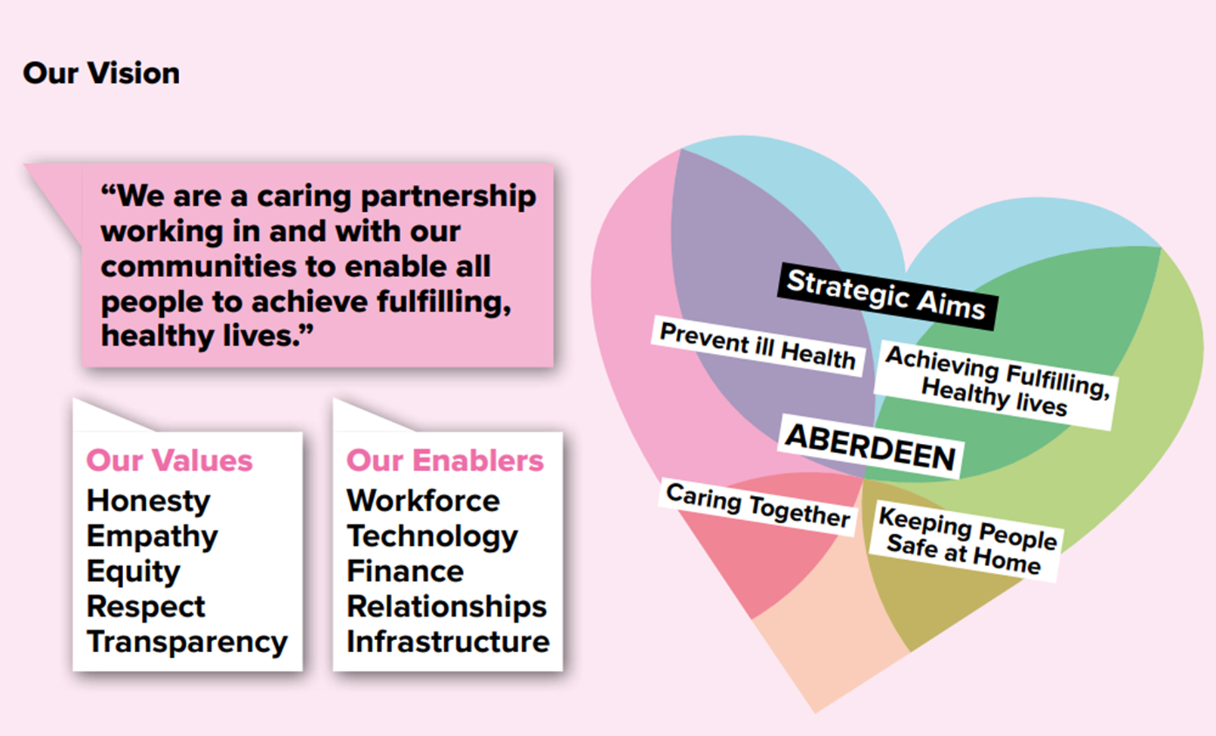
Alison MacLeod

Slide 6
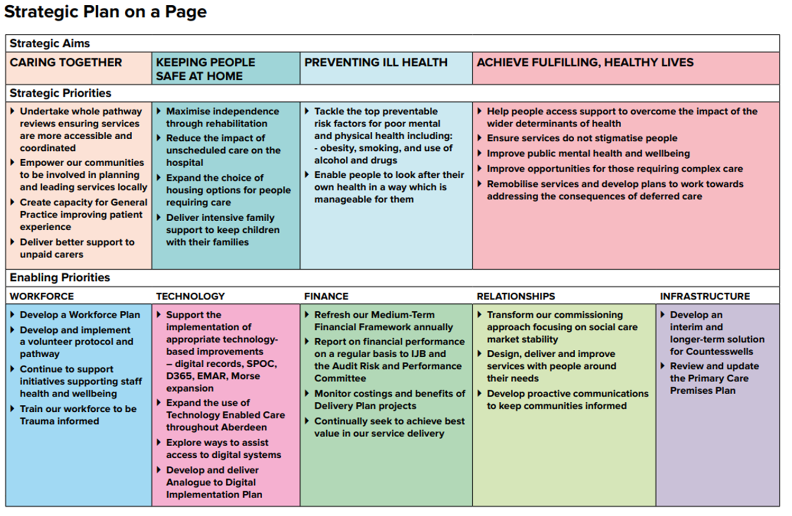
Alison MacLeod

Slide 7
Alison MacLeod

Slide 8
Strategic Planning
National – Strategic Planning and Performance Officers Group (SPPOG)
Regional – North East Strategic Partnership Group, NHS Grampian Whole System and Portfolio Approach
Local – Integrated Locality Planning
Alison MacLeod

Slide 9
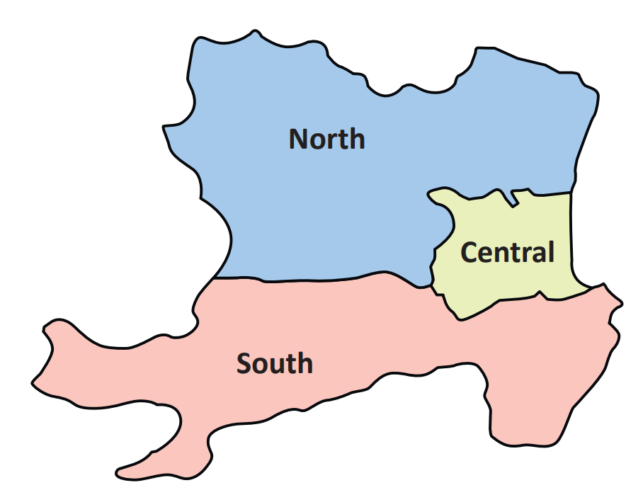
Integrated Locality Planning Model
Localities
Priority Neighbourhoods
North: Heathryfold, Middlefield, Northfield, Cummings Park, Mastrick
South: Torry, Kincorth
Central: Tillydrone, Seaton, Woodside, Stockethill, Ashgrove and George Street
Notes:
Integrated LP model since 2021 following review in 2020
Came on the back of the very close joint working during the pandemic
Time was right to tackle some of the issues around locality planning since the community empowerment act and public bodies joint working legislation introduced the separate duties in relation to locality planning
Had us developing separate models resulting in duplication and confusion

Slide 10
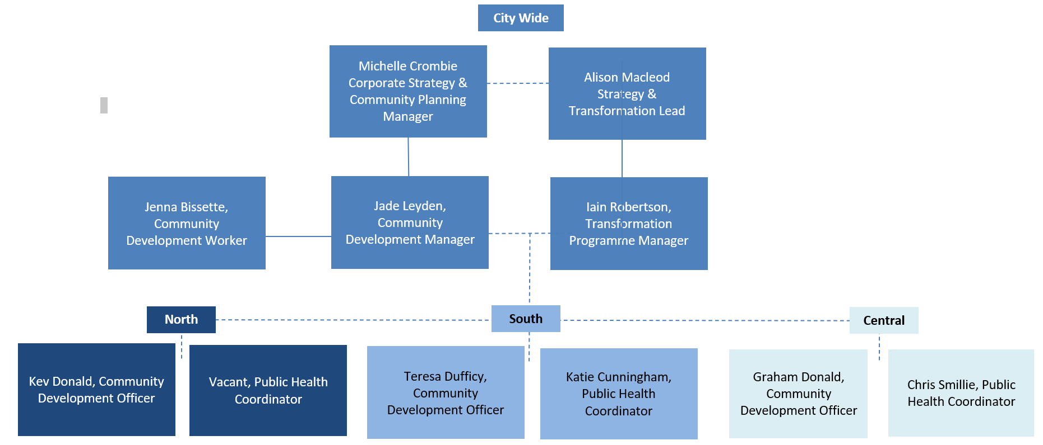


Shared Responsibility and Leadership

Slide 11
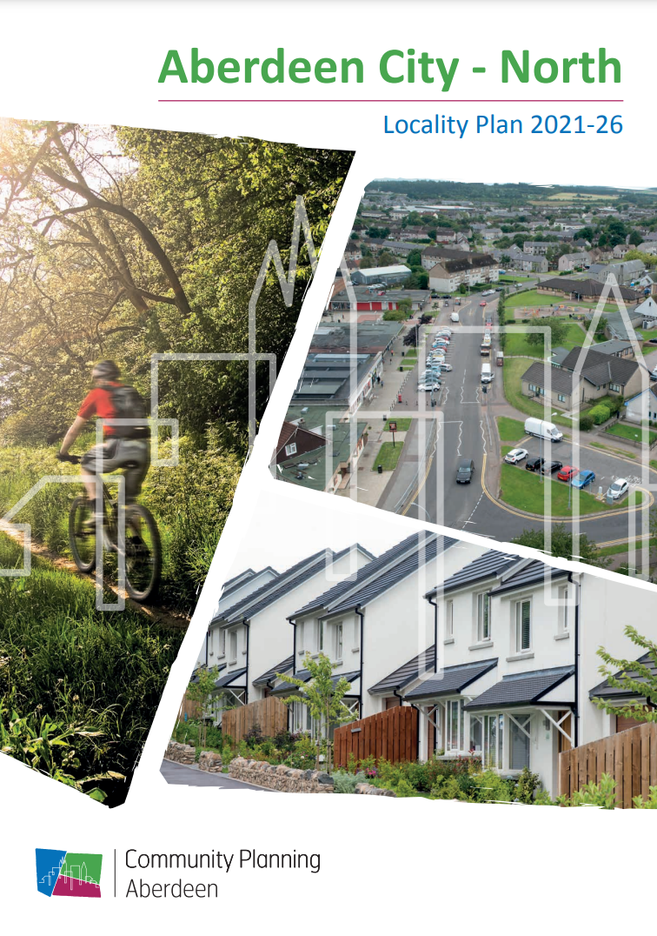


Shared Locality Plans
Priority Neighbourhoods:
Heathryfold, Middlefield, Northfield, Cummings Park, Mastrick
Priority Neighbourhoods:
Torry, Kincorth
Priority Neighbourhoods:
Seaton, Tillydrone, Woodside, George Street, Ashgrove, Stockethill

Slide 12


Shared Community Groups
3 Locality Empowerment cover the whole of the City
They invite community participation in developing and taking forward the Locality Plans
Open to any community member or group
Priority Neighbourhood Partnerships have been set up in the most disadvantaged areas to support communities to engage

Slide 13

Community Connectors
Members of the community or locality based staff
Supported to participate in health improvement projects in their area
Providing community perspective
Helping shape thinking
Ensuring partners are listening

Slide 14
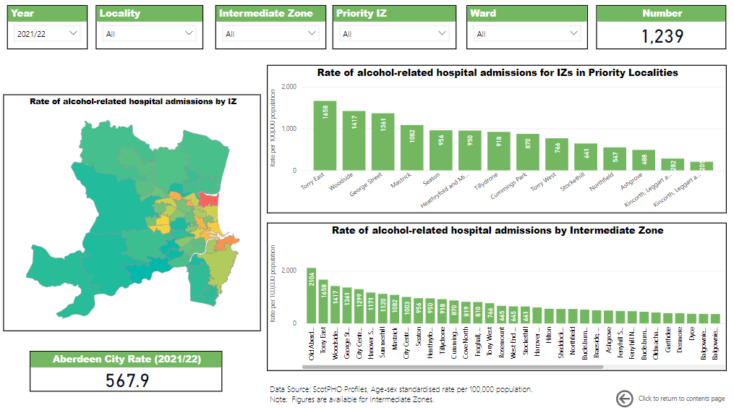

Shared Management of Outcomes

Slide 15

2023-2026

Slide 16
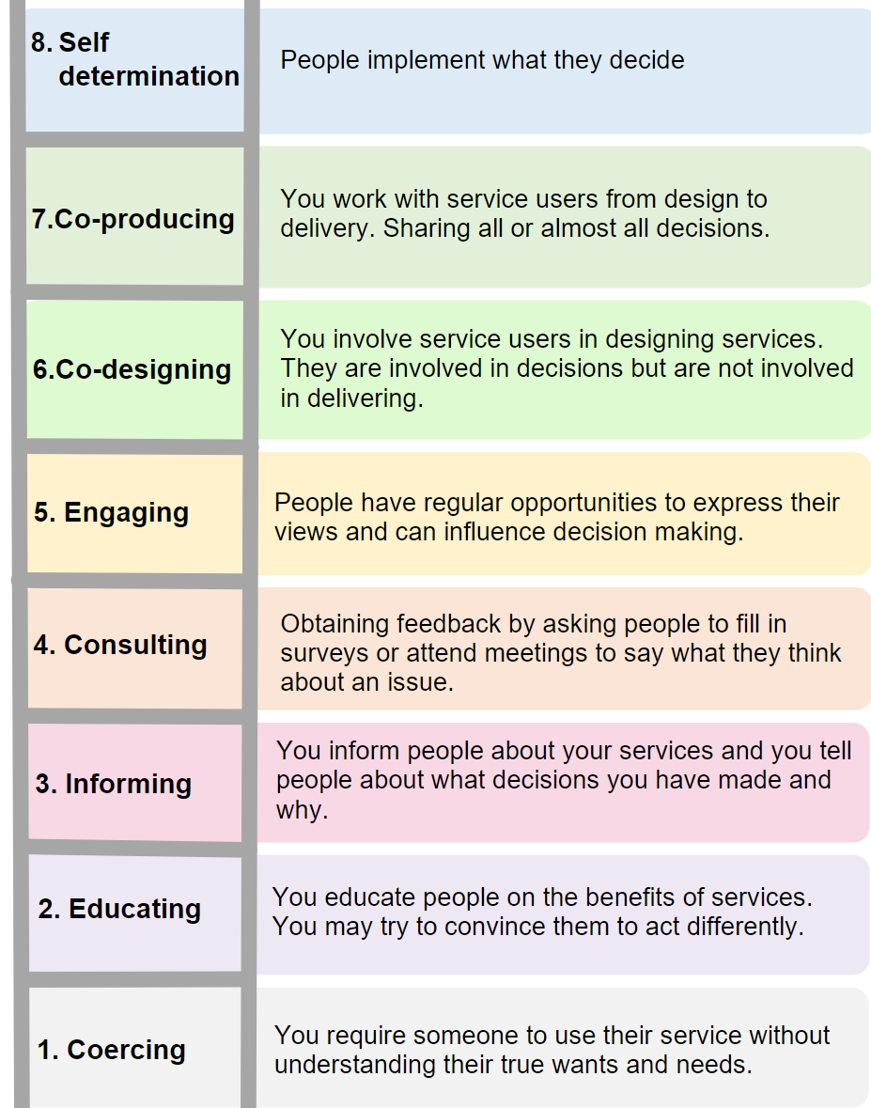
Ladder of Empowerment

Slide 17

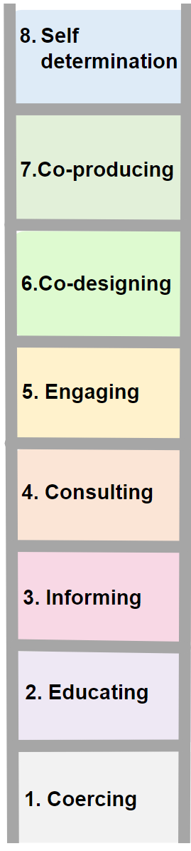
Where we are now
Locality Empowerment Groups
City Voice
Social Media
Community Learning & Development
Community Connector
Participatory Budgeting
Aberdeen Youth Network
Priority Neighbourhood Partnerships
Fairer Aberdeen Board
Simulator
Website
Community Empowerment Network
Community Updates

Slide 18
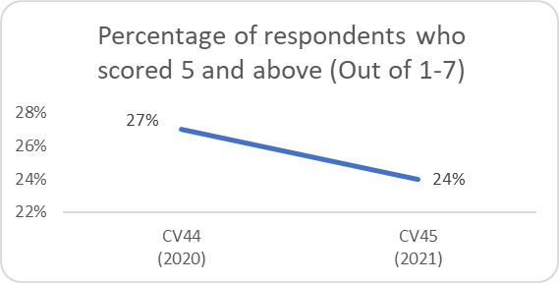
How we will know if we are improving
New Stretch Outcome 16
100% increase in the proportion of citizens who feel able to participate in decisions that help change things for the better by 2026
Baseline 2021: 24%
Source: Aberdeen City Voice Place standard question

Slide 19
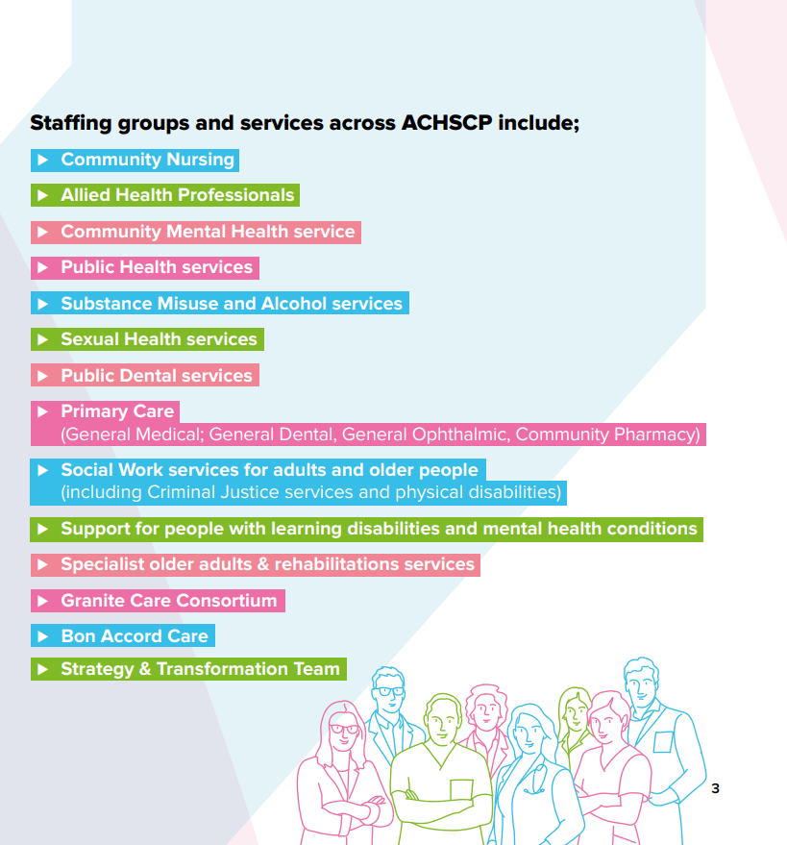
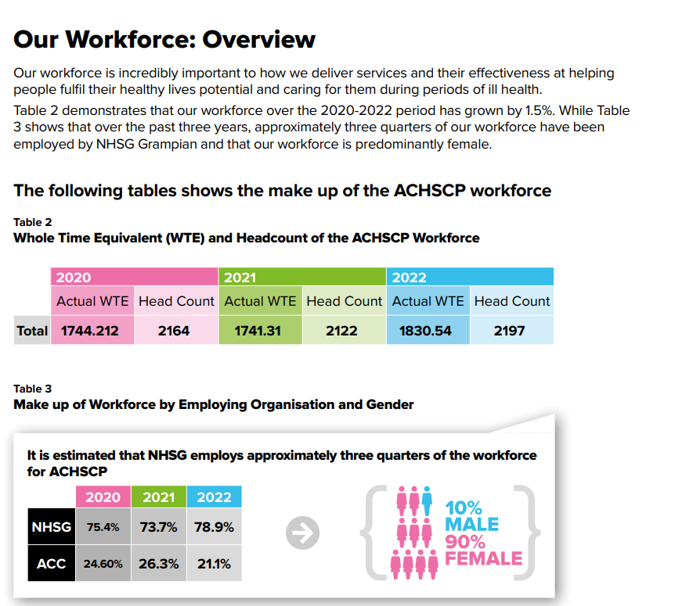
ACHSCP Workforce Plan 2022 – 2025

Slide 20
