Slide 1
Grampian’s Portfolio Approach
A model for planning and delivering integrated services

Slide 2
What is a Portfolio?
“A collection of linked services that sit naturally together. Our health and care system is made up of several Portfolios and each Portfolio works in a different way to improve the health of our population”

Slide 3
Integrated Family Portfolio
Adult Medical / Unscheduled Care Portfolio
Aberdeenshire Services Portfolio
Integrated Specialist Care Services Portfolio
Aberdeen City & Mental Health / Learning Disability Portfolio
Moray Portfolio
Population Health Portfolio
What are the Grampian Portfolios?

Slide 4
Cross Portfolio view
Our Plan for the Future “Healthier Together 2022 – 2028”
People |  |  | Places |  |  | Pathways
Citizens | Children | Colleagues | Being an anchor organisation | Communities | Environment | Empowering | Access | Whole system working
No citizens in Grampian will be left behind | Children are given the best start, to live healthy, happy lives | Colleagues are empowered to succeed, and be safe and well through work | We have social responsibility, beyond healthcare | Playing our role with partners for flourishing communities | We are leaders in sustainability, minimising our environmental impact | Grampian’s population is enabled to live healthier for longer | Patients are able to access the right care at the right time | Joined up and connected, with and around people
Measureable Benefits and Whole System Outcomes achieved by Portfolios
Population Health Portfolio
Exec Lead: Susan Webb
Exec Lead:
Geraldine Fraser
Exec Lead:
Paul Bachoo
Exec Lead:
Sandra Macleod
Exec Lead:
Sandra Macleod
Exec Lead:
Pamela Milliken
Exec Lead:
Simon Bokor-Ingram
Shared Portfolio Objectives and Outcomes
Shared Portfolio Objectives and Outcomes
Shared Portfolio Objectives and Outcomes
Integrated Family Portfolio
Integrated Specialist Care Services Portfolio
Adult Medical/ Unscheduled Care Portfolio
Aberdeen City & Mental Health/ Learning Disability Portfolio
Aberdeenshire
Services Portfolio
Moray Portfolio
Women & Children
Surgery /CSS
Medicine / Unscheduled
Mental Health / Learning Disability
Aberdeenshire Services
Dr Gray’s
PGv2.0200223

Slide 5
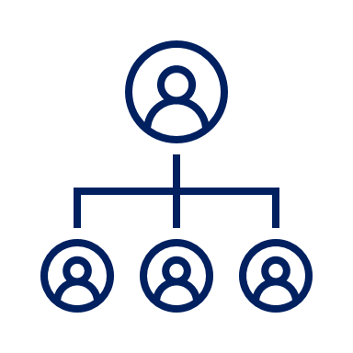
Why do we need a Portfolio approach?
Hierarchal structures are not effective at addressing wicked issues
The system is not managing increasing demands and health inequalities are rising
Opportunity to build relationships and create solutions through more integrated cross departmental / organisational working

Slide 6
Improved efficiencies related to service planning and delivery
Appropriate level of care in and out of hospital within available resources
What does success for Portfolios look like?
Grampian is a place people want to work in health and care
Support people to keep well at home

Slide 7
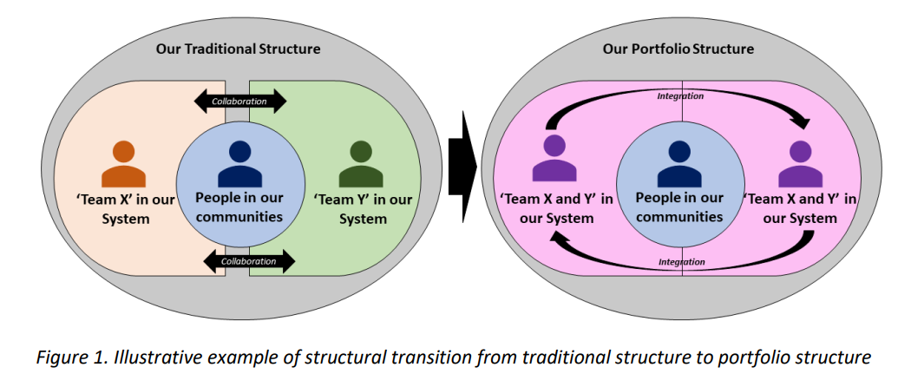
What do Portfolios mean for people living in our communities?

Slide 8
Common purpose & unifying vision
Maximising digital
Empowering teams to develop innovative solutions
What principles underpin the Portfolio approach?
Iterative, embedded approach to learning & evaluation
Positive engagement culture with staff and communities
Ensuring a well developed network that spans the system

Slide 9
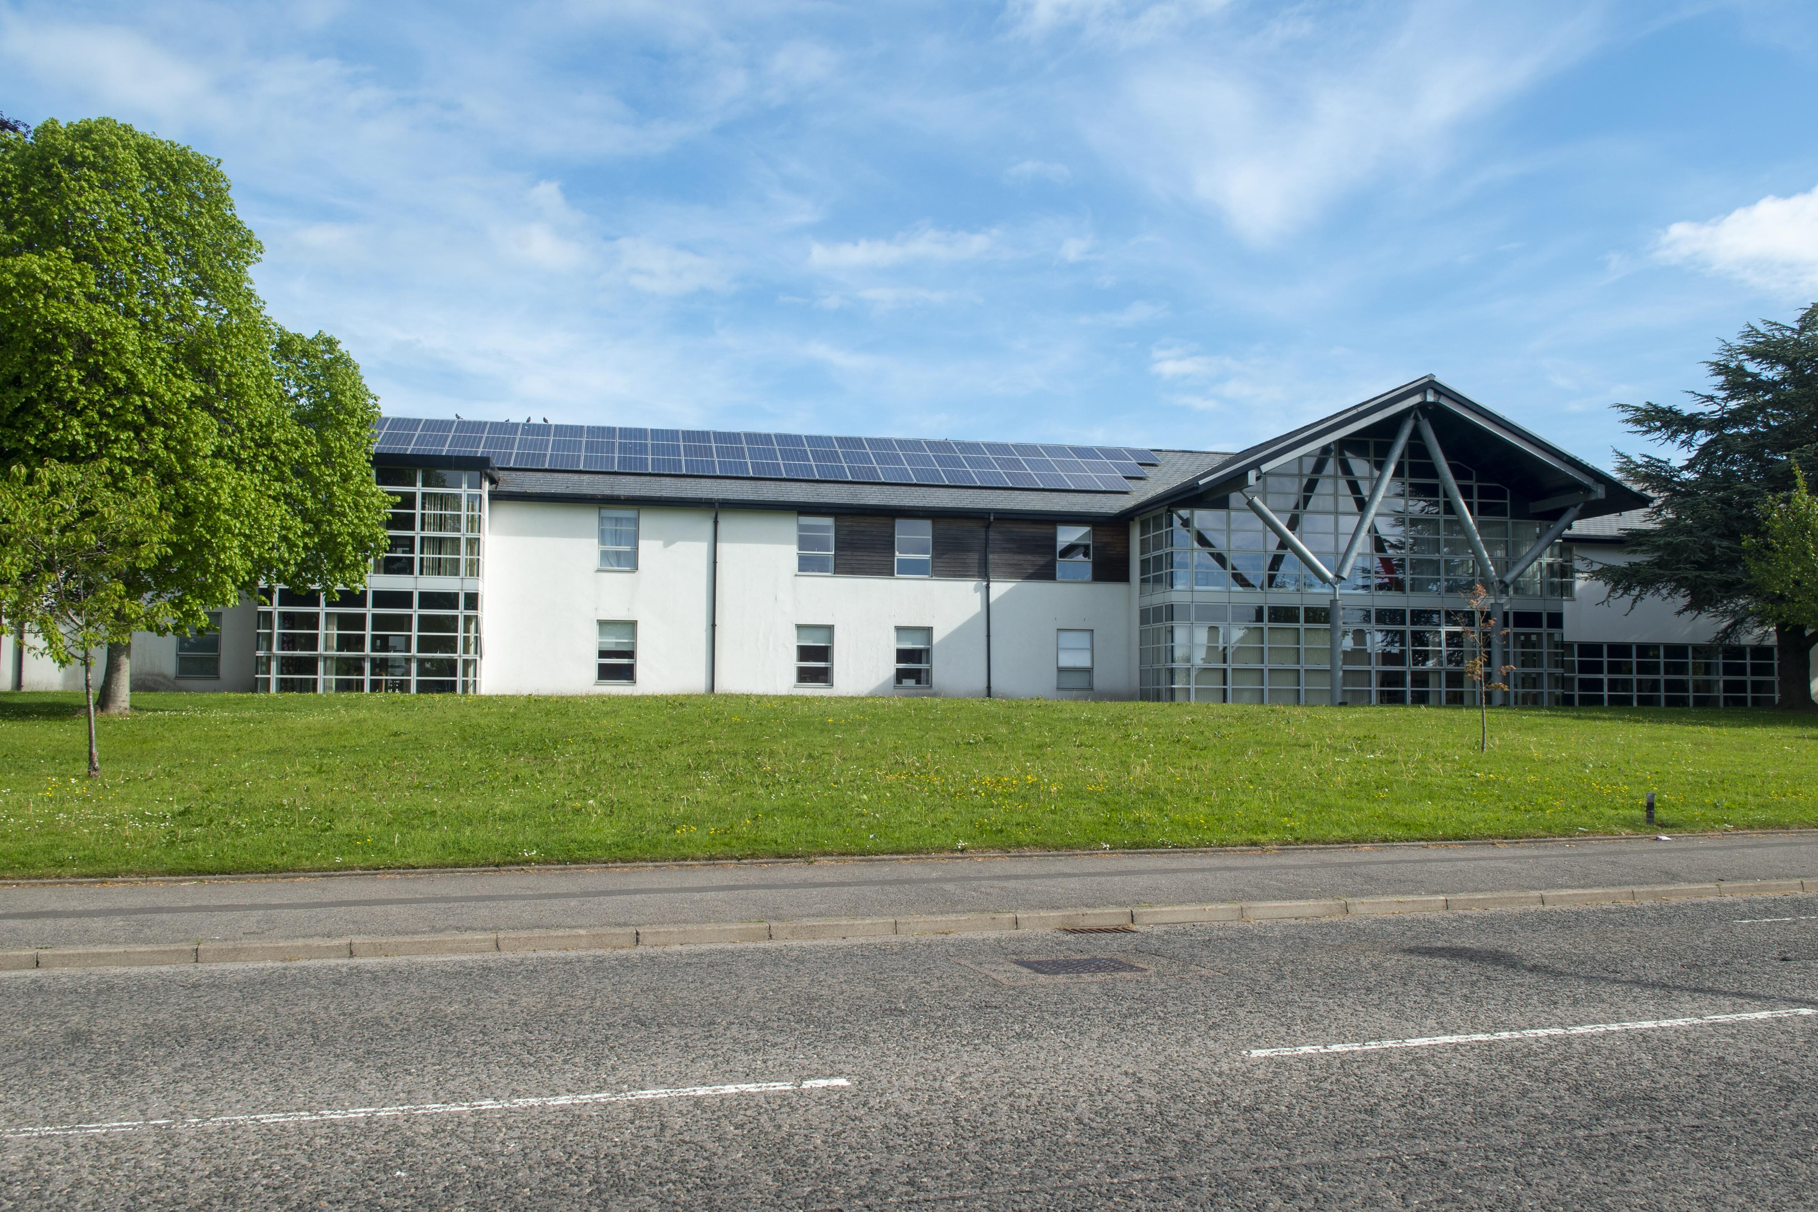
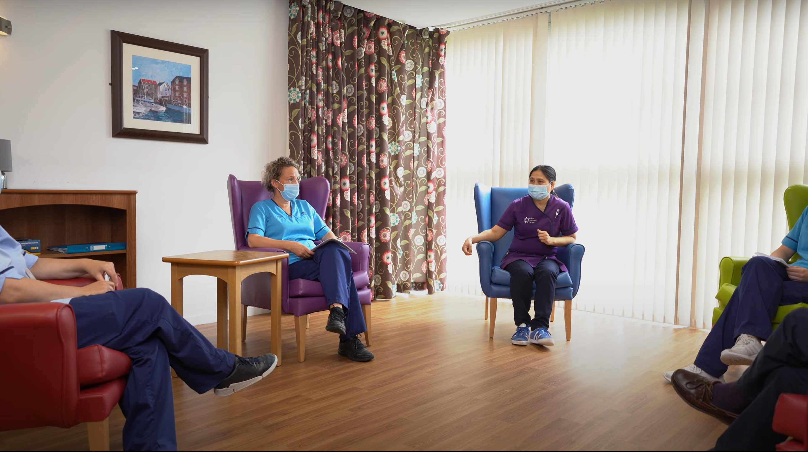
Rosewell House
What kind of initiatives can Portfolios deliver? (Case Study)
“The staff were friendly, attentive, made me feel I was well care for. Very nice.”
Service User
Rosewell House
>700
Referrals to date
Rosewell
Step-Down care from hospital
Step-Up care from community

Slide 10
“An exciting new chapter of integration and whole-system working”
“An environment in which staff can thrive and find joy at work”
What do Portfolios mean to us?
“Bringing everyone together to deliver seamless support to our population”
“An opportunity to strike the right balance between community and hospital care”

