Slide 1
Frailty Pathway Wednesday 3rd May 2023

Slide 2
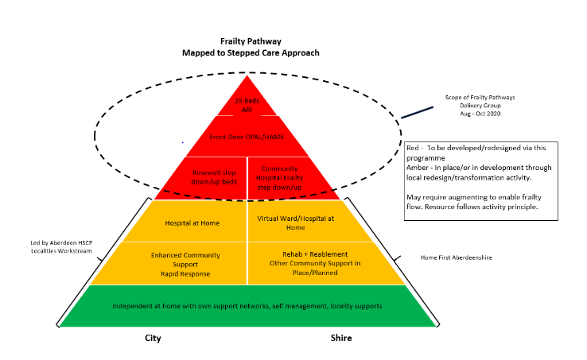
Frailty Pathway

Slide 3
Work to Date
Frailty Pathway
Rosewell House:
Next focus:
Vision – integrated intermediate care facility
January 2021 – phased opening of 40 intermediate care beds
20 rehab beds
Different model of care
Evaluation 2021 & 2023
Progress of the step up beds
Notes:
Support mechanisms = DSC, Provider Network, Care Home Team etc.
Aberdeen is a City but unlike any other in Scotland – north east is very remote from Central Belt.
We are facing similar increases in elderly population as the rest of Scotland
Although Aberdeen is seen as affluent from Oil and Gas, 22 of our data zones are in the most deprived 20%, this represents 18,055 people.
11% of our workforce are due to retire between 2023 and 2027 and we have a higher staff turnover rate than both of our partner organisations (+1.86% compared to NHSG, +1.7% compared to ACC). Our sickness absence rates are higher than we would like (5% NHSG employed staff and 17% ACC employed staff). Our overall vacancy rate is 8% but of course this varies between services.
Care home bed capacity is usually around 93% occupancy which leaves very little wiggle room, this is even with the additional capacity created by Woodlands.
Need to mention Primary Care pressure – practice list sizes in Grampian have increased by higher than the Scottish average (10.4% against 10.2%) but GP Headcount which has increased in Scotland by 6.2% has decreased in Grampian by 4.6%. 85% of our GP practices remain at high or medium risk and we currently have 10 with closed lists (although working to reverse that)

Slide 4
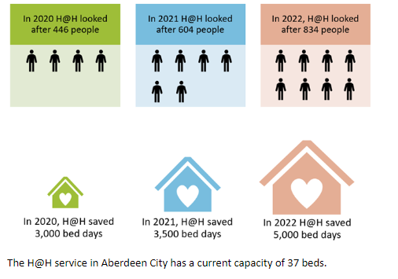
Hospital @ Home
Frailty Pathway

Slide 5
Care Homes
Frailty Pathway
1463 total NH and CH beds across 31 settings. (91% occ)
Care Home team formally in place
Excellent relationship with all homes
Project on admission from hospital to reduce (SAS/Lead Nurse)
Test of change – call before you convey – ED clinician to nurse

Slide 6
Community Capacity
Frailty Pathway
Outcomes focused C@H contract with Granite Care Consortium (Nov 2020)
10 providers
1,200 packages of care provided every week
4 additional C@H providers commissioned over winter 2022/23
Currently providing +522 hours of care
Potential for +2,000 hours of care (dependant on recruitment)
Increase in Care Home Bed Capacity
+49 Interim Beds at Woodlands Care Home
+5 Dedicated End of Life Care Home Beds at Rubislaw
Interim Accommodation in Sheltered housing
12 Visitors Flats
2 Bedsits
Hospital Homecoming Project
Over 3,000 interactions across Grampian since August 2022

Slide 7
Enablers/Future Plans
Frailty Pathway
Enablers
Future Plans
Various Daily meetings
Hospital Social Work focus on Home First model
Dedicated Interim Bed Lead
Review Team established with reablement/TEC focus
Dedicated Geriatric Consultant in AMIA
CLD, D2A, RAC
Hospital at Home (37 Beds)
Joint Working Care Homes/SAS
Strategic Home Pathways Lead
Expand H@H to 100 Beds
Further Work with Option 2 providers
Enhanced Community Support Huddle Coordinator
A further 5 Interim Sheltered Housing Units
Complex Care Accommodation Provision
Implement our Workforce Plan
Notes:
Daily – DSC plus those with BAC and GCC

