Slide 1
Current Challenges
Susie Downie – Acting Primary Care Lead
Claire Wilson – Chief Social Work
Kay Diack – Strategic Home Pathways Lead

Slide 2
Key facts – Aberdeen City General Practice
27 GP Practices in Aberdeen City
Practice populations and size of practices vary. They range from 5,000 to 20,000
We have one Homeless Practice - Marywell - who has 300 patients - recently supporting Refugees caseload
Increased patient choice with overlapping boundaries within city centre (different to rural)
Over last 5 years with recent closures and mergers practices are moving to be bigger – this helps with sustainability
Susie Downie

Slide 3
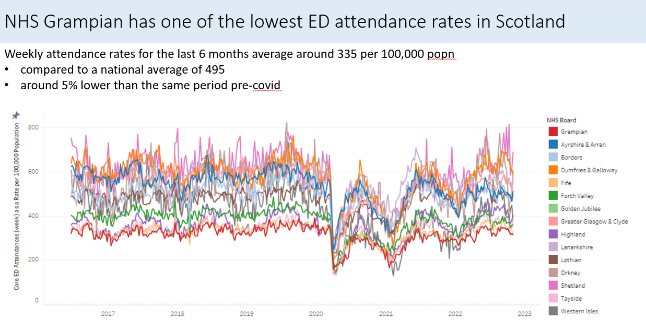
General Practice is a Successful Gatekeeper for secondary care services
Susie Downie

Slide 4
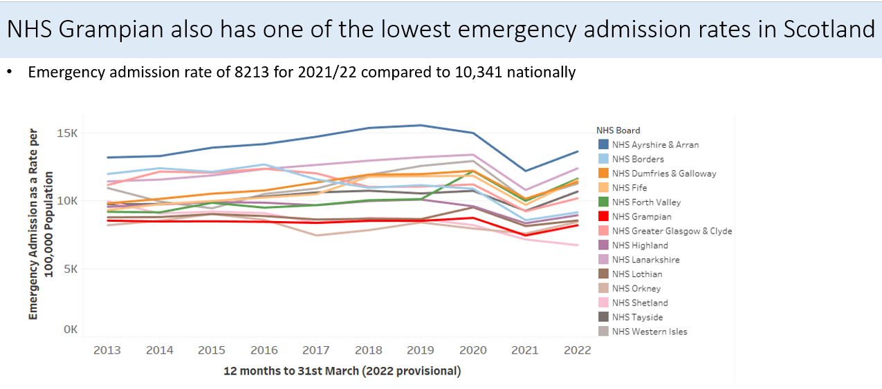
General Practice is a Successful Gatekeeper for secondary care services
Susie Downie

Slide 5
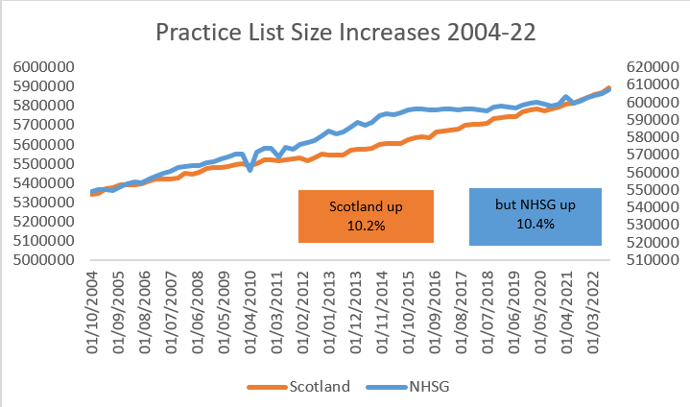
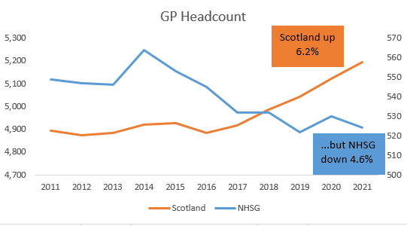
Demand has increased but supply has increased
Points
GP Practice List Growth (some practices up 35%)
GP Headcount. E.g. 11% vacancies in one Grampian HSCP
Susie Downie

Slide 6
Recent Events
Asylum Seekers and Refugees
New Service in place
SLA
International Student Population
2000+ international students and families
Practice Closed Lists
14 currently closed
Working with all pracitces & LMC/SG to mitigate and manage
Care Homes
Woodlands newbuild
Loirston Care Home
Susie Downie

Slide 7
Challenges Sustainability Assessment 2022
Ongoing workforce recruitment & retention challenges
Practices seeking new ways to manage this (Hybrid Models / Practice Mergers)
Infrastructure
Lack of physical Space
Appropriate ICT for new models
Delivery of premises plan
Patient Expectations increased
(therefore decreased satisfaction) very challenging impacting practice staff satisfaction & retention
Legal &
Contractual challenges
Non-core work
Limited Liability Partnership’s (LLP’s)
PCIP Delivery
Susie Downie
Notes:
Nothing new here – so we want to focus on solutions today and get actions going forward:
Ongoing workforce recruitment and retention challenges to fully meet the Memorandum of Understanding (MOU) recruitment requirements.
Practices have very little capacity to take on any additional patients to meet the increasing demand for services across the city, with the above challenges in workforce recruitment a key factor.
Concerns regarding the Primary Care Improvement Plan (PCIP) as not fit for purpose to develop the necessary multi-disciplinary teams in particular, Mental Health, Pharmacy and Community Treatment and Care Services.
Increasing cost of Locum GP’s due to high demand creating a competitive market thus increasing the cost and decreasing flexibility.
Increased Patient Expectations and thus decreased satisfaction very challenging. The lack of public awareness and understanding of the current situation. This has a profound impact on practice staff, their resilience, morale and overall job satisfaction.
Limited functional suitability of existing premises which inhibits service development and modernisation, including concerns regarding lease arrangements and cost rent.
There is a new direction amongst city practices to become Limited Liability Partnership’s (LLP’s) to protect against the financial risks associated should a practice close.
There is an overwhelming desire for practices to work within and manage their own practice teams.

Slide 8
Social Care - Challenges
Medical Support (Interim Beds and H@H)
Complex Care (particularly EMI and ABI)
Recruitment and Retention of Staff – all types and levels
Parity of professions – health and social care
Resource for prevention
Increased third sector solutions
Communication with Public
National Assurance Framework
Claire Wilson
Notes:
Challenges around GP provision for Interim beds as GP's require an increase in payments for all interim beds (payment per bed per week and separate payments for each visit and phone or near me contact) - this was not included in the NHS Interim bed payments and had to be met by the partnership.
NCHC rate is not enough to support these more complex placements and be a viable option for providers.

Slide 9
Challenges pertaining to Complex Care
Key Challenges
Whole system budgeting
Losing the labels and moving to “Supported Living”
Influencing City capital build and refurbishment programme to meet need (Banks o’ Dee, Loirston, New Wernham, Willows)
Housing for Varying Needs Review and implementation
Develop strong relationships with RSLs, Aberdeenshire and Moray HSCPs
Kay Diack

Slide 10
Complex Care continued
What success looks like
Reduction in delayed discharge
Reduction in delayed transfer of care
Zero Out of Authority placements
Improved placement sustainment
Robust stakeholder engagement
Capital developments and nominations
Kay Diack

